Slide 1
MODELING AND SIMULATION
University of Msila
FACULTY OF MATHEMATICS AND
INFORMATICS
DEPARTMENT OF COMPUTER
SCIENCE
Introduction

Slide 2
Introduction
Technological development and the rapid evolution of systems lead to critical performance problems
What is performance evaluation?
performance: is the ability to carry out an action to obtain results in accordance with previously set objectives while minimizing the cost of resources and processes implemented.
Evaluating a system: “means measuring its ability to solve all the problems for which we use it or plan to use it”: suitable for a given service.
The evaluation of the performance of a system can take place at two levels
In design: in this case, the system does not yet exist. Nowadays, most real systems are increasingly complex, and designing a system without first carrying out a performance analysis can result in the creation of an unusable system.
Example: Buying a machine for a production workshop
- Acquire a very expensive machine: to be sure of meeting production targets But only a prior performance analysis can confirm that, in practice, the machine will be largely under-used.

Slide 3
Introduction
In operation: the system exists, but you want to modify it.
Example: modification of a manufacturing workshop whose production capacity is no longer sufficient. It is proposed to replace a given machine with one that is twice as fast => the new system's performance must be analyzed in order to verify that the change has led to a reduction in production capacity. the performance of the new system must be analyzed to check that the change has achieved the desired increase in production.

Slide 4
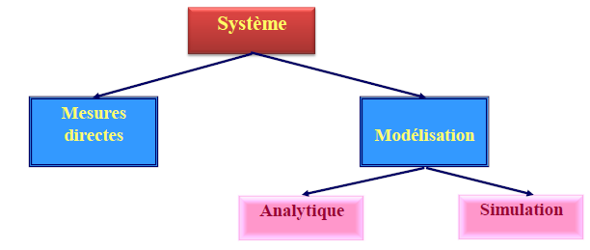
Introduction
How do you evaluate system performance? There are two types of analysis:
1- Qualitative analysis: consists in defining the structural and behavioral properties of the system and verifying its logical correctness, such as the absence of deadlocks. The most commonly used formalisms include Petri nets and process algebras.
2- Quantitative analysis: consists in calculating the system's performance parameters (after carrying out a qualitative analysis).
The various methods of quantitative performance analysis can be divided into three broad categories:

Slide 5
Introduction
System modeling and computer simulation, recently has become one of the premier subject in the industry as well as Defence.
It helps an engineer or a scientist to study a system with the help of mathematical models and computers.
system simulation is nothing but an experiment with the help of computers, without performing actual experiment. It saves lot of money which is required, if we actually perform experiments with the real system.

Slide 6
Concept of system
what a system is?
a system is, “Any object which has some action to perform and is dependent on number of objects called entities, is a system”
University consists of number of colleges (which are entities of the system called university) and a college has class rooms, students, laboratories and lot many other objects, as entities.
Each entity has its own attributes or properties. For example attribute of a student is to study and work hard. Each college in itself can be treated as a complete system.
There are also certain interactions occurring in the system that cause changes in the system. A term entity will be used to denote an object of interest in a system and the term attributes denotes its properties
If we combine few of these objects, joined in some regular interactions or inter-dependence, then this becomes a large system.
A function to be performed by the entity is called its activity. For example, if system is a class in a school, then students are entities, books are their attributes and to study is their activity.
we can say university is a large system whereas college is a system.

Slide 7
Concept of system
Systems broadly can be divided into two types, static system and dynamic system.
If a system does not change with time, it is called a Static System
if changes with time, it is called a Dynamic System.
Study of such a system is called System Analysis.

Slide 8
Concept of system
Different types of system:
Deterministic system: Works in a predictable way. The interaction between its different parts is known with certainty. If we have a description of the state of the system at a given moment, the next state of the system can be given exactly and without error.
Example:
● The solar system: the motions of the planets around the sun are well known.
● A program running in monoprogramming mode is deterministic.On the other hand, in multiprogramming, there may be unforeseen interactions between programs.programs.
Probabilistic (stochastic) system: It is described in terms of probable behavior (which depends on chance). A certain margin of error always accompanies the prediction of what the system will do.
Example:In an inventory management system, average demand, replenishment time and other factors may be defined, but their exact values at any given time are not known. (since purchase requisitions arrive randomly).

Slide 9
Concept of system
Continuous system:
Changes in the state of the system occur continuously over time (it depends on a variable related to time: speed, acceleration, etc.).
Example:
- The movement of an aircraft's wings during flight.
Population growth (births and deaths)
Discrete (discontinuous) system: The system is characterized by events that occur at non-fixed times and cause changes in the state of the system. The system retains this state until the next event.
Example:
- A customer arrives at a post office counter. If the employee is free, the customer is served immediately, otherwise he joins a queue. The system state changes each time a customer arrives or leaves.

Slide 10
Modeling and simulation
For an observer A, b is a model of B if A can learn , from b something useful about how B works
Problem
Building a model
Implementation
of the solution
Search for a solution
on the model

Slide 11
Modeling and simulation
Modeling is a tool used to configure or analyze systems; more specifically, a computer system. The purpose of a model is to evaluate a system quantitatively and qualitatively, and to shed light on its behavior and proper operation.
Modelling involves defining the following points:
The system:
existing (or not) to which the model refers.
The model: abstract representation of the system (simplified)
The objective : the purpose for which the model has been developed.
Profitability criterion : an economic criterion that justifies the use of a model.
System study : The study of a system is carried out with the aim of understanding the system's behavior, predicting its future behavior and optimizing the system.

Slide 12
Modeling and simulation
Simulation :
Reproducing the behavior of a system and its dynamic evolution step by step, using a system model.
Interests:
❑ Very general: we can do almost anything and therefore study any model
❑ Allows very complex systems to be addressed
❑ Repetition of experiments.
Means:
❑ Software development (languages: C, Java ..)
❑ Based on a simulation engine.
Disadvantages:
❑ Heavy and complex to develop.
❑ Very greedy in resources (CPU, disk, ..) and computing time.

Slide 13
Modeling and simulation
Simulation is a decision-making tool widely used by designers and managers of complex systems,
It consists in building a model of a real system (physical, economic, human ... etc.) and conducting experiments on this model in order to fully understand the system's behavior and improve its performance.
Examples of fields of application:
- Meteorology: to avoid natural disasters.
- Medicine: surgery, pharmaceuticals, etc.
- Industry: computer-aided automobile design, flight simulators, etc.
- Video games.
Astronautics (space travel): simulating life in a space shuttle.

Slide 14
Concept of model
Definition
A model is a representation of a real system (physical, economic, human...etc.) created in order to better study this system and explain certain aspects of its behavior.
Sometimes, it is impossible to study the system directly, because it is inaccessible (solar system), too costly, changes too quickly (nuclear blast), or slowly (comet motion). In this case, the study is carried out on a model, i.e. a second system built for the occasion, and whose similarity to the original system is as perfect as the study requires.
Example: A project to build an airplane involves the following steps 1)Design a prototype airplane, then build a full-scale model using wood and plywood. 2) Scale models of the aircraft are built using real materials. These models will be used to explain certain aspects (material resistance tests, flight and landing speeds, ....). 3) The first "real" full-scale aircraft is built for testing. Results from the flight tests are collected, then compared with those obtained using the scale models. New parameters are updated, and model tests are repeated.

Slide 15
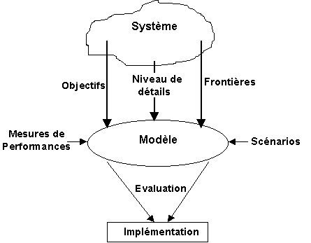
Concept of model
Modeling process
A model of a system can be divided into number of blocks, which in itself are complete systems.
these blocks should have some relevance to main system.
example :
In a school. Class rooms are blocks of the school. Aim of the school is to impart education to students and class rooms are required for the coaching

Slide 16
Concept of model

Slide 17
Concept of simulation
Definition:
Simulation is the study of the dynamic behavior of a system, using a model that evolves over time according to well-defined rules, for predictive purposes.
The term simulation can be characterized by the following keywords:
A fundamental element is the model
The model is manipulated (on a computer), with the solutions found being those of the model and not of the system being modeled.
Its aim is to choose the solution that seems to be the best from among those available.
Simulation can also be seen as indirect experimentation (on the model, not the system) to compare different ways of proceeding. It does not solve the problem by finding the right solution. It merely helps to select the best possible solution from among several.

Slide 18
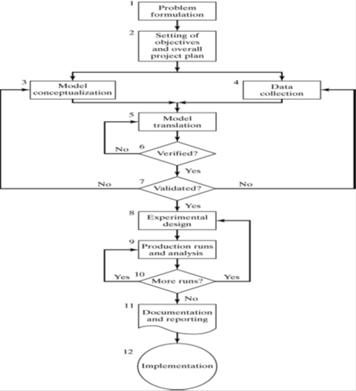
Concept of simulation
Steps of simulation

