Slide 1
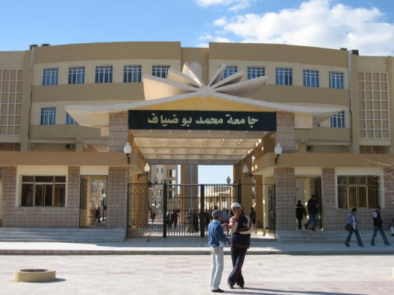
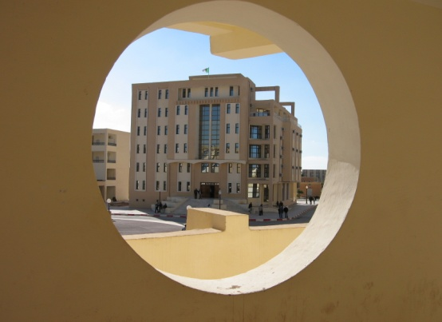
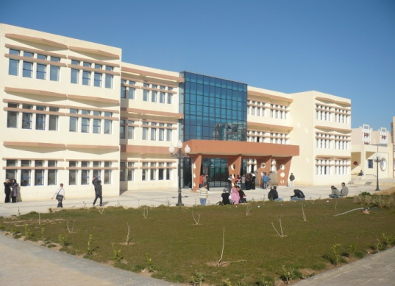
Course n01 . General Introduction
University of M’sila
Urban Technology Management Institute
Department of Architecture
Academic year 2023 / 2024
prepared by
professor Hynda Boutabba- Mili
1st year architecture course

Slide 2
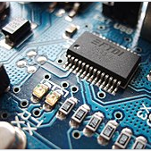
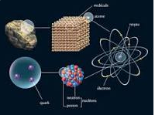
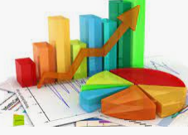
University education in Algeria
Domain
Science of engineering
/ Science of matter
Life Science
Sciences of the universe
Management Science
Earth Science

Slide 3
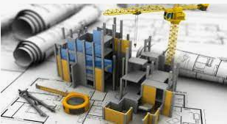
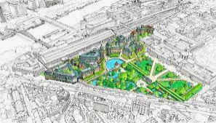
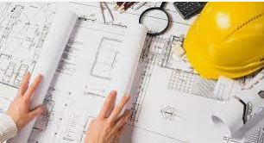
Domain: Architecture, Urban planning and City Professions AUCP
…..and we are here

Slide 4
Domain: Architecture, Urban planning and City Professions AUCP
…..we are here
Sectors
2. Urbanism
3. Architecture
1. Management of Urban Techniques MUT
City management1
Specialties
Urban Engineering
Operational Project Management

Slide 5
What do we mean by Architecture?

Slide 6
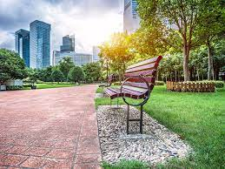
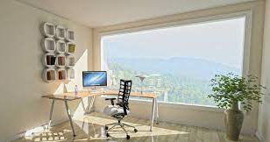
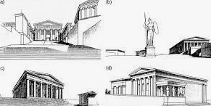
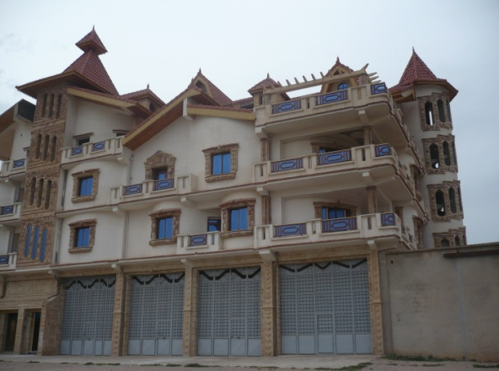
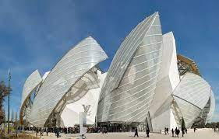
Architecture is the major art of designing spaces
and constructing buildings,
respecting empirical or scientific construction rules, as
well as aesthetic concepts
La construction c’est pour tenir, l’architecture c’est pour émouvoir »

Slide 7
Organization of Architect Training
Five Years
ten Semesters
Première année /First Year
History of Architecture
Fundamental teaching
Project Theory
Applied teaching
Related teaching with training
Project workshop
Practical courses

Slide 8
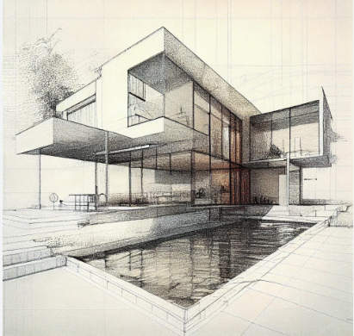
Quel est Le BUT de l’Atelier de projet?
What is The PURPOSE of the Project Workshop?
permet de découvrir l’architecture/ allows you to discover architecture
Son langage/ Its language
ses moyens/Its means
Ses techniques de représentation/
Its representation Techniques
concevoir un petit projet
Design a small project

Slide 9
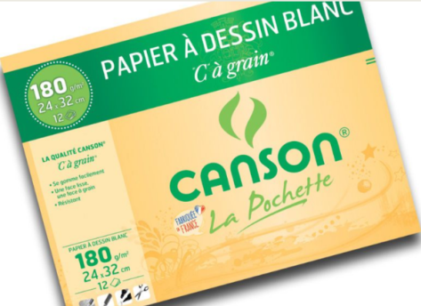
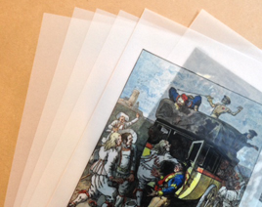
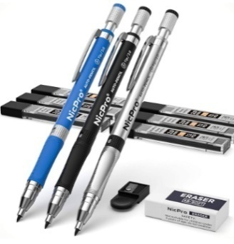
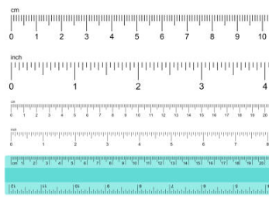
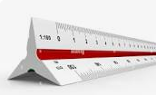
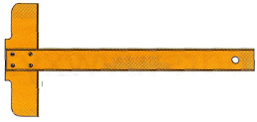
Drawing materials /Matériel de dessin
You will need the following materials
1. a sketchbook to sketch out your plans
2. Canson paper
3. Tracing paper
4. mechanical pencil or drawing pencil
5. a graduated ruler
6. “KUTSCH” Triangular scale ruler
7T square

Slide 10
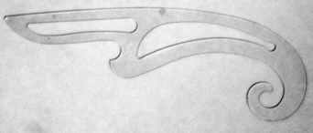
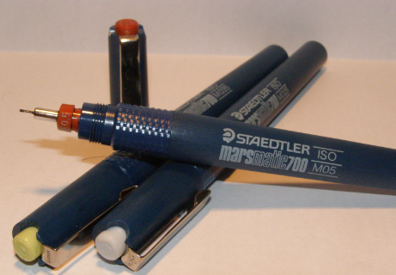
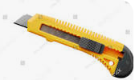
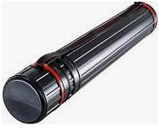
Drawing materials /Matériel de dessin
8. équerre/ Trianges
9. Trace-cercles et ellipses/
Template ruler for circles
10. Trace-courbes « perroquet »
French curved ruler
11. stylos tubulaires (ou rapidos)/ Tubular pens (or rapidos)
12. Cutter «grattoir »/ Cutter “scraper”
13. Ruban adhésif Scotch/Drafting tape
14. un porte-plan pour transporter vos dessins/
a plan holder to carry your drawings

Slide 11
University of M’sila
Urban Technology Management Institute
Department of Architecture
Exo1: Representation graphique à main levee
Freehand graphic representation
Academic year 2023 / 2024
prepared by
professor Boutabba Hynda-Mili
1st year architecture course

Slide 12
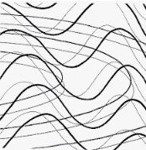
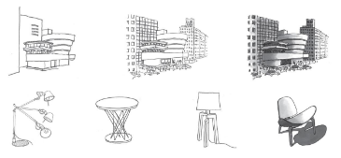
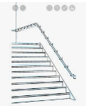
Objectives of the exercise
Learn the best way to draw different lines and curves
to be able to sketch an object at the end of the day
Drawing is essential because, even if digital tools are improving, the architect must be able to bring out creativity and artistic passion through his sketches

Slide 13
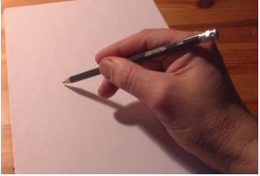
Approach Methodology
How do I position the hand and pencil?
It is important to correctly hold the pencil in your hand from the very beginning, i.e. a little higher than if you were writing. The hand should be relaxed and rest well on the support
Materials required: a pencil and sheets of paper. A4 paper for drawing 3 sets

Slide 14
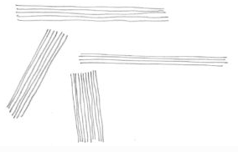
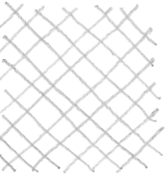
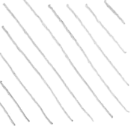
Series n°1
Draw perfectly straight lines
1.Parallel Horizontal Lines
2. Parallel Vertical Lines
3. Perpendicular Straight Lines
4.Parallel lines in different directions
5. Oblique lines dir. right
6. Oblique lines dir. left
7. Cross Oblique Lines
Do as many trials as you feel you need. Remember, the more you practice, the straighter the lines will be.

Slide 15
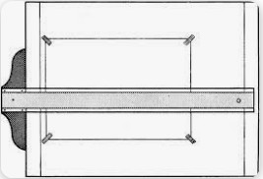
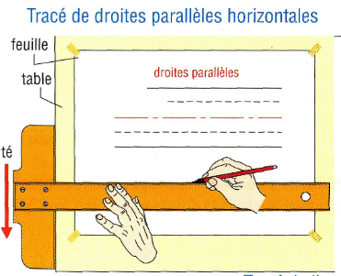
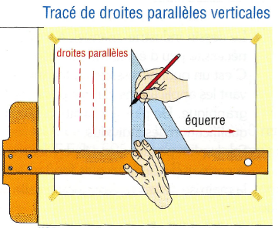
Series n°2
Draw two horizontal lines with a ruler, then take care not to protrude,
Freehand trace the different shapes, doing your best to make each shape look like the previous one.
To Draw Parallel Lines
Tracing parallel horizontal lines
Tracing parallel vertical lines

Slide 16
Series n°3
Draw simple geometric shapes such as rectangles or triangles with a ruler
Then try to place the different curves there, making sure to keep a certain number of contact points.

Slide 17
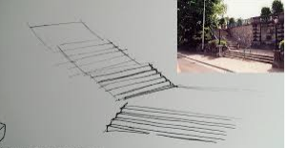
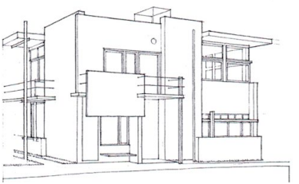
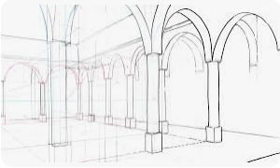
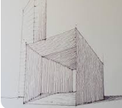
Freehand Sketch Examples

Slide 18
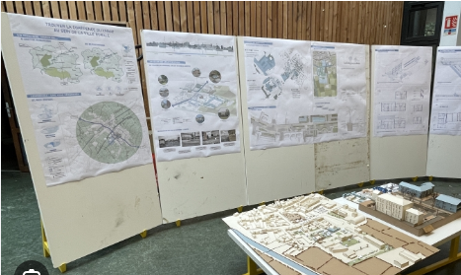
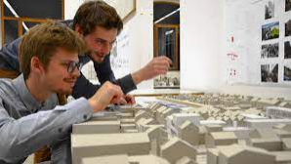
The exercise will be graded
In the Architecture workshop, there are two ways to correct the exercises either by:
1. Presentation
2. Hand in (Render)

Slide 19
Thank you for your attention
و شـــكــــرا

