Slide 1
Ministry of Higher Education
Mohamed Boudiaf University- M’sila
Faculty of Letters and Languages
English Department
LECTURE 4
Theories on Culture Classification
(Part 2)
Master One
Dr, Boulanouar S,

Slide 2
Hofstede’s six Cultural
Dimensions
(1980)

Slide 3
Hofstede’s six Cultural Dimensions(1980)
Hofstede’s cultural dimensions originate from a large survey that he conducted from the 1960s to 1970s that examined value differences among different divisions of IBM, a multinational computer manufacturing company.
Hoftstede, using a specific statistical method called factor analysis, initially identified four value dimensions: individualism and collectivism, power distance, uncertainty avoidance, and masculinity and femininity.

Slide 4
Hofstede’s six Cultural Dimensions(1980)
Culture is “the collective programming of the mind distinguishing the members of one group or category of people from others”.
Correlations With Other Country’s Differences
Hofstede’s dimensions have been found to correlate with a variety of other country difference variables, including:
geographical proximity,
shared language,
related historical background,
similar religious beliefs and practices,
common philosophical influences,
and identical political systems (Hofstede, 2011).

Slide 5
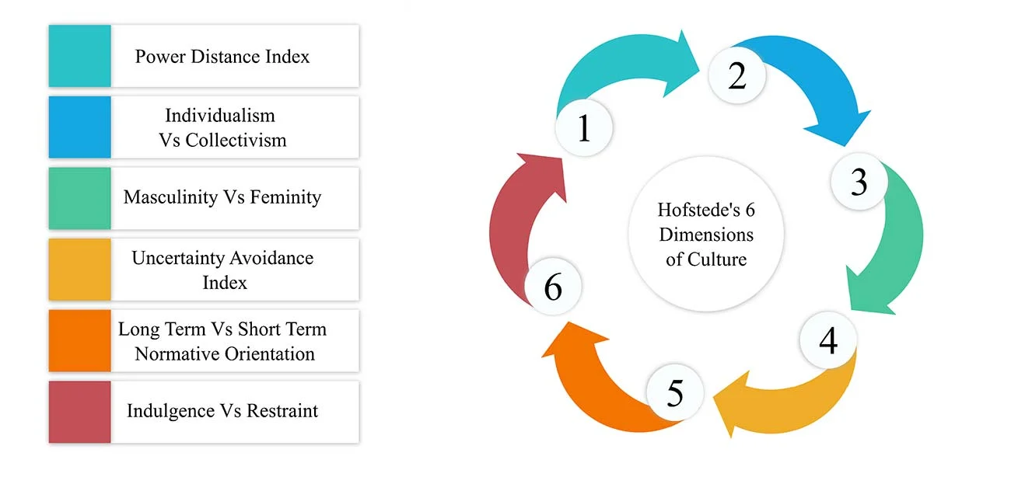

Slide 6
POWER DISTANCE INDEX
It expresses the degree to which the less powerful members of a society accept and expect that power is distributed unequally.
In societies with high Power Distance accept a hierarchical order in which everybody has a place and which needs no further justification.
In societies with low Power Distance, people strive to equalize the distribution of power and demand justification for inequalities of power

Slide 7
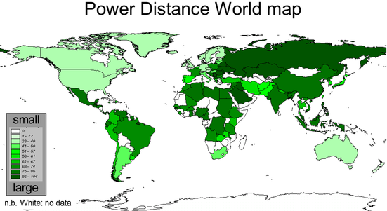

Slide 8
INDIVIDUALISM VS. COLLECTIVISM (IDV)
Individualism can be defined as a preference for a loosely-knit social framework in which individuals are expected to take care of only themselves and their immediate families.
Collectivism represents a preference for a tightly-knit framework in society in which individuals can expect their relatives or members of a particular in-group to look after them in exchange for unquestioning loyalty.

Slide 9
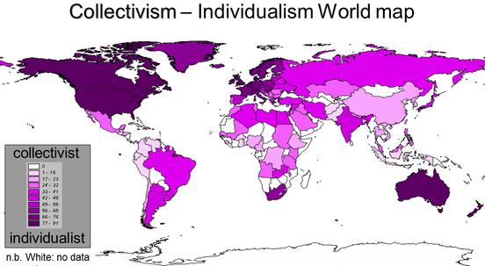

Slide 10
MASCULINITY VS. FEMININITY (MAS)
Also known as gender role differentiation
* This dimension looks at how much a society values traditional masculine and feminine roles.
* A masculine society values assertiveness, courage, strength, and competition; a feminine society values cooperation, nurturing, and quality of life.

Slide 11
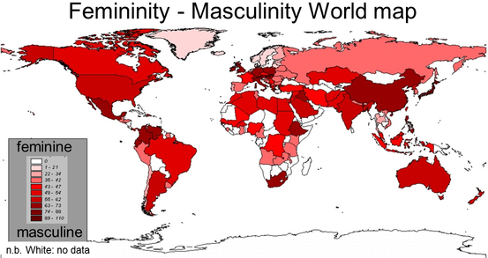

Slide 12
UNCERTAINTY AVOIDANCE INDEX
A high uncertainty avoidance index indicates a low tolerance for uncertainty, ambiguity, and risk-taking. Institutions and individuals within these societies seek to minimize the unknown through strict rules, regulations, and so forth.
In contrast, those in low uncertainty avoidance cultures accept and feel comfortable in unstructured situations or changeable environments and try to have as few rules as possible. This means that people within these cultures tend to be more tolerant of change.

Slide 13
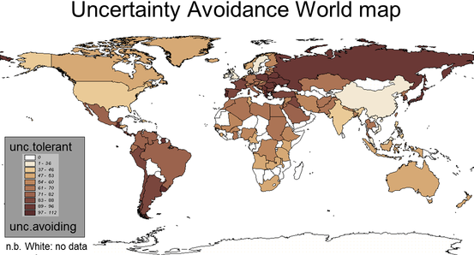

Slide 14
Long-term VS Short-term Orientation
This dimension associates the connection of the past with the current and future actions or challenges .
A low degree i.e. short term indicates that traditions honored and kept , while steadfastness is valued
While in long term, society takes a more pragmatic approach: they encourage thrift and efforts in modern education as a way to prepare for the future.

Slide 15
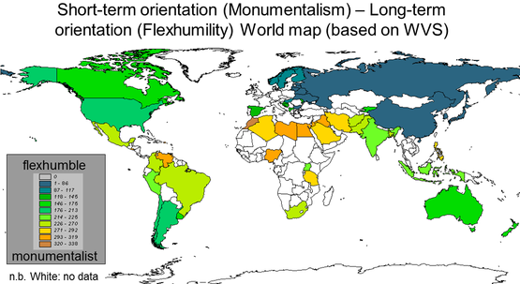

Slide 16
Indulgence VS restraint
This dimension is essentially a measure of happiness whether or not simple joys are fulfilled .
Indulgence is defined as a society that allows relatively free gratification of basic and natural human desires related to enjoying life and having fun .
Its counterpart is defined as a society that control gratification of needs and regulates it by means of strict social norms.

Slide 17
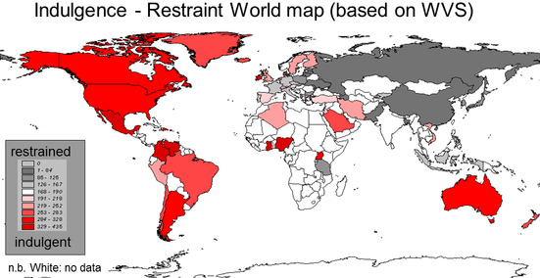

Slide 18
https://www.hofstede-insights.com/country-comparison-tool

Slide 19
Trompenaars’ Seven Dimensions
of Culture
(1993)

Slide 20
Trompenaars’ Seven Dimensions
of Culture (1993)
The model was first described in the book, Riding the Waves of Culture: Understanding Diversity in Global Business. Written by Fons Trompenaars and Charles Hampden-Turner in 1993.
To create the model, they surveyed over 40,000 managers from 40 countries.
The modal works by differentiating cultures based on their preferences in the following 7 dimensions:

Slide 22
Universalism Versus Particularism
(Rules Versus Relationships)

Slide 23
Universalism | People place a high importance on laws, rules, values, and obligations. They try to deal fairly with people based on these rules, but rules come before relationships. | Help people understand how their work ties into their values and beliefs. Provide clear instructions, processes, and procedures. Keep promises and be consistent. Give people time to make decisions. Use an objective process to make decisions yourself, and explain your decisions if others are involved.
Particularism | People believe that each circumstance, and each relationship, dictates the rules that they live by. Their response to a situation may change, based on what's happening in the moment, and who's involved. | Give people autonomy to make their own decisions. Respect others' needs when you make decisions. Be flexible in how you make decisions. Take time to build relationships and get to know people so that you can better understand their needs. Highlight important rules and policies that need to be followed.

Slide 24
Individualism Versus Communitarianism (The Individual Versus The Group)

Slide 25
Individualism | People believe in personal freedom and achievement. They believe that you make your own decisions, and that you must take care of yourself. | Praise and reward individual performance. Give people autonomy to make their own decisions and to use their initiative. Link people's needs with those of the group or organization. Allow people to be creative and to learn from their mistakes.
Communitarianism | People believe that the group is more important than the individual. The group provides help and safety, in exchange for loyalty. The group always comes before the individual. | Praise and reward group performance. Don't praise individuals publically. Allow people to involve others in decision making. Avoid showing favoritism.

Slide 26
Specific Versus Diffuse
(How Far People Get Involved)

Slide 27
Specific | People keep work and personal lives separate. As a result, they believe that relationships don't have much of an impact on work objectives, and, although good relationships are important, they believe that people can work together without having a good relationship. | Be direct and to the point. Focus on people's objectives before you focus on strengthening relationships. Provide clear instructions, processes, and procedures. Allow people to keep their work and home lives separate.
Diffuse | People see an overlap between their work and personal life. They believe that good relationships are vital to meeting business objectives, and that their relationships with others will be the same, whether they are at work or meeting socially. People spend time outside work hours with colleagues and clients. | Focus on building a good relationship before you focus on business objectives. Find out as much as you can about the people that you work with and the organizations that you do business with. Be prepared to discuss business on social occasions, and to have personal discussions at work. Try to avoid turning down invitations to social functions.

Slide 28
Neutral Versus Emotional
(How People Express Emotions)

Slide 29
Neutral | People make a great effort to control their emotions. Reason influences their actions far more than their feelings. People don't reveal what they're thinking or how they're feeling. | Manage your emotions effectively. Watch that your body language doesn't convey negative emotions. "Stick to the point" in meetings and interactions. Watch people's reactions carefully, as they may be reluctant to show their true emotions.
Emotional | People want to find ways to express their emotions, even spontaneously, at work. In these cultures, it's welcome and accepted to show emotion. | Open up to people to build trust and rapport. Use emotion to communicate your objectives. Learn to manage conflict effectively, before it becomes personal. Use positive body language. Have a positive attitude.

Slide 30
Achievement Versus Ascription
(How People View Status)

Slide 31
Achievement | People believe that you are what you do, and they base your worth accordingly. These cultures value performance, no matter who you are. | Reward and recognize good performance appropriately. Use titles only when relevant. Be a good role model.
Ascription | People believe that you should be valued for who you are. Power, title, and position matter in these cultures, and these roles define behavior. | Use titles, especially when these clarify people's status in an organization. Show respect to people in authority, especially when challenging decisions. Don't "show up" people in authority. Don't let your authority prevent you from performing well in your role.

Slide 32
Sequential Time Versus Synchronous Time
(How People Manage Time)

Slide 33
Sequential Time | People like events to happen in order. They place a high value on punctuality, planning (and sticking to your plans), and staying on schedule. In this culture, "time is money," and people don't appreciate it when their schedule is thrown off. | Focus on one activity or project at a time. Be punctual. Set clear deadlines. Keep to deadlines.
Synchronous Time | People see the past, present, and future as interwoven periods. They often work on several projects at once, and view plans and commitments as flexible. | Be flexible in how you approach work. Allow people to be flexible on tasks and projects, where possible. Highlight the importance of punctuality and deadlines if these are key to meeting objectives.

Slide 34
Internal Direction Versus Outer Direction (How People Relate to Their Environment)

Slide 35
Internal Direction (This is also known as having an internal locus of control.) | People believe that they can control nature or their environment to achieve goals. This includes how they work with teams and within organizations. | Allow people to develop their skills and take control of their learning. Set clear objectives that people agree with. Be open about conflict and disagreement, and allow people to engage in constructive conflict.

Slide 36
Outer Direction (This is also known as having an external locus of control.) | People believe that nature, or their environment, controls them; they must work with their environment to achieve goals. At work or in relationships, they focus their actions on others, and they avoid conflict where possible. People often need reassurance that they're doing a good job. | Provide people with the right resources to do their jobs effectively. Give people direction and regular feedback, so that they know how their actions are affecting their environment. Reassure people that they're doing a good job. Manage conflict quickly and quietly. Do whatever you can to boost people's confidence. Balance negative and positive feedback. Encourage people to take responsibility for their work.

Slide 37
Reading list
THE ROUTLEDGE HANDBOOK OF
LANGUAGE AND CULTURE
(2015) edited by Farzad Sharifian
Chapter 17 p,240
CULTURE AND LANGUAGE
PROCESSING

Slide 38
Reference list
Trompenaars, F., Hampden-Turner, C. (1997) Riding the Waves of Culture.
Hofstede, G. (1996) "Riding the waves of commerce: a test of Trompenaars' "model" of national culture differences", in: International Journal of Intercultural Relations 20(2): p. 189-198.Hampden-Turner, C., & Trompenaars, F. (1997). Response to geert hofstede. International Journal of Intercultural Relations, 21 (1), 149.
Hofstede, G. (1980). Culture and organizations. International studies of management & organization, 10 (4), 15-41.
Hofstede, G. (2011). Dimensionalizing cultures: The Hofstede model in context. Online readings in psychology and culture, 2 (1), 2307-0919.
Hofstede, G., & Minkov, M. (2010). Long-versus short-term orientation: new perspectives. Asia Pacific Business Review, 16(4), 493-504.
Hofstede, G. (1980). Culture’s Consequences (Vol. Sage): Beverly Hills, CA.
Hofstede, G. (1991). Cultures and Organizations: Software of the mind. London, England: McGraw-Hill.
McSweeney, B. (2002). The essentials of scholarship: A reply to Geert Hofstede. Human Relations, 55( 11), 1363-1372.
Orr, L. M., & Hauser, W. J. (2008). A re-inquiry of Hofstede’s cultural dimensions: A call for 21st century cross-cultural research. Marketing Management Journal, 18 (2), 1-19.

