Slide 1
Lecture 02: Considerations in Academic writing
Audience/organization/Purpose/flow/ coherence and cohesion.

Slide 2
Introduction
Academic writing is:
the kind of writing used in high school and college classes.
different from creative writing; writing stories.
different from personal writing; writing letters or e-mails to your friends and family.
formal; no slang or contractions
Academic writing tends to be impersonal in style in order to be objective. This make it sound formal. The last lecture dealt with formality and informality ; the style of academic writing, now we will deal with the most important considerations in academic writing.

Slide 3
Resume
Academic writing
.
Having a clear sense of :
Organization,
Audience,
Purpose,
Flow,
And Presentation considerations is the most important aspect of becoming a good writer in your field or discipline.

Slide 4
1. Organization
Introduction
Academic writing follows a standard organizational pattern. For academic essays and papers, there is an introduction, body, and conclusion. Each paragraph logically leads to the next one. Each body paragraph has one main point to support the thesis, which is named in a topic sentence. Each point is then supported in the paragraph with logical reasoning and evidence. Each sentence connects to the one before and after it. The readers do not have to work to find the connection between ideas. The conclusion summarizes the paper’s thesis and main points and shows the reader the significance of the paper’s findings.
Information is presented to readers in a structured format. Even short pieces of writing have regular, predictable patterns of organization. You can take advantage of these patterns, so that readers can still follow, even if you make errors.

Slide 5
How are organizational patterns used in academic writing?
The purpose of academic writing is to present a number of ideas that somehow fit together to make sense. There are several types of organizational patterns that we use to communicate our ideas clearly:
Chronological pattern
Sequential pattern
Spatial pattern
Cause and effect pattern
Compare and contrast pattern
Problem and solution pattern
Topical pattern

Slide 6
2. Audience
Audience is another way to refer to your readers. Even before you write, you need to consider your audience. The audience for most graduate students will be an instructor, who is presumably quite knowledgeable about the assigned writing topic. To be successful in your writing task, you need to have an understanding of your audience's expectations and prior knowledge, because these will affect the content of your writing. Audience, purpose, and strategy are typically interconnected. If the audience knows less than the writer, the writer's purpose is often instructional (as in a textbook). If the audience knows more than the writer, the writer's purpose is usually to display familiarity, expertise, and intelligence. The latter is a common situation for the graduate.
Because focusing on audience will enhance your writing, your process, and your finished product, you must consider the specific traits of your audience members. Use your imagination to anticipate the readers’ demographics, education, prior knowledge, and expectations.

Slide 7
Demographics. These measure important data about a group of people, such as their age range, their ethnicity, their religious beliefs, or their gender. Certain topics and assignments will require these kinds of considerations about your audience. For other topics and assignments, these measurements may not influence your writing in the end. Regardless, it is important to consider demographics when you begin to think about your purpose for writing.
Education. Education considers the audience’s level of schooling. If audience members have earned a doctorate degree, for example, you may need to elevate your style and use more formal language. Or, if audience members are still in college, you could write in a more relaxed style. An audience member’s major or emphasis may also dictate your writing.
Prior knowledge. This refers to what the audience already knows about your topic. If your readers have studied certain topics, they may already know some terms and concepts related to the topic. You may decide whether to define terms and explain concepts based on your audience’s prior knowledge

Slide 8
Although you cannot peer inside the brains of your readers to discover their knowledge, you can make reasonable assumptions. For instance, a nursing major would presumably know more about health-related topics than a business major would.
Expectations. These indicate what readers will look for while reading your assignment. Readers may expect consistencies in the assignment’s appearance, such as correct grammar and traditional formatting like double-spaced lines and legible font. Readers may also have content-based expectations given the assignment’s purpose and organization. In an essay titled “The Economics of Enlightenment: The Effects of Rising Tuition,” for example, audience members may expect to read about the economic

Slide 9
Selecting an Appropriate Tone: how to select an appropriate tone to match the audience and purpose. Tone identifies a speaker’s attitude toward a subject or another person. You may pick up a person’s tone of voice fairly easily in conversation. A friend who tells you about her weekend may speak excitedly about a fun skiing trip. An instructor who means business may speak in a low, slow voice to emphasize her serious mood. Or, a coworker who needs to let off some steam after a long meeting may crack a sarcastic joke. Just as speakers transmit emotion through voice, writers can transmit through writing a range of attitudes, from excited and humorous to somber and critical. These emotions create connections among the audience, the author, and the subject, ultimately building a relationship between the audience and the text. To stimulate these connections, writers intimate their attitudes and feelings with useful devices, such as sentence structure, word choice, punctuation, and formal or informal language. Keep in mind that the writer’s attitude should always appropriately match the audience and the purpose. .

Slide 10
3. Purpose
The general purpose of academic writing is to present information in order to display a clear understanding of a particular subject. There are different types of academic writing however, each of them has its specific purpose (explain, describe, analyze, persuade, etc.).
The Purpose of your paper is your reason for writing. The goal is to answer the question you posed as your topic. Your question gives you a purpose. The most common purposes in academic writing are to persuade, analyze/synthesize, and inform.

Slide 11
o Persuasive purpose –
The persuasive purpose is used to convince, or persuade, the reader that the opinion, or assertion, or claim, of the writer is correct or valid.
Persuasive writing assignments include argumentative and position papers: Persuasion is more selfish than argument (debate). Argument attempts to arrive at a logical solution to an issue. But persuasive writing is concerned primarily with convincing the reader at any cost. Various appeals are used to manipulate the reader. Persuasive writing has a definite bias, or lack of objectivity. Its function is to change the mind of the reader or to move the reader to action.

Slide 12
Kinds of Persuasive Writing
TV commercials or print ads
Newspaper editorials
Personal opinion or thought pieces
Political speeches and literature
Songs and poems
Love letters

Slide 13
o Analytical purpose –
In analytical academic writing, the purpose is to explain and evaluate possible answers to your question, choosing the best answer(s) based on your own criteria. Analytical writing pulls out facts and discusses, or analyzes, what this information means. Based on the analyses, a conclusion is drawn, and through persuasive techniques, the writer attempts to convince the reader to see her point of view. it often investigate causes, examine effects, evaluate effectiveness, assess ways to solve problems, find the relationships between various ideas, or analyze other people’s arguments.

Slide 14
o Informative purpose
– In informative academic writing, the purpose is to explain possible answers to your question, giving the readers new information about your topic. This differs from an analytical topic in that you do not push your viewpoint on the readers, but rather try to enlarge the readers’ view.
Some assignments will have a pre-determined purpose ,for other assignments, you will have to choose a purpose when you choose a topic (research paper, term paper). And some assignments may have two purposes. In all cases, the purpose will be clear at the beginning of your paper, and your paper must achieve its purpose in order to be successful.

Slide 15
4. Flow
Another important consideration for successful communication is flow; “Flow” is a word often used by lecturers to describe the way that the essay holds together and moves from point to point.—moving from one statement in a text to the next. In an essay it is very easy to pile facts upon facts, and thus lose sight of the overall cohesion of the essay. Naturally, establishing a clear connection of ideas is important to help your reader follow the text. Flow can apply within individual paragraphs and between different paragraphs.

Slide 16
4.1 Flow Within Paragraphs
By the title of this part you can have an idea about it:
Flow within a paragraph means that the movement from one sentence to the next should be logical.
The order in which information should be presented needs to keep the reader in control of the focus of the paragraph, and the development of the points along the topic should be in a logical sequenced way.
Flow within a paragraph can be achieved in many ways using transitional words and phrases:

Slide 17
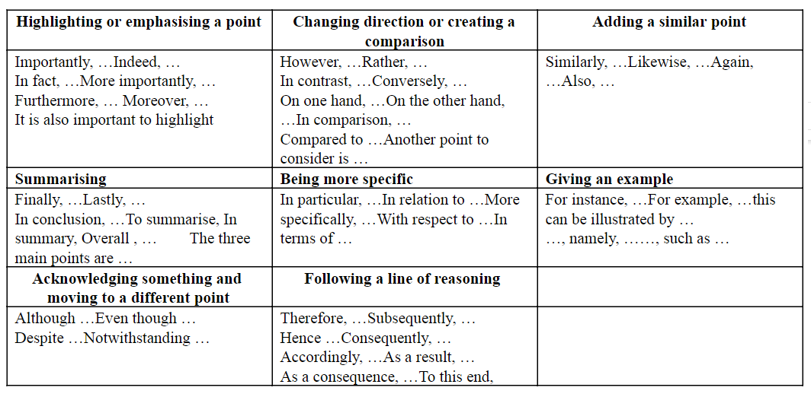

Slide 18
4.2 Flow Between Paragraphs
“Flow” can also be applied to the connections between paragraphs. Each body paragraph should discuss only one major point. However, each body paragraph must also be different from the other paragraphs. Its major point should be unique.
The unique point of each paragraph should be identified before you begin writing: This is the most important part of the planning stage. You might be discussing several aspects of the answer, or analyzing it from different perspectives. You might be following it chronologically, or presenting one side and then the other.
If a paragraph flows well from point to point, it should be obvious to the reader when you move from one point to another. The signpost words described above can also be used between paragraphs, to indicate the transitions from one sub-topic to another.

Slide 19
For example, if you are analyzing one study and then comparing it to another in a later paragraph, a transition would use a word or phrase from the “changing direction or creating a comparison” list. :
In contrast to the conclusion drawn by Smith (2004), Nguyen (2006) showed that the connection between the factors was not causal in most circumstances.
Transitions show the reader the “movement” between paragraphs:
They show that they follow a logical order and build on each other.
They can also show the reader how the paragraphs reconnect with the overall topic of the essay as described in the thesis statement.

Slide 20
If you cannot identify the movement from one paragraph to another, you may need to return to the plan to see if they are actually unique. If your paragraphs jump over important points, repeat themselves, or leave gaps in the explanation, this will also undermine the flow of the essay.
Look at another example:
The company completely upgraded their computer systems... (This paragraph goes on to detail these changes) ...
As a consequence of this upgrading, the efficiency... (This paragraph goes on to detail these consequences)...
As you can see from both of these examples, drawing out the common themes of the information being presented or highlighting the logical sequence of the information helps to create a logical flow of information across the whole text

Slide 21
Topic Sentence

Slide 22
4.3 How to achieve flow:
A variety of methods create stronger flow, or coherence:
create an outline: to helps determine where key points.
Unity: Write topic sentences and conclusions for each paragraph.
transitions : by linking ideas and sentences *but / however *moving from zone section to another indicating addition ,contrast ,or opposition
e.g : on the other hand ,however, this system also has .......... _despite this, little progress has been made in.........

Slide 23
4. Clear, concise wording. E.g: online education ,which means education in an online format where you are not face - to- face with your teacher or classmates ,can help a student become more proficient in their area of expertise or field ,which in turn can also help a student show leadership skills and receive a promotion or recognition for his / her good work at their job . * online education helps students become proficient in their field ,which can result in recognition for students in the form of a promotion.
5. varied wording and sentence structure : E.g: online education is beneficial for many students. Online education benefits many students in rural areas. Online education benefits many students working full-time jobs. * online education is beneficial for many students. In particular , students in rural areas and those working full-time joks can find online education convenient and useful.

Slide 24
6. linking and connections: This / these + noun E.g:
ESL lectures know that students need to understand the differences between formal and informal language .however ,this understanding cannot usually be acquired quickly.
7_ the WEED model: *W is for what *E is for evidence * E is for exampel * D is for do
8_ Use complete sentence : Subject + verb E.g: *the light turning green. * the light turned green
9_Homonyms :Affect/ effect _ new/ knew _ to/too/two

Slide 25
4.4 Cohesion & Coherence
Cohesion – Flow of a Text
Cohesion can be thought of as glue sticking different parts of furniture so that it takes the shape the writer wants it to give. Cohesion is the grammatical and lexical linking within a text or sentence that holds a text together and gives it meaning. In short, the links that stick different sentences and make the text meaningful can be thought of as cohesion in the text. Establishing connections between sentences, sections, and even paragraphs using synonyms, adverbials, conjunctions etc. is what brings cohesion in a text.
New-Old contract with the reader.
Write familiar information before new information.
Arrange sentences in orderly scheme with transitions

Slide 26
Coherence – Semantic Property
Coherence is a quality of a piece of text that makes it meaningful in the minds of the readers. When the text begins to make sense on the whole, it is said to be coherent. Coherence can be achieved through the use of titles, subtitles, paragraphing, logical ordering..etc
Consistent subject-topic strings
Common themes
Parallel Structure
Topic Sentence

Slide 27
Cohesion & Coherence | Cohesion with NO Coherence | Coherence with NO Cohesion
"My favorite color is blue. I like it because it is calming and it relaxes me. I often go outside in the summer and lie on the grass and look into the clear sky when I am stressed. For this reason, I'd have to say my favorite color is blue." | "My favorite color is blue. Blue sports cars go very fast. Driving in this way is dangerous and can cause many car crashes. I had a car accident once and broke my leg. I was very sad because I had to miss a holiday in Europe because of the injury." | "My favorite color is blue. I'm calm and relaxed. In the summer I lie on the grass and look up."

Slide 28
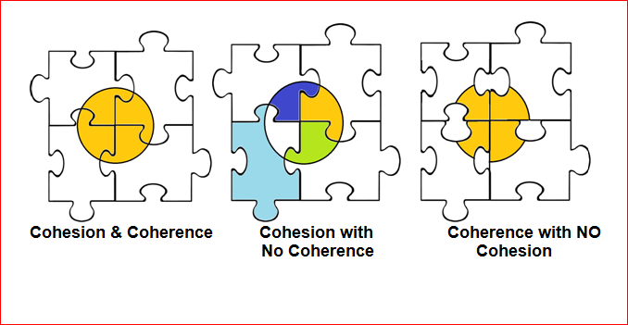

Slide 29
In order to test the coherence and cohesion of what you write ask these questions:
Pronouns and Determiners: does each pronoun/Dtr have a clear antecedent in its own sentence or the one just before? Have you used any pronouns/Dtr without antecedents? Does each pronoun/Dtr agree with its antecedent in number and gender? Have you used the same point of view the whole composition, or have you shifted from first- to second- to third-person pronouns without a reason?
Adverbs: Do adverbs (single words, phrases, and clauses) show relationships between ideas clearly? Do you need more adverbs? Have you used the right word to show the meaning you want?
Conjunctions: Have you used conjunctions where they are needed, Have you used the right word to show the meaning you want?

Slide 30
The Australian prime minister has called an early election. The date was selected to coincide with the start of the Olympic Games. This decision was based on the views of his ministerial advisors, who predicted that voter confidence in the government’s policies would be strong at this time. As previously mentioned, decisions on the timing of elections are based on predictions of voter confidence in the existing government, but some consider that this move is manipulation.
4. Repetition of Structure (parallel structure): Have you used the same grammatical structure for similar ideas or for ideas of the same importance?
And so, my fellow Americans: ask not what your country can do for you--ask what you can do for your country.

Slide 31
5. Repetition of Words: Have you repeated key words, especially nouns, so that the reader easily remembers what the you are writing about?
The problem with contemporary art is that it is not easily understood by most people. Contemporary art is deliberately abstract, and that means it leaves the viewer wondering what s/he is looking at
6. Synonyms: Have you used synonyms in their correct meaning?
Myths narrate sacred histories and explain sacred origins. These traditional narratives are, in short, a set of beliefs that are a very real force in the lives of the people who tell them.

Slide 32
7.Order: Have you arranged your ideas in a clear order? (Chronological, Logical, Spatial orders)
8.Relevance: Have you kept to the point? Do you have any detail or illustration that is not directly related to the topic sentence of your paragraph or to the thesis statement of your whole composition?

Slide 33
Moreover, writers also need to be aware of the way in which topics change and move on through a paragraph in English academic writing. The development of topics through a paragraph or longer pieces of text is called topical progression. There are 4 basic patterns that writers can.
Pattern 1: Constant Topic
Here, the writer uses the same topic in a series of sentences. Often, the actual word(s) used in the topic of the first sentence may be repeated using identical wording or reduced wording ('ceramic ink' 'ink') in the topic of a later sentence.

Slide 34
Pattern 2: Progressive Topic
In this pattern, an element of the comment of the previous sentence becomes the topic of the next. Sometimes, the actual word(s) used in the comment of the first sentence may be repeated in the topic of a later sentence, or a synonym or closely related word or phrase may be used.

Slide 35
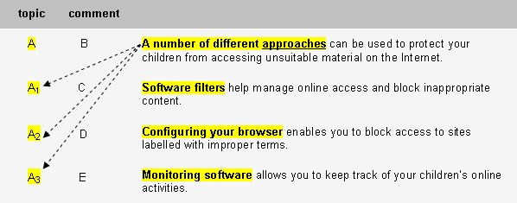
Pattern 3: Hypertopic
In this pattern, the first sentence introduces a general topic, the 'hypertopic', using a superordinate term. The topics of the following sentences form sub-topics (e.g., car, bicycle, train, bus) of the hypertopic (e.g., vehicle). Often, the relationship of the sub-topics to the hypertopic is common general knowledge, but other times the relationship between these may be understood only by expert readers in a particular field.

Slide 36
Pattern 4: Split Topic
In this pattern, two or more elements of the 'comment' in the first sentence are picked up as the topics of the following sentences. Sometimes, the actual word(s) used in the comment of the first sentence may be repeated using identical wording or reduced wording in the 'split topics' that follow, though a synonym may also sometimes be used.

Slide 37
Thank you for your attention

