Slide 1
revision

Slide 2
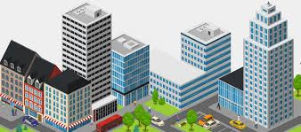
city
a large and densely populated urban area; may include several facilities and services

Slide 3
City Facilities
means any building, structure, property, park, open space, or vehicle, owned or leased by the City, its agents, agencies, or departments.

Slide 4
City Facilities may include, but are not limited to, public streets, curbs and gutters, sidewalks, traffic signals, signing, roadways, bridges, retaining walls, alleys, water lines, storm drains, sanitary sewers, parking lots, parks, public landscaping and trees, traffic control devices/systems, street lighting systems ...

Slide 5
Commercial facilities
such as a strip mall, office parks, downtown, central business district, financial district, "Main Street", or shopping centers.

Slide 6
A health facility
clinics
doctor's offices
hospitals
emergency rooms
laboratories

Slide 7
Entrainement facilities
Entertainment holds a significant place in human life, serving as a source of relaxation, enjoyment, and relief from the demands of daily routines.
Park
Theatre
Cinema
Hotels
Restaurants
indoor swimming pool,
gymnasium,
table tennis centre,
health studio,
bowling alley,

Slide 8
Educational facilities
Schools(middle schools, primary schools)
University
library

Slide 9
Cultural facilities
mosque
Museum
Theatre
Cinema
Auberge

Slide 11
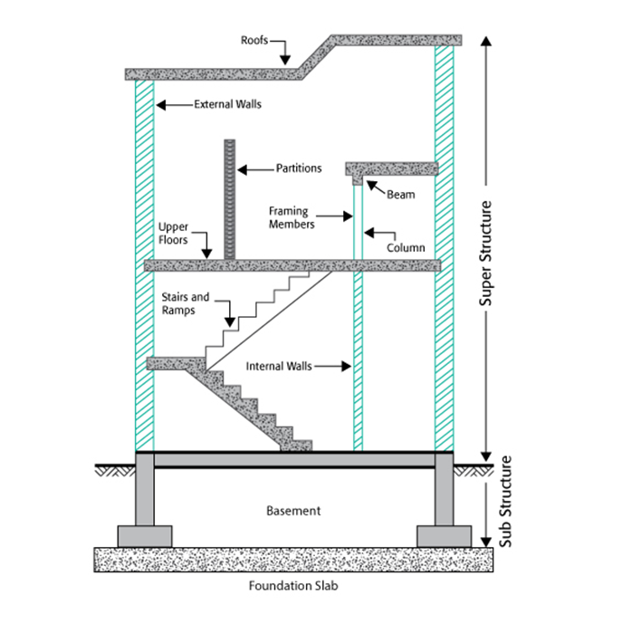

Slide 12
House plans should include the scale (or multiple scales), so you know how to interpret the relationship between the drawings and the actual size of the building.

Slide 13
Definition
Construction project management could be defined as the direction, regulation, and supervision of a project from early development to completion. The ultimate goal of construction project management is the full satisfaction of the client's demands for a viable project both in terms of functionality and budget.

Slide 14
Types of building
Residential home building and renovation
Heavy industrial construction
Commercial and institutional construction
Engineering construction

Slide 15
Phase 1: Pre-Design (Project Initiation) ...
Phase 2: Design (Pre-Construction) ...
Phase 3: Execution:
Phase 4: Construction and Monitoring. ...
Phase 5: Post-Construction (Closeout) ...

Slide 16
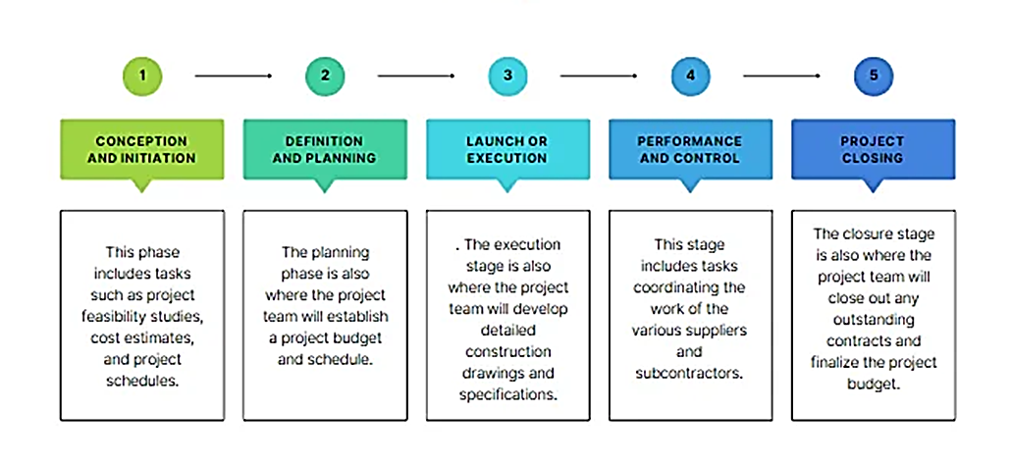

Slide 17
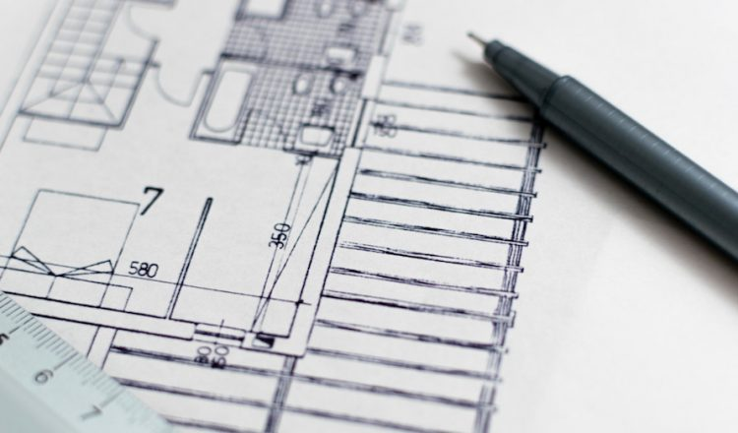
1.Initiation:Pre-Design 1.البدء: التصميم المسبق
This is the stage where the project is proposed and its objectives and scope are defined.

Slide 18
2. Planning: Design (Pre-Construction) ... التخطيط: التصميم (ما قبل البناء) ...
In this stage, a detailed plan for the project is developed, including a schedule, budget, and resource requirements.

Slide 20
3. Executionالتنفيذ
This is the stage where the project is carried out and the work is completed.

Slide 21
4. Monitoring and Control: التحكم والمراقبة
During this stage, progress is monitored and any necessary adjustments are made to keep the project on track.

Slide 22
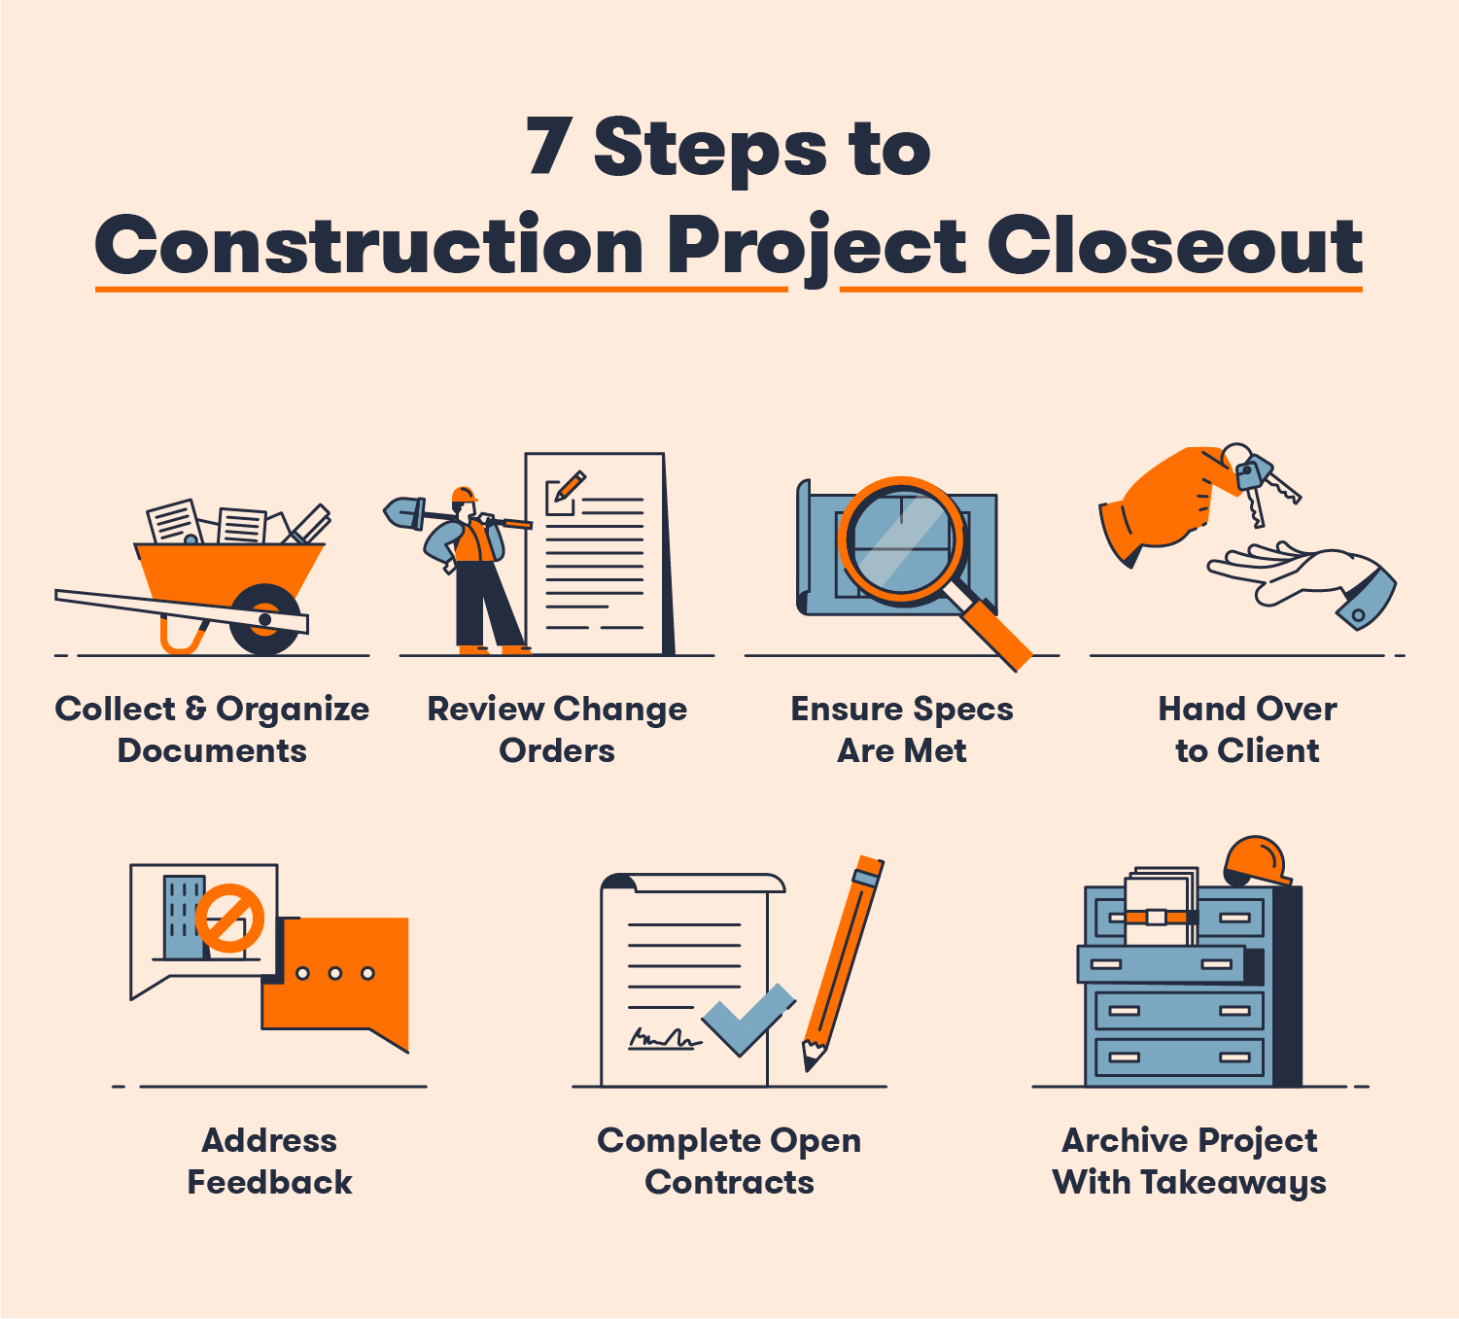
5. Closure: إنهاء
This is the final stage in which the project is completed and evaluated, and any final deliverables are handed over to the customer.

