Slide 1
Ministry of Higher Education
Mohamed Boudiaf University- M’sila
Faculty of Letters and Languages
English Department
LECTURE 7
Language, Culture
and Society
Master One
Dr, Boulanouar S,

Slide 2
OUTLINE
Language and Cultural Context
Language Variations
Language, Culture and Identity
Language and Age
Language and Gender
Language and Socio-economic Class

Slide 3
Language and Cultural Context

Slide 4
Language and Cultural Context
Culture isn’t solely determined by a person’s native language or nationality. It’s true that languages vary by country and region and that the language we speak influences our realities, but even people who speak the same language experience cultural differences because of their various intersecting cultural identities and personal experiences.

Slide 5
Language Variations
Speech Community
The social group that is singled out for any special study is called the speech community. It refers to the a group of people who have the opportunity to interact with each other and who share not just a single language with its related varieties, but also attitudes toward linguistic norms.
Speech Variety
Speech variety, or language variety, refers to any distinguishable form of speech used by a speaker or a group of speakers.
Varieties of language Dialects varieties related to the user Registers varieties related to the use

Slide 6
Dialectal varieties Regional dialects
A regional dialect is a linguistic variety used by people living in the same geographical region. Sociolect
Sociolect, or social-class dialect, refers to the linguistic variety characteristic of a particular social class.
Idiolect
Idiolect is a personal dialect of an individual speaker that combines elements regarding regional, social, gender, and age variations. In other words, an individual speakers regional and social background, his gender and age jointly determine the way he talks. And the language he uses, which bears distinctive features of his own, is his idiolect

Slide 7
What is Register?
It refers to the type of language which is selected as appropriate to the type of situation.
Three variables to determine the register
Field of discourse
Tenor of discourse
Mode of discourse

Slide 8
Field of discourse
It refers to what is going on. It is concerned with the purpose and topic of communication. It answers Why and about what.
Tenor of discourse
It refers to the role of relationship in the situation in question who are the participants in the communication groups and in what relationship they stand to each other. To whom.
What is the relation between the speaker and the listener?
Mode of discourse
It mainly refers to the means of communication. How.
Spoken or written?

Slide 9
Standard Dialect
Definition
The standard variety is a superimposed, socially prestigious dialect of a language. It is the language by the government and the judiciary system, used by the mass media, and taught in educational institutions, including school settings where the language is taught as a foreign or second language.
Features of the standard variety
1. It is based on a selected variety of the language, usually it is the local speech of an area which is considered the nations political and commercial center.
2. It is not a dialect a child acquires naturally like his regional dialect, rather it is taught and learnt in schools.
3. It has some special functions and it the language used on any formal occasions.

Slide 10
Pidgin and Creole
Pidgin
A pidgin is a special language variety that mixes or blends languages and it is used by people who speak different languages for restricted purposes such as trading.
Features : limited vocabulary and very reduced grammatical structure
Creole
When a pidgin has become the primary language of a speech community, and is acquired by the children of that speech community as their native language, it is said to have become a Creole.
Features : the structure of the original pidgin is expanded, the vocabulary vastly enriched, new
syntactic-semantic concepts developed.

Slide 11
Language , Culture and Identity

Slide 12
HOW DO WE FORM AN IDENTITY?
CULTURAL OR SOCIETAL?
NURTURE VS. NATURE?

Slide 13
Factors influencing our identity
1. SOCIETY
2. FAMILY AND LOVED ONES
3. ETHNICITY, RACE AND CULTURE
4. LOCATION AND OPPORTUNITIES
5. MEDIA
6. PERSONAL INTERESTS
7. APPEARANCE AND SELF EXPRESSION
8. LIFE EXPERIENCES

Slide 15
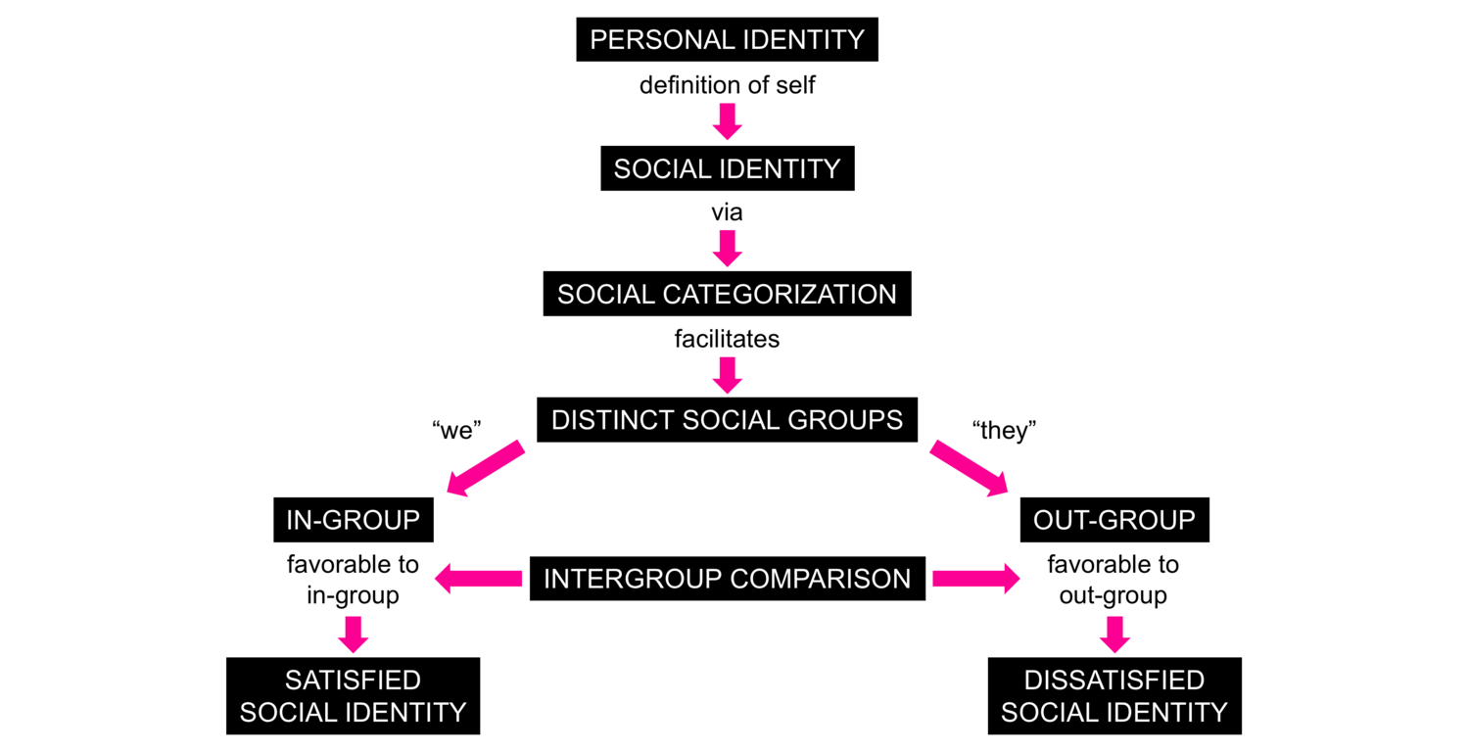

Slide 16
Language and Age
Does language use change with age ?
Does speech differ between teenagers and adults ?

Slide 17
The relationship between language and age can be broken down into several parts.
Firstly, there's the concept that groups of people of different ages will acquire and use language in different ways.
Then there is the link between age and how an individual's language use develops over time.

Slide 18
Adolescent language use
teenager-specific language includes:
frequent slang
colloquial word choices/ non-standard forms of English
taboo words and subjects
dialect words
Adolescents will generally use more non-standard varieties than younger adults (= non-prestige varieties, often specific ‘anti-prestige’). From adolescence to adulthood the use of non-standard forms of speech will gradually decrease in favour of more standard forms of speech (prestige varieties) until a particular stage in late adulthood.

Slide 19
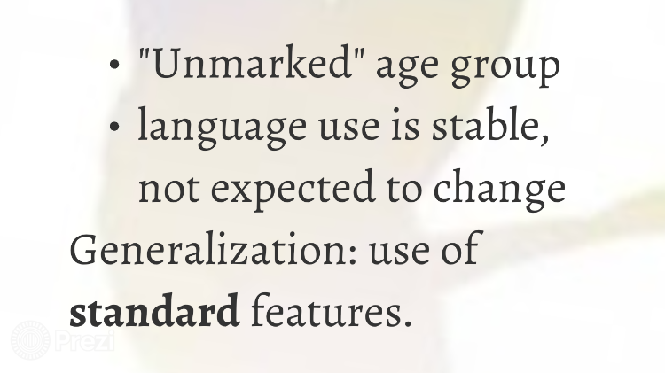

Slide 20
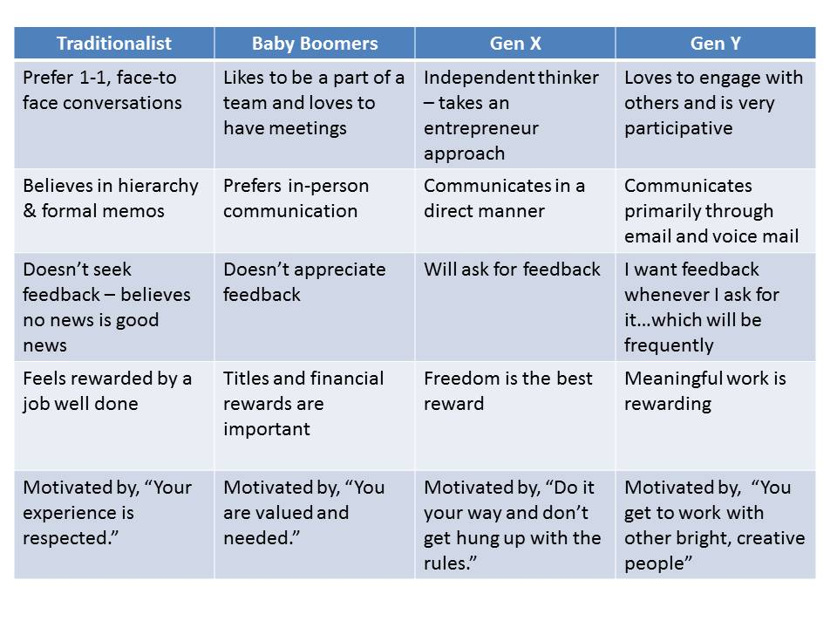

Slide 21
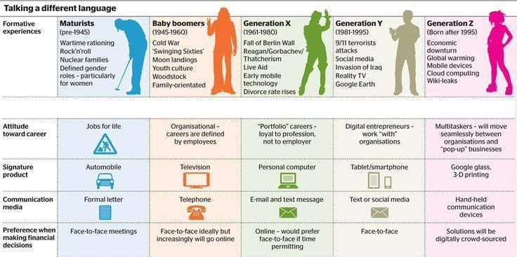

Slide 22
DO MEN AND WOMEN SPEAK THE SAME?

Slide 23
LANGUAGE, CULTURE, AND GENDER

Slide 24
GENDER
Refers to the socially constructed roles, behaviors, activities, and attributes that a given society considers appropriate for men and women,
REASONS FOR THESE
DIFFERENCES IN BRAIN STRUCTURE
Most of Men’s activities are dominated by the Left Brain while most of Women’s activities are dominated by the Right Brain.

Slide 25
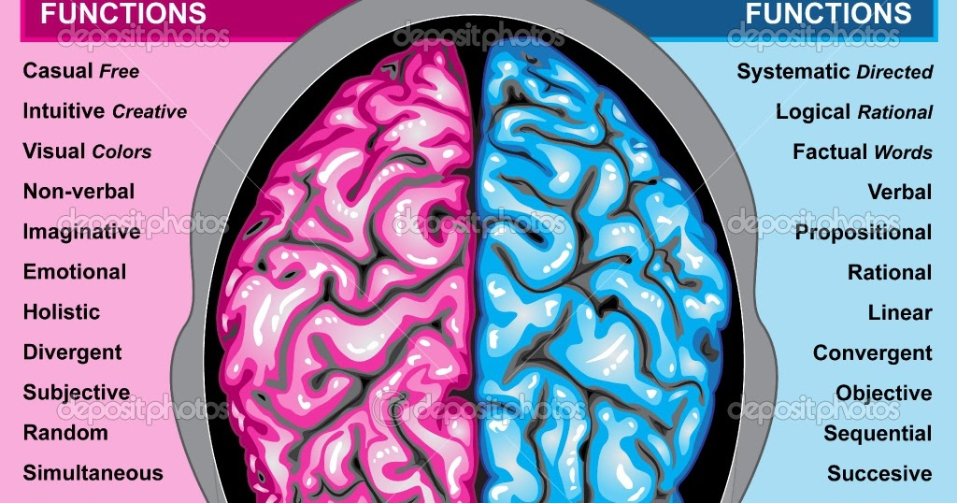

Slide 26
Reality check
women | men
Talk more than men, talk too much, are more polite, are indecisive/hesitant, complain and nag, ask more questions, support each other, are more cooperative | Swear more, don't talk about emotions, talk about sport more, talk about women and machines in the same way, insult each other frequently, are competitive in conversation, dominate conversation, speak with more authority, give more commands, interrupt more
Living Language (2000) by George Keith and John Shuttleworth

Slide 27
Childhood Study: Development of social skills begins at a very early age.
BOYS: | GIRLS:
group-oriented teamwork= strong group of friends | individual-oriented one-on-one talking= one or two best friends

Slide 28
Verbal and Non-verbal communication
Men | Women
Less facial expressions More relaxed posture Avoid eye contact Misinterpret direct eye contact as confrontational Men’s speech is clear, direct and straightforward Men use speech as a means of conveying only facts and information | More facial expressions Tension in posture Prefer eye contact Misinterpret no eye contact as a sign of not listening Speak indirectly and IMPLICITLY. To fully express their feelings they use various superlatives, metaphors and generalisations

Slide 29
Gender Differences in Belief and Value
Men | Women
Concerned with getting results, achieving goals, status and power, and beating the competition Tend to value things more (e.g., car, hi-tech products, model) Need to be trusted / seen as capable / independent Solve problem by themselves (taking help/advice are perceived as weak) Fear of failure | Focus on communication, cooperation, harmony, love, sharing and relationships Value relationships first Need to be cared for/ supported/ understood Ready to seek / offer help and advice Fear of being isolated, care much about others’ comments / impressions

Slide 30
Women’s language (Lakoff, 1975)
Hedge: using phrases like “sort of”, “kind of”, “it seems like”, and so on. Use (super)polite forms: “Would you mind. . . ”, “I'd appreciate it if. . . ”, “. . . if you don't mind”.
Use tag questions: “You're going to dinner, aren't you? ”
Speak in italics: intonational emphasis equal to underlining words - so, very, quite.
Use empty adjectives: divine, lovely, adorable, and so on
Use hypercorrect grammar and pronunciation: English prestige grammar and clear enunciation.
Use direct quotation: men paraphrase more often.
Have a special lexicon: women use more words for things like colours, men for sports.
Use question intonation in declarative statements: women make declarative statements into questions by raising the pitch of their voice at the end of a statement, expressing uncertainty.
For example, “What school do you attend? Eton College?

Slide 31
” Use “wh-” imperatives: (such as, “Why don't you open the door? ”) Speak less frequently Overuse qualifiers: (for example, “I Think that. . . ”)
Apologise more: (for instance, “I'm sorry, but I think that.. ”)
Use modal constructions: (such as can, would, should, ought - “Should we turn up the heat? ”)
Avoid coarse language or expletives Use indirect commands and requests: (for example, “My, isn't it cold in here? ” - really a request to turn the heat on or close a window)
Use more intensifiers: especially so and very (for instance, “I am so glad you came!”)
Lack a sense of humour: women do not tell jokes well and often don't understand the punch line of jokes.

Slide 32
Is there a cultural/societal reason for the difference in men and women’s speech?

Slide 33
Cultural/societal reason for the difference in men and women’s speech
Society tends to expect ‘better’ behaviour from women than from men. Therefore they serve as role models for children’s speech.
Women as a subordinate group must speak carefully and politely, and therefore tend to use more standard forms

