Slide 1
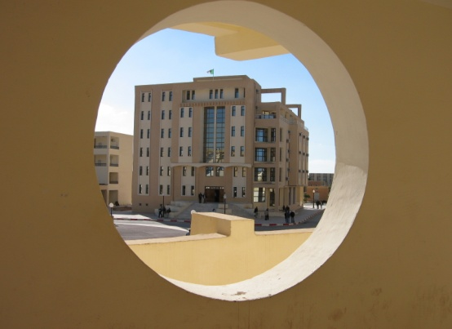
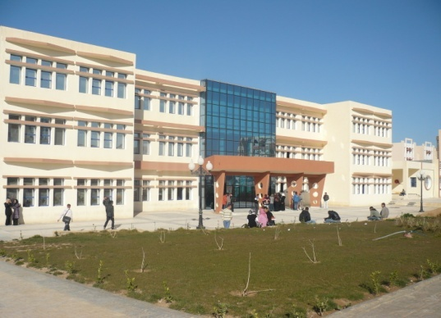
Course n06 . Conical Perspective
Urban Technology Management Institute
Department of Architecture
Academic year 2023 / 2024
prepared by
professor Boutabba Hynda- Mili
1st year architecture course

Slide 2
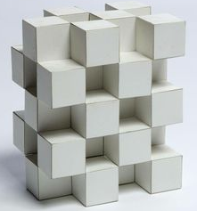
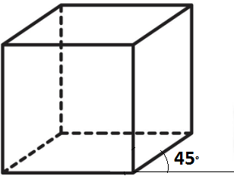
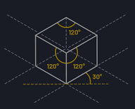
BRIEF REMINDER: What is Perspective?
Perspective is the art and technique of representing an object in 3 Dimensions on a flat surface in 2 Dimensions. (Example a sheet of paper, a wall, a screen...) giving the feeling of depth
CAVALIER PERSPECTIVE
AXONOMETRIC PERSPECTIVE (isometric)
The Oblique PERSPECTIVE known as CONICAL
Subject of this course

Slide 3
What is Conical Perspective?
Unlike cavalier and axonometric perspectives, conical perspective is the one that best mimics the perception that human beings have of an image
So......., in order to be able to understand the characteristics of the conical perspective, we must first understand the most important characteristics of human perception

Slide 4
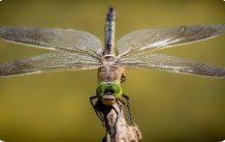
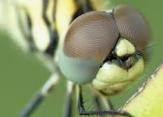
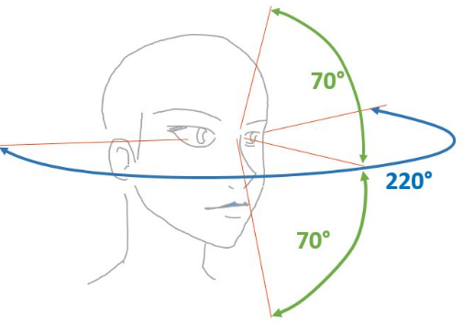
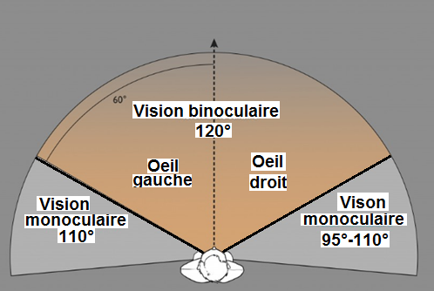
Human Perception
1. The visual field
Unlike animals or some insects
Humans have a field of vision of about 220°.

Slide 5
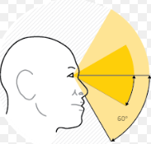
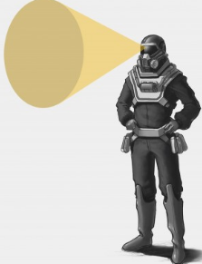
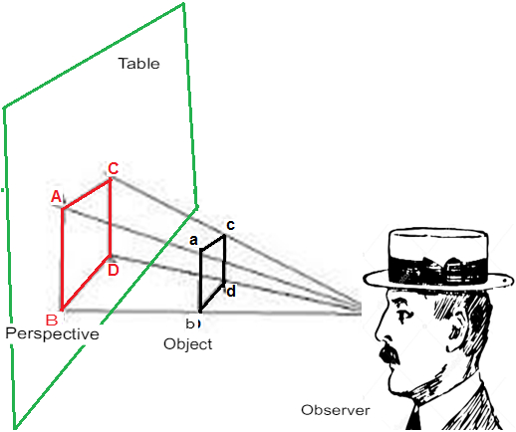
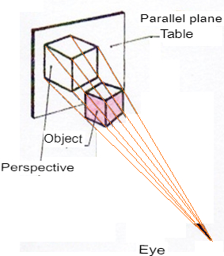
Visual Field and Conical Perspective
The visual field does not simply form a semicircle with different perceptual angles, but rather a cone
which is oriented according to the gaze.
Hence the name conical perspective

Slide 6
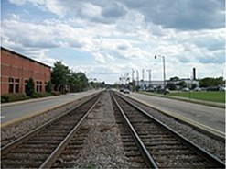
Human Perception
2. The Horizon line
The "imaginary" line is the boundary between
Between the sea and the sky
between the ground and the sky,
Between the city and the sky
behind which, the human eye is unable to see
this is the HORIZON LINE "LH"
The farther away the rails, the smaller they appear
When an object is located at infinity, it is represented by a point, which is called
3. Vanishing point "F"
Obligatorily located on the Horizon line " LH"

Slide 7
Human Perception & Conical Perspective
To conclude: we can say that there are 3 important elements of
human perception that can be found in the conical perspective:
1. The observer "O" and his field of vision
2. The Horizon line "LH"
3. Vanishing point "F"
The conical perspective differs and changes depending on :
the number of vanishing points
the position of the observer
the height of the horizon line

Slide 8
Conical perspective with 1 single vanishing point or CENTRAL pers
Conical perspective with 2 vanishing points or oblique pers
Conical perspective with 3 vanishing points or bird’s eye pers

Slide 9
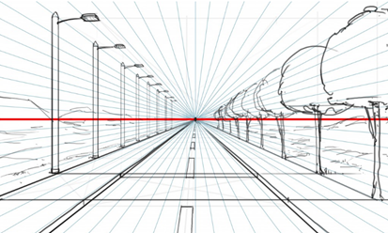
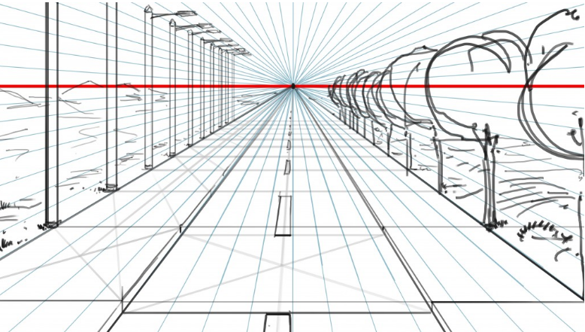
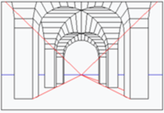
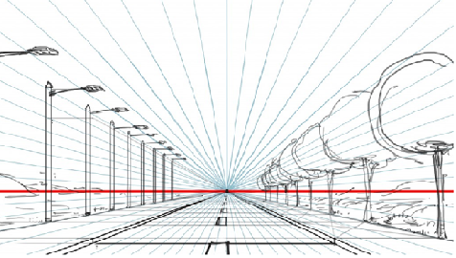
Conical perspective with 1 single vanishing point
L H
Called FRONTAL perspective
Horizontals remain parallel
Verticals remain parallel
Only the sidelines converge to the vanishing point F on the horizon line LH
The Object
Also known as CENTRALE
LT

Slide 10
Conical perspective with 1 single vanishing point
1 vanishing point
Horizon Line

Slide 11
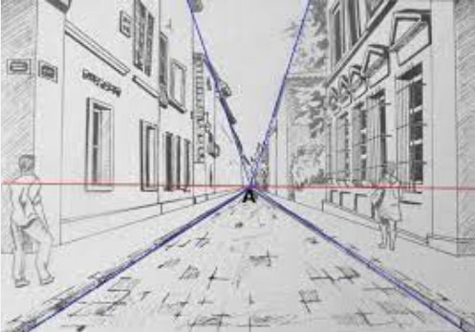
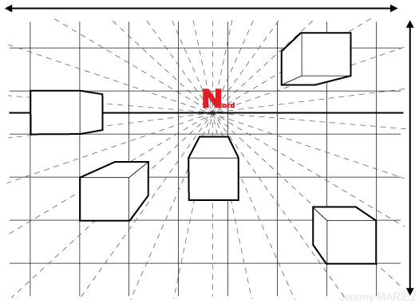
Examples of Conical Perspective with 1 Single Vanishing Point

Slide 12
2-vanishing points conical perspective
or oblique perspective

Slide 13
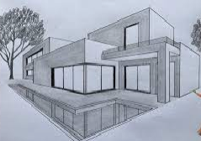
Conical perspective with 2 vanishing points or oblique pers
Only the verticals remain parallel
Object
Parallels of right direction vanish toward a vanishing point on the right F
Good
Parallels of left direction vanish toward a vanishing point on the Left G
Bad
The 2 vanishing points, F and G, are placed on the same LH horizon line
F
G
Worm’s eye view
LH
G
F
Bird’s eye
The conical perspective drawing with 2 vanishing pts will give us this shape

Slide 14
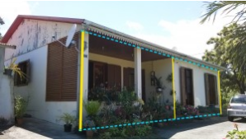
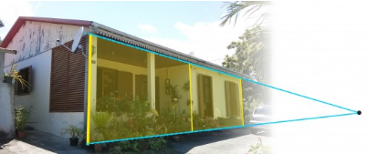
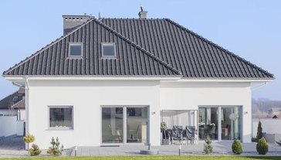
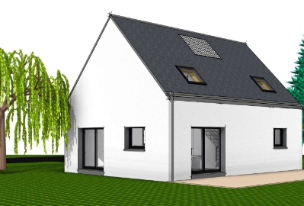
In Conclusion vanishing 2-points conical perspective
The edge closest to the observer seems to us to be larger than the one we see at the very end. And yet, in reality, we understand that they are the same size
Although they are parallel, the ground line and that of the beginning of the roof eventually meet at a single point.
These are: Vanishing points
All parallel lines in reality are perceived by our eyes as if they’re vanishing towards the same point

Slide 15
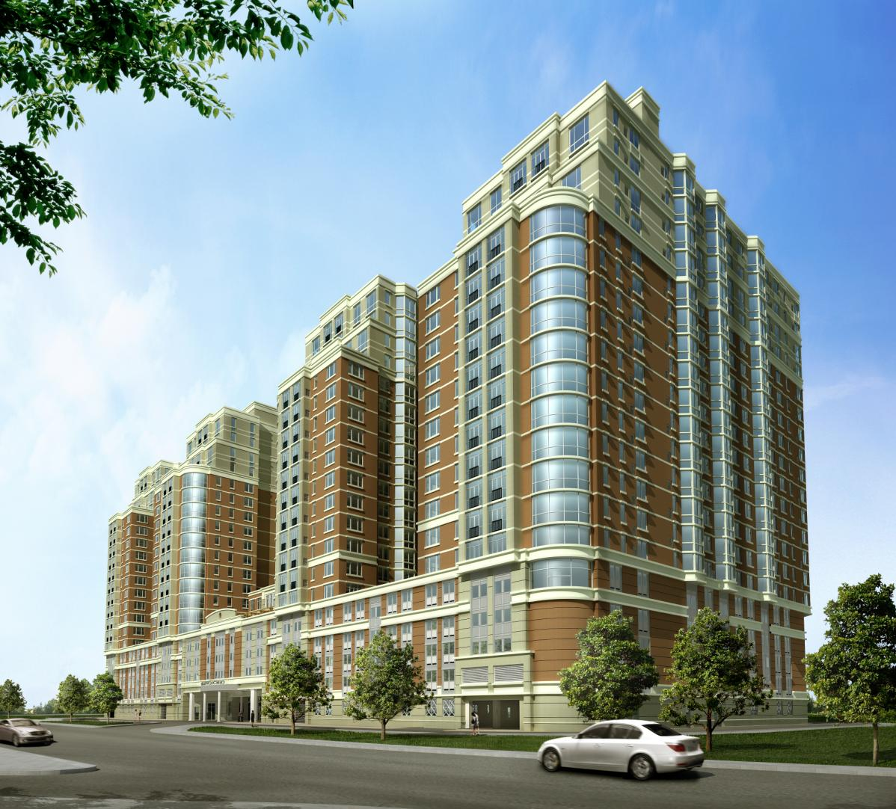
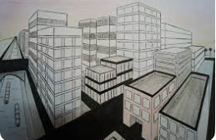
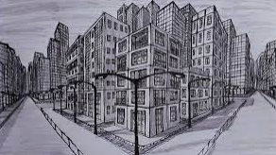
Examples of 2-Vanishing Points Conical Perspective

Slide 16
3-vanishing points conical perspective
or AERIAL perspective

Slide 17
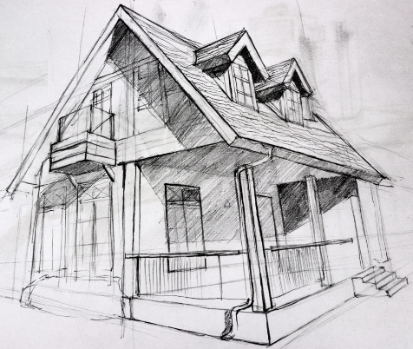
Conical perspective with 3 vanishing points or AERIAL pers
Parallels of the right direction Vanish toward a vanishing point on the right side F
L’objet
Parallels of the left direction Vanish toward a vanishing point on the left side G
Vertical parallels vanish toward to a vanishing point H
LH
G
F
H
F
LH
G
The conical drawing with 3 vanishing pts will give us this shape

Slide 18
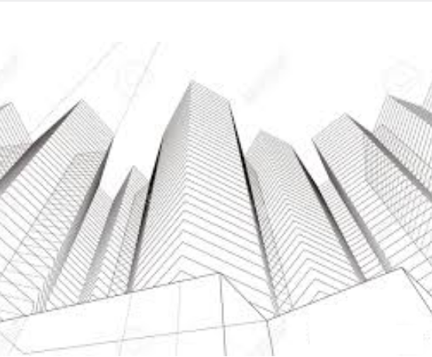
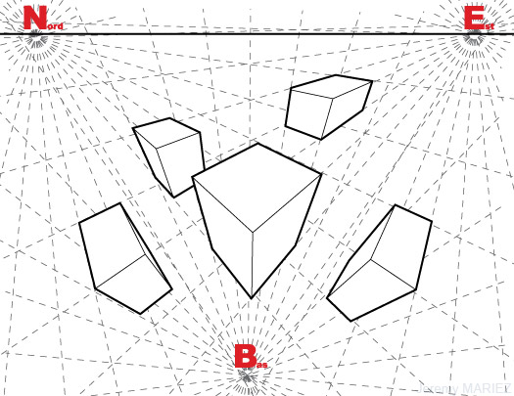
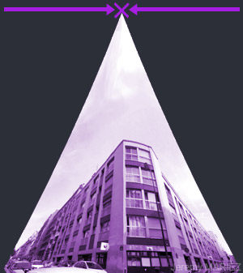
Examples of 3-Vanishing Points Conical Perspective

Slide 19
How to Draw Oblique Conical Perspective
From the top and right views

Slide 20
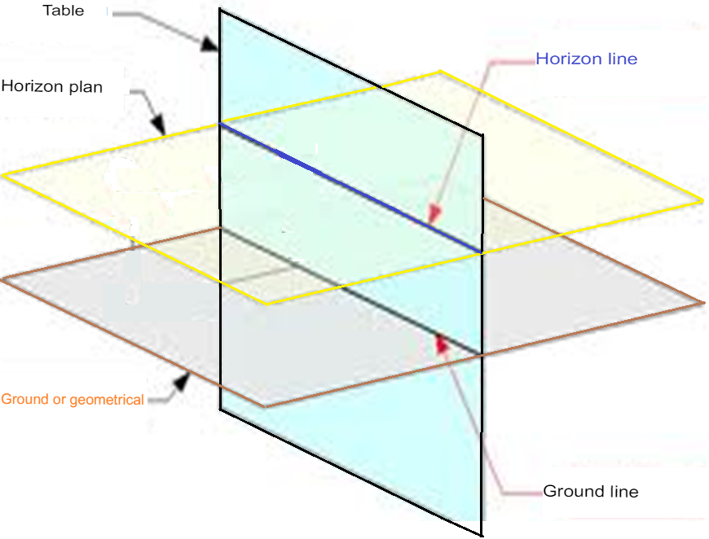
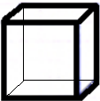

Slide 21
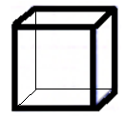
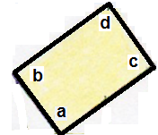
h
h
f
f
g
g
e
e
The Object
The Object
d
c
d
c
G’
b
a
b
a
F’
LT
LH
G
F
H
E
F
G
F
E
Right view
B
C
A
A
C

Slide 22
University of M’sila
Urban Technology Management Institute
Department of Architecture
Exo7: The Conical Perspective
Academic year 2023 / 2024
prepared by
professor Boutabba Hynda- Mili
1st year architecture course

Slide 23
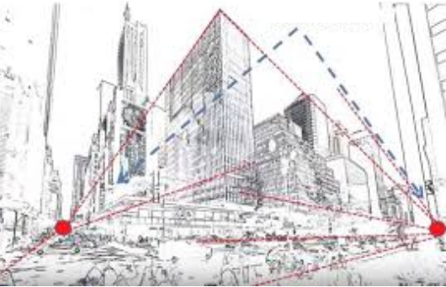
Assignment
Once the volumetric composition chosen by the student is approved by the teacher. Draw on A2 format:
Oblique "two- vanishing points" conical perspective
Choose the proper Scale
The duration of the exercise is 4 sessions
2 sessions before the winter holidays, two more just after

Slide 24
Thank you for your attention
و شـــكــــرا

