Slide 1
Writing the Dissertation Introduction

Slide 2
What is dissertation:
The document that will evidence your research journey.

Slide 3
Managing your time
Don't panic! Your dissertation might seem like an endless project, but you can break it down into a list of tasks. Having a plan for using your time to complete those tasks will get it done.
Plan an overall work schedule
Break down your dissertation into stages and plan backwards from your deadline to fit them all in.

Slide 4
Overall Work Schedule
Start with your literature review
Think about your methodology
Identify primary sources
Identify secondary sources, if appropriate
Write as you go along
Organise and analyse your material
Write up
Redraft / check / proofread

Slide 5
The structure is very important. The accepted structure of dissertation is as follow:
1.Cover page
2. Declaration
3. dedication
4. Acknowledgment
5. Abstract
6. Abbreviations
7. List of tables and figures
8. Table of contents
9. Introduction
10. Chapters
11. Conclusion
12. Works Cited
13. Appendices if any

Slide 6
The Table of Contents
The signposts of your dissertation for the reader.
Can be used as a checklist to help you ensure that you have not missed anything.
And your work follows a logical thread that can be easily understood by reader.
Examiners place high importance on the logical structure of a dissertation, and the first place they take look to evaluate

Slide 7
The List of Tables and Figures
If the report contains figures or tables a list of these should be provided. The list should give the table or figure number, the title of the table or figure and the page number.

Slide 8
Structuring the Introduction
As Swales and Feak (2012) have argued in terms of the research article, the thesis Introduction is of strategic importance: its key role is to create a research space for the writer.
It is in the Introduction that the writer makes claims for the centrality or significance of the research in question and begins to outline the overall argument of the thesis

Slide 9
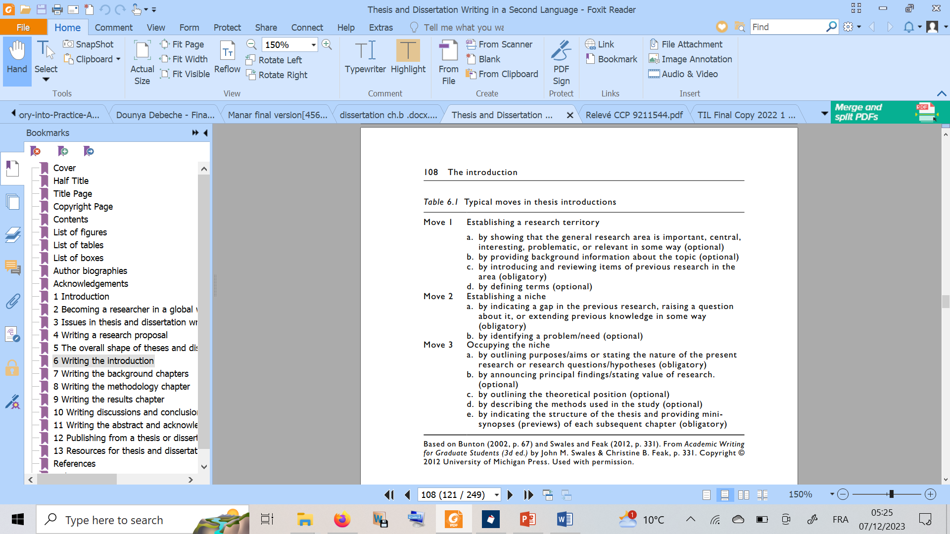

Slide 10
The typical structure of the Introduction
The organizational structure of the Introduction can be said to move from a fairly general overview of the research terrain to the particular issues under investigation through three key moves which capture the communicative purposes of the Introduction (Swales and Feak 1994):
● to establish a research territory;
● to identify a niche or gap in the territory;
● to then signal how the topic in question occupies that niche.

Slide 11
Introduction Contents
Background of the study/ introduction to the field
Motivation
Scope
Objectives
Research questions
Methodology
Division of chapters

