Slide 1
Definitions
Informatics: automatic processing of information using machine.
Computer: electronic machine that executes instructions organized in program.
computer program: set of instructions written in a programming language that tells a computer what tasks to perform
Software :is a collection of programs, data, and instructions that enable a computer to perform specific tasks

Slide 2
Example Of A Program
Let consider a robot that can do only Four Tasks ( Move , Turn right, Turn left, Stop).
this robot can listen instruction from user and execute it immediately
How do we move this robot from A to B
Program
Move
Trun Right
Move
Turn left
Move
Stop
A
B

Slide 3
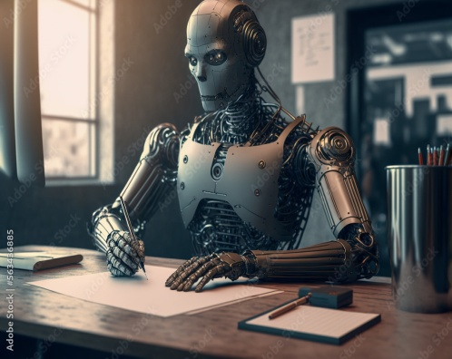
Example Of A Program
Let's consider another robot equipped
with a blank piece of paper and a pen,
but it can only perform a single task:
Write(X).
The action Write(X) represents putting X ( only one line) on the paper. This instruction has two forms:
Write(X) And Write(“X”)
Write(X): Perform X and write the result on paper
Write(“X”): Write X on paper as it is

Slide 4
Example Of A Program
Hello World
Welcome to our university
So, what is the result of this code?
And This ?
Write("Hello World")
Write(" Welcome to our ")
Write(" university ")
?
Write("Hello World")
Write ( 5 + 6)
Write(" 10 - 2 ")
?
Write (Hello World)

Slide 5
Other Definitions
A computer is a programmable machine that processes data and instructions to perform various tasks and operations as directed by a program.
A computer is an electronic device, operating under the control of instructions stored in its own memory that can accept data (input), process the data according to specified rules, produce information (output), and store the information for future use

Slide 6
Computer Structure

Slide 7
Example of Input Devices
Keyboard
Mouse(pointing device)
Microphone
Touch screen
Scanner
Webcam, etc
Keyboard The most common use keyboard is the QWERTY keyboard (AZERTY). Generally standard Keyboard has 104 keys

Slide 8
Central Processing Unit
CPU known as microprocessor or processor It is responsible for all functions and processes
CPU Components
The CPU is composed of two main parts
Arithmetic Logic Unit (A L U )
Control Unit (CU)

Slide 9
Central Processing Unit
ALU Executes all arithmetic and logical operations. Arithmetic calculations like as addition, subtraction, multiplication and division. Logical operation like compare numbers, letters, or special characters
Control Unit (CU) Read the code for the next instruction to be executed. Increment the program counter so it points to the next instruction. Read whatever data the instruction requires from cells in memory

Slide 10
Memory R.A.M
RAM: Random Access Memory: is a memory scheme within the computer system responsible for storing data on a temporary basis, so that it can be accessed by the processor as and when needed. It is volatile in nature, which means that data will be erased once supply to the storage device is turned.
RAM is considered "random access" because you can access any memory cell directly if you know the row and column that intersect at that cell.

Slide 12
Memory R.O.M
ROM (READ ONLY MEMORY ) a permanent form of storage.. ROM devices do not allow data stored on them to be modified.
is useful for storing software that is rarely changed during the life of the system, also known as firmware

Slide 13
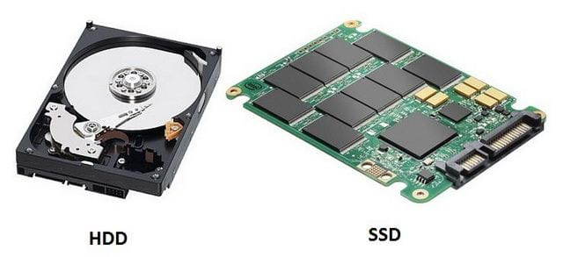
Secondary Memory Stores data and programs permanently (HDD, SSD, Flash Disk …)

Slide 14
What Can a Computer do?
A computer is a machine that can store and process information.
Which can do with Very high speed:
Basic Arithmetic operations (+ , - , * , /)
Logical operations (AND, OR , … )
Compare Expressions ( if )
Exchange data between CPU and devices

Slide 15
Programming Language
formalized system of instructions used to communicate with computer. It serves as an intermediary between human-readable code and the machine-level language (machine code) that computers can understand and execute directly.
Language Machine : low-level programming language that consists of binary code or a set of instructions directly understood and executed by a computer's central processing unit (CPU)

Slide 16
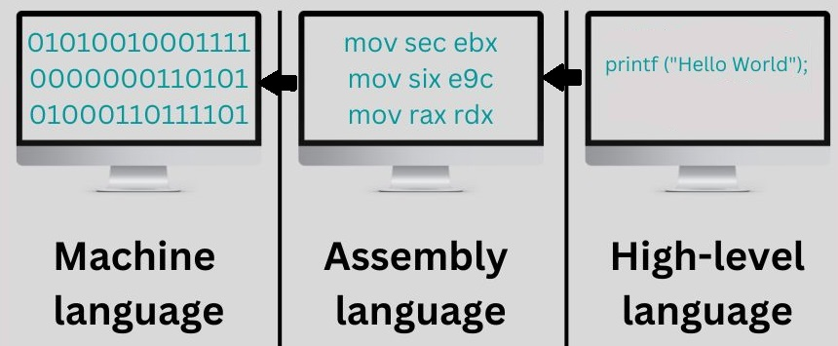
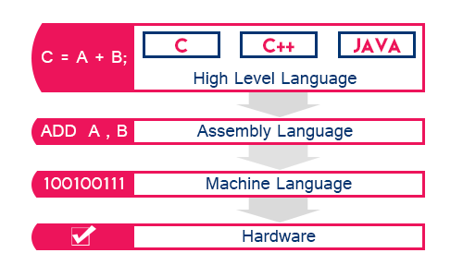
COMPILER

Slide 17
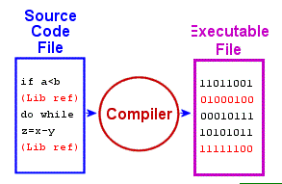
Compiler / interpreter
A compiler is a software tool that translates human-readable source code written in a high-level programming language (Python,Java,…) into machine-readable code, typically in the form of binary machine language or assembly language

Slide 18
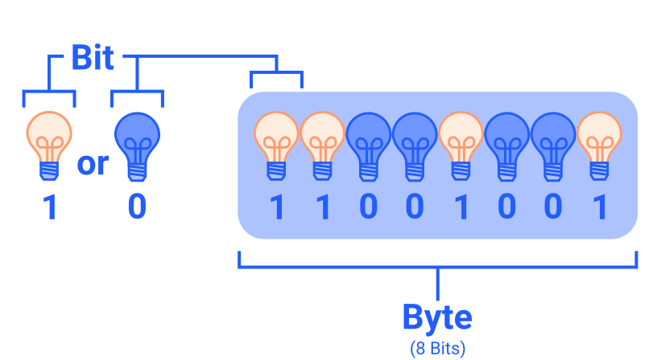
How computer Treat data
1
Bit
0

Slide 19
BIT
0
1
1
0
1
0
1
1
0
1
0
1
1
0
1

Slide 20
Measure Unit
2¹⁰ Byte
2²⁰ Byte
2³⁰ Byte
2⁴⁰ Byte
PetaByte, ExaByte, ZettaByte, …

Slide 21
Information Representation

Slide 22
Numeral system
2

Slide 23
Introduction
always the nature of the information processed by a computer (image, sound, text, video) is represented by a set of binary numbers.
An elementary piece of information corresponds to a binary digit (0 or 1), called 'bit.' The term 'bit' stands for « binary digit »
Information encoding enables establishing a correspondence between the external representation of information and its binary representation

Slide 24
Introduction
We have usually representing the numbers using ten different symbols: 0, 1, 2, 3, 4, 5, 6, 7, 8, 9
This system is called decimal system.
However, there are other numeral systems that operate using a different number of distinct symbols.
Example :
The binary system (bi: two)
the octal system (oct: eight)
the hexadecimal system (hexa: sixteen)
In a numeral system, the number of distinct symbols is referred to the base of this numeral system.
4

Slide 25
Decimal system
Using 10 symbols 0 , 1 , 2 , 3 , … , 9
Example:
The 3213 number can be written using the form :
3213 = 3*10³ + 2*10² +1*10¹ + 3*10⁰
this form is called polynomial
A real number can also be expressed in polynomial form:
3213,987 = 3*10³ + 2*10² +1*10¹ + 3*10⁰ + 9*10⁻¹ + 8*10⁻² + 7*10⁻³

Slide 26
binary System (base 2 )
Exemple
One bit : 0 , 1
Two bits :
On 3 Bits
Binary | Decimal
000 | 0
001 | 1
010 | 2
011 | 3
100 | 4
101 | 5
110 | 6
111 | 7
Binary | Decimal
00 | 0
01 | 1
10 | 2
11 | 3
4 combinations= 2²
8 combinations= 2³

Slide 27
octal system (base 8)
8 symboles Are Used :
{ 0 , 1 , 2 , 3 , 4 , 5 , 6 , 7 }
Example 1 :
(526)₈ = 5*8² + 2 *8¹+ 6*8⁰
(537,235) = 5*8² + 3*8¹ + 7 *8⁰ + 2 *8⁻¹ + 3*8⁻²
8
+ 5*8⁻³
Example 2 :
The number (1289) Does not exist in base 8 because the symbols 8 and 9 do not belong to the base.
7

Slide 28
hexadecimal system (base 16 )
We use sixteen (16) different symbols : (17) = 1*16¹ + 7 *16⁰ 16 (AB) = A*16¹ + B *16⁰ = 10 *16¹ +11*1 16 | Decimal | Hexadecimal | 8
 | 0 | 0
 | 1 | 1
 | 2 | 2
 | 3 | 3
 | 4 | 4
 | 5 | 5
 | 6 | 6
 | 7 | 7
 | 8 | 8
 | 9 | 9
 | 10 | A
 | 11 | B
 | 12 | C
 | 13 | D
 | 14 | E
 | 15 | F

Slide 29
Information Representation

