Slide 1
Lecture 06: Letters Writing

Slide 2
Letters
Letters are a well organized text in form and content generally follow a pattern, that is similar to basic composition writing.
A salutation.
A general message.
A closing and signature.

Slide 3
Order of Information
Letterhead or sender's address
Date
Inside address
Salutation or Greeting
Message
Closing
Signature, printed name, and position of sender

Slide 4
Content of letters
Addresses
Date
Salutation or greeting
1) Dear Sir or Madam,
2) Dear Mr Jenkins,
Ending a letter:
1) Yours Faithfully
2) Yours Sincerely
3) Your signature

Slide 5
Content of letters
The first paragraph should be short and state the purpose of the letter- to make an enquiry, complain, request something, etc.
The paragraphs in the middle of the letter should contain the relevant information behind the writing of the letter.
The last paragraph of a formal letter should state what action you expect the recipient to take- to refund, send you information, etc.

Slide 6
Sample Format of Letter

Slide 7
Types of letters

Slide 8
Application letter/ Cover Letter
When you submit your resume (CV), you will typically need to write a cover letter. In this letter, you'll make a case for your candidacy, highlighting your relevant skills. Cover letters are not just for job applications.
An application letter is a specific type of cover letter that is used on an application. Application letters can accompany job applications, and they can also go with applications for admissions to schools and applications for grants. They are usually more detailed than general cover letters.

Slide 9
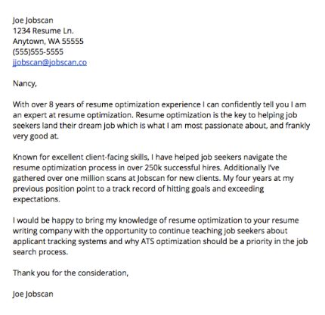
Application letter Sample

Slide 10
Motivation letter
It is sometimes called “statement of purpose”. In this letter, you should point out why you want a study/ job/grant . You should state your interest for the study or the job that you are applying for.

Slide 11
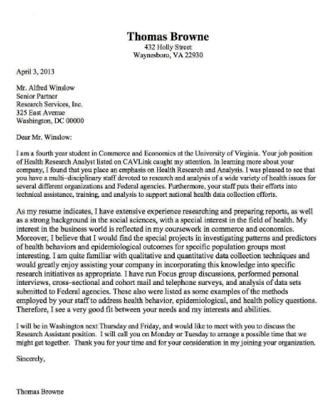
Motivation letter Sample

Slide 12
Academic Recommendation Letters
Generally, the letter of recommendation is related to employment or education. So, in such a letter you can include several things like: Qualification of an individual, Skills of an individual, Qualities as well as capabilities of a candidate and Extra educational details.

Slide 13
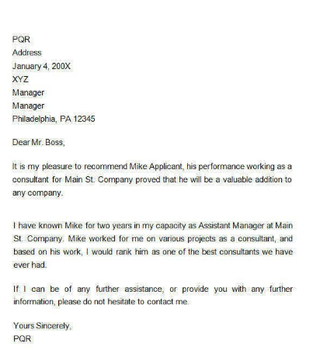
Recommendation Letter Sample

Slide 14
Reference Letter
A reference letter is a letter in which skills and capabilities of another person are mentioned in a positive way.
The person writing a reference letter is called as a referee and sometimes is also called as a sponsor.
It is a letter in which the writer makes a general assessment of the qualities, interests, attitude, integrity, community involvement, and personal characteristics of a person.

Slide 15
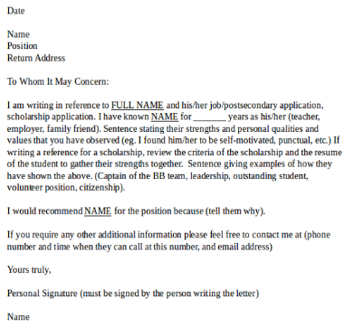
Reference Letter Sample

Slide 16
The Difference Between a Recommendation Letter and a Reference Letter
A recommendation letter is more specific and usually for the purpose of obtaining employment or admission to advanced education. The information is more related to skills and abilities than it is to personal characteristics.
A reference letter is usually more general in nature and refers more to the overall character of a person. The information is more related to an individual’s personality and character than it is to their skills and abilities.

Slide 17
Inquiry Letter
Any kind of a letter, that is written for collecting information can be called as an inquiry letter. This information can be related to anything like product, price, job, contract etc. Employers and business owners write this type of a letter to generally obtain the desired information.

Slide 18
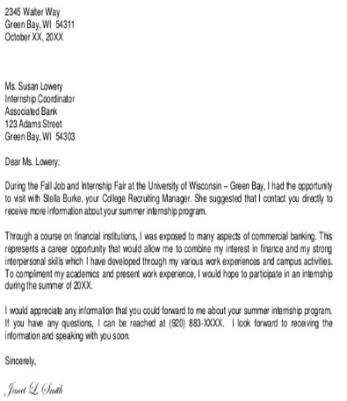
Inquiry Letter Sample

Slide 19
Opening lines
to make reference to previous correspondence.
to say how you found the recipient's name/address .
to say why you are writing to the recipient.

Slide 20
Opening lines
With reference to your letter of 8 June, I ...
I am writing to enquire about ...
After having seen your advertisement in ... , I would like ...
After having received your address from ... , I ...
I received your address from ... and would like ...
We/I recently wrote to you about ...
Thank you for your letter of 8 May.
Thank you for your letter regarding ...
Thank you for your letter/e-mail about ...
In reply to your letter of 8 May, ...

Slide 21
Closing lines
to make a reference to a future event
to repeat an apology
to offer help

Slide 22
Closing lines
If you require any further information, feel free to contact me.
I look forward to your reply.
I look forward to hearing from you.
I look forward to seeing you.
Please advise as necessary.
We look forward to a successful working relationship in the future.
Should you need any further information, please do not hesitate to contact me.
Once again, I apologise for any inconvenience.
We hope that we may continue to rely on your valued custom.
I would appreciate your immediate attention to this matter.
When the recipient's name is unknown to you:
Dear Sir ... Yours faithfully
Dear Madam ... Yours faithfully
Dear Sir or Madam ... Yours faithfully

Slide 23
Useful Expressions in Letters Writing
Apologizing
I'm sorry about...
I am sorry that...
I'm very sorry about...
I'm very sorry for...
Please forgive me for...
I'd like to apologize for...
Please accept my apologies.
Please accept my sincere apologies. (Very formal)
Asking for Help
I'd be grateful if you
could...
I would be grateful if you
could...
I would appreciate it if you
could...
Could you please...
I was wondering if you
could help me.(informal)
I would like to know...

Slide 24
Useful Expressions in Letters Writing
Asking for Information
I am writing to enquire about...
I am writing to find out about...
What I am looking for is...
I would like to know about/if...
Closing
I look forward to seeing you.
I look forward to hearing from you.
I look forward to meeting you.

Slide 25
Useful Expressions in Letters Writing
Complaining / expressing dissatisfaction
I'm writing to express my dissatisfaction with...
I'm writing to express my annoyance with...
I am not happy about...
...was very disappointing.
Conveying regards
Please give my best regards to your family.
Please pass on my best wishes to your wife and children.
Please give my regards to your parents.

Slide 26
Useful Expressions in Letters Writing
Expressing concern / sympathy
I was sorry to hear about... (your accident/ illness)
I am writing to express my concern about...
Expressing satisfaction
I was delighted to hear that...
I was very happy to learn that...
I was thrilled to find out that...
I was glad to hear that...
...was very enjoyable.

Slide 27
Useful Expressions in Letters Writing
Giving good news
I am pleased to inform you that...(semi-formal)
I am delighted to tell you that...(informal)
I am happy to advise you that...(formal)
I thought you might like to know that...
Giving bad news
I regret to inform you that...(semi-formal)
I am sorry to tell you that...(informal)
I regret to advise you that...(formal)
I am afraid I have some bad news.(informal)

Slide 28
Useful Expressions in Letters Writing
Giving reasons
This is because...
This is because of...
This is due to... (formal)
This is as a result of...(formal)
This is owing to...(formal)
Making suggestions
Would it be a good idea to...
Perhaps it would be a good idea to...

Slide 29
Useful Expressions in Letters Writing
Thanking
Thanks.
Thank you.
Thank you very much.
Thank you kindly.
I can't thank you enough.
No words can express my gratitude
I am extremely grateful for...
I very much appreciate your ______ing

Slide 30
Samples of Social Letters

Slide 31
Apology Letter

Slide 32
Thanks Letter

Slide 33
Congratulation Letter

Slide 34
Condolence Letter

Slide 35
Invitation Letter

