Slide 1
Distributed Databases
ملاحظة: تجدون فصلا كاملا خاص بهذا العرض في مطوية الدروس على منصة موودل
Rabah mokhtari

Slide 2
Introduction
Distributed database system (DDBS) technology is the union of two approaches to data processing: database system and computer network technologies.
1- Database systems
Database systems have taken us from a paradigm of data processing in which each application defined and maintained its own data to one in which the data are defined and administered centrally.
2- Computer network technologies
The technology of computer networks, on the other hand, promotes a mode of work that goes against all centralization efforts.

Slide 3
Distributed Data Processing
Distributed data processing is a computing model in which data processing is distributed across multiple computers or nodes in a network.
The processing can be done in parallel, allowing for faster and more efficient processing of large amounts of data.
Each node in the network has access to a subset of the data, and the nodes work together to process the data and generate the desired output.

Slide 4
Distributed Database system
A distributed database system is a type of database system that is spread across multiple computers geographically distributed.
In a distributed database system, the data is partitioned or replicated across multiple nodes, and the nodes work together to process queries and transactions from clients.
A DDBS is also not a system where, despite the existence of a network, the database resides at only one node of the network.

Slide 5
Distributed Database system

Slide 6
DDBS benefits
Scalability: Distributed database systems can scale horizontally by adding more nodes to the network. This allows the system to handle large volumes of data and high transaction rates.
Fault tolerance: Distributed database systems can continue to operate even if one or more nodes fail. Data can be replicated across multiple nodes, so if one node fails, another node can take over without loss of data.
Improved performance: By distributing the data and processing across multiple nodes, distributed database systems can improve performance by processing queries and transactions in parallel.

Slide 7
Distributed DBMS architecture
The architecture of a system defines its structure.
This means that the components of the system are identified, the function of each component is specified, and the interrelationships and interactions among these components are defined.
The specification of the architecture of a system requires identification of the various modules, with their interfaces and interrelationships, in terms of the data and control flow through the system.

Slide 8
ANSI/SPARC Architecture
ANSI/SPARC Architecture is an early milestone in the field of database systems
It was developed by the American National Standards Institute (ANSI) and the Standards Planning and Requirements Committee (SPARC) in the 1970s, when the field of database management was still in its early stages.
It helped to establish many of the fundamental concepts and principles that are still used today.
The ANSI/SPARC architecture defines three levels of abstraction for a database system

Slide 9
ANSI/SPARC Architecture

Slide 10
ANSI/SPARC Architecture
External level: It describes how data is viewed by different users and groups, and how data is accessed and manipulated by applications. Each external schema is tailored to meet the specific needs of a particular user or application.
Conceptual level: This is the level of the database system that describes the overall logical structure of the database. The conceptual schema is independent of any particular application or user, and is used to ensure that all data in the database is consistent and integrated
Internal level: This is the level of the database system that describes how data is physically stored and accessed by the computer system. It defines the storage structures and access methods used by the DBMS to manage the data.

Slide 11
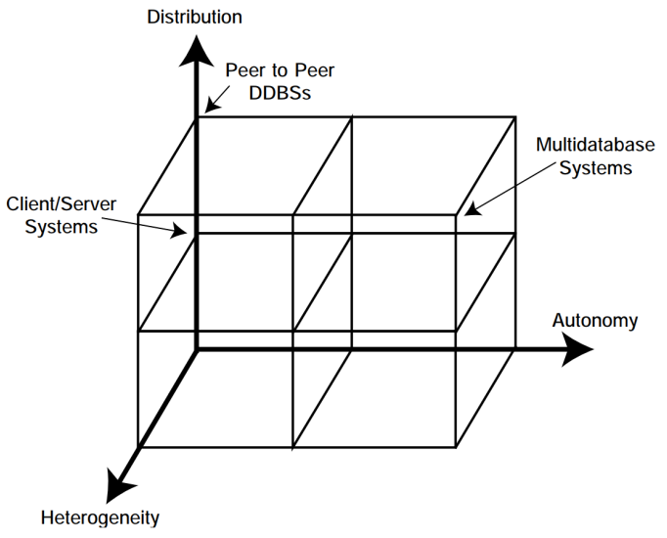
Architectural Models for Distributed DBMSs
The ways in which a distributed DBMS can be architected can be classified in terms of: the autonomy of local systems, their distribution, and their heterogeneity.

Slide 12
Architectural Models for Distributed DBMSs
Autonomy
Autonomy refers to the distribution of control, not of data. It indicates the degree to which individual DBMSs can operate independently.
The local operations of the individual DBMSs are not affected by their participation in the distributed system.
The manner in which the individual DBMSs process queries and optimize them should not be affected by the execution of global queries that access multiple databases.
System consistency or operation should not be compromised when individual DBMSs join or leave the distributed system.

Slide 13
Architectural Models for Distributed DBMSs
Distribution
Distribution refers to the distribution of data over multiple sites.
There are two alternatives classes: client/server distribution and peer-to-peer distribution (or full distribution).
Heterogeneity
Heterogeneity refers to the presence of diversity or differences in a distributed database environment in terms of data models, query languages, and transaction management protocols.

Slide 14
Client/Server architecture
Client/server DBMSs entered the computing scene at the beginning of 1990s and have made a significant impact on both the DBMS technology and the way we do computing.
the functions are divided into two classes: server functions and client functions.
This provides a two-level architecture which makes it easier to manage the complexity of modern DBMSs and the complexity of distribution.
We can cite many examples of DDBMS that use client/server architecture of distributed database systems. One such example is Microsoft SQL Server, Oracle Database, MySQL and PostgreSQL.

Slide 15
Client/Server architecture

Slide 16
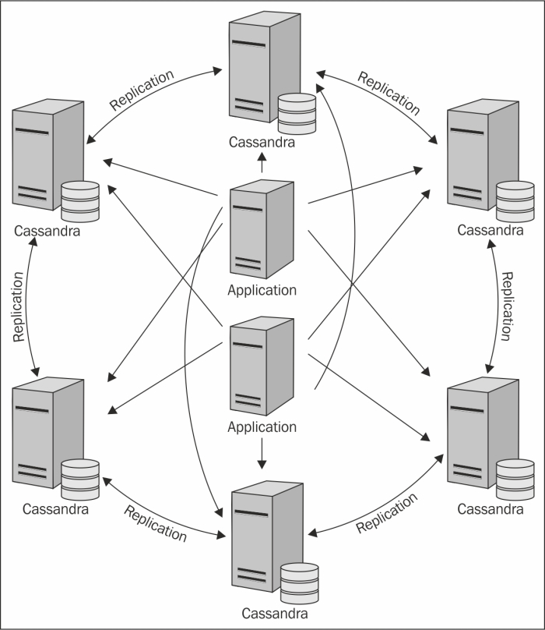
Peer-To-Peer architecture
After a decade of popularity of client/server computing, peer-to-peer have made a comeback in the last few years as an alternative to distributed DBMSs.
Apache Casandra DBMS represent a good example of peer-to-peer DDBMS and makes use of an entirely peer-to-peer architecture.
All nodes in a Cassandra cluster can accept reads and writes

Slide 17
Distributed query processing
Distributed query processing is the process of executing a database query that involves data stored on multiple nodes or servers in a distributed database system.
When a query is submitted, it must be broken down into smaller subqueries that can be executed on different nodes in parallel.
The results must be combined to form the final result set.
Distributed query processing involves several steps, including query optimization, query decomposition, data fragmentation and distribution, data transfer, local processing, and result consolidation.

Slide 18
Distributed query processing
The goal of distributed query processing is to minimize the amount of data that needs to be transferred between nodes and to maximize parallelism in the execution of subqueries in order to improve query performance .
Query processing problem
The main function of a relational query processor is to transform a high-level query (typically, in relational calculus) into an equivalent lower-level query (typically, in some variation of relational algebra).
The low-level query actually implements the execution strategy for the query and The transformation must achieve both correctness and efficiency.

Slide 19
Distributed query processing
Query processing problem
The main function of a relational query processor is to transform a high-level query (typically, in relational calculus) into an equivalent lower-level query (typically, in some variation of relational algebra).
The low-level query actually implements the execution strategy for the query and The transformation must achieve both correctness and efficiency.
Since each equivalent execution strategy can lead to very different consumptions of computer resources, the main difficulty is to select the execution strategy that minimizes resource consumption.

Slide 20
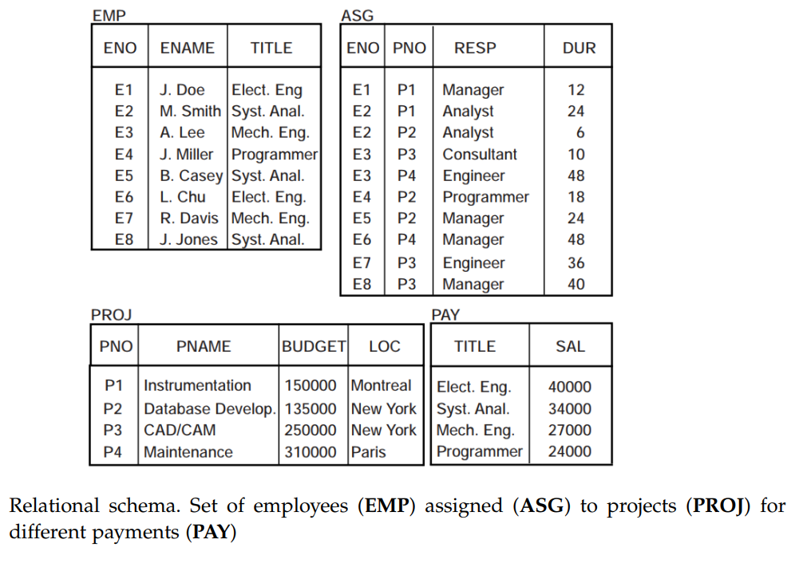
Distributed query processing
Query processing problem (Example)

Slide 21
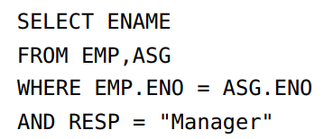
Distributed query processing
Query processing problem (Example)
following simple user query: “Find the names of employees who are managing a project”.
The expression of the query in relational calculus using the SQL syntax is

Slide 22
Distributed query processing
Query processing problem (Example 1)
Two equivalent relational algebra queries that are correct transformations of the query above are:
It is intuitively obvious that the second query, which avoids the Cartesian product of EMP and ASG, consumes much less computing resources than the first, and thus should be retained.

Slide 23
Distributed query processing
Query processing problem
In a centralized context, query execution strategies can be well expressed in an extension of relational algebra
The main role of a centralized query processor is to choose, for a given query, the best relational algebra query among all equivalent ones.
In a distributed system, relational algebra is not enough to express execution strategies. It must be supplemented with operators for exchanging data between sites
In addition to the relational algebra operators, the distributed query processor must also select the best sites to process data, and possibly the way data should be transformed.

Slide 24
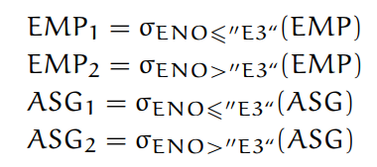
Distributed query processing
Query processing problem (Example 2)
We consider the following query
We assume that relations EMP and ASG are horizontally fragmented as follows

Slide 25
Distributed query processing
Query processing problem (Example 2)
Fragments ASG1, ASG2, EMP1, and EMP2 are stored at sites 1, 2, 3, and 4, respectively and the result is expected at site 5.
Two equivalent distributed execution strategies for the above query are possibles.

Slide 26
Distributed database design
In the design of a distributed DBMSs, the distribution of applications involves two things
The distribution of the distributed DBMS software, and
The distribution of the application programs that run on it
Two major strategies that have been identified for designing distributed databases
The top-down approach and the bottom-up approach

Slide 27
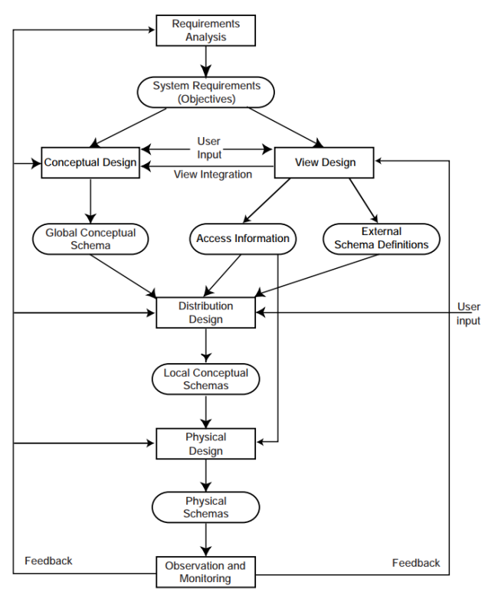
Distributed database design
Top-down approach

Slide 28
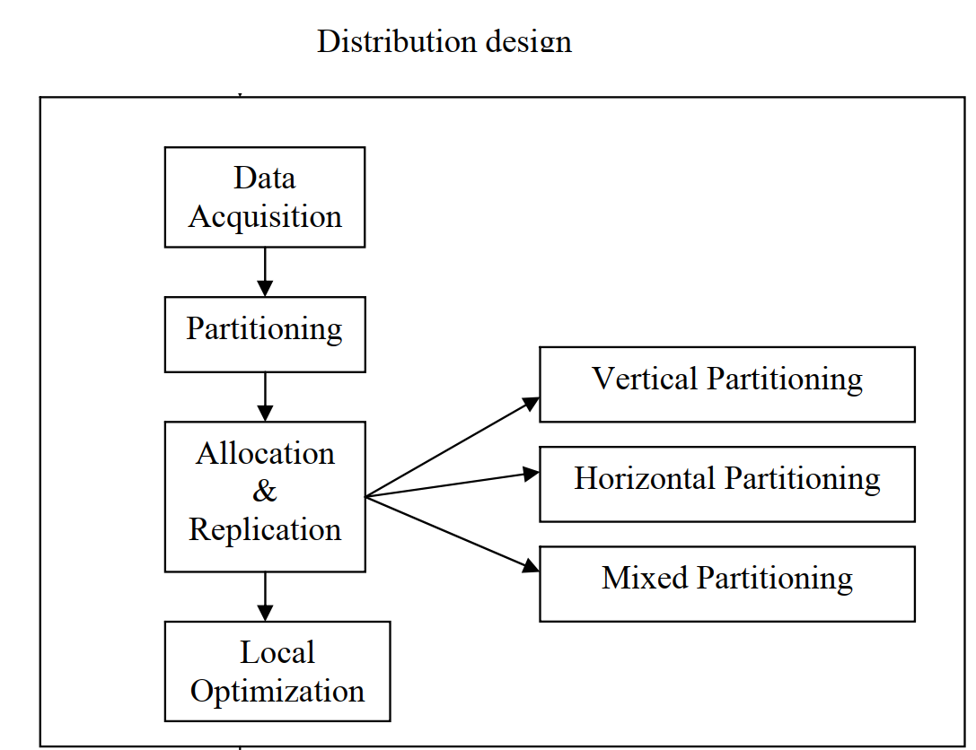
Distributed database design
Distribution design

Slide 29
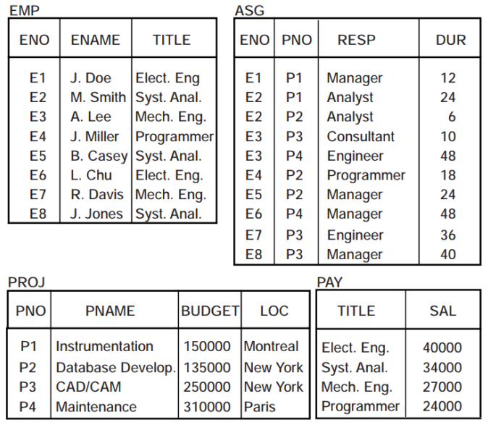
Fragmentation alternatives
Vertical and horizontal fragmentation

Slide 30
Correctness Rules of Fragmentation
Completeness

Slide 31
Correctness Rules of Fragmentation
Reconstruction

Slide 32
Correctness Rules of Fragmentation
Disjointness

