Slide 1
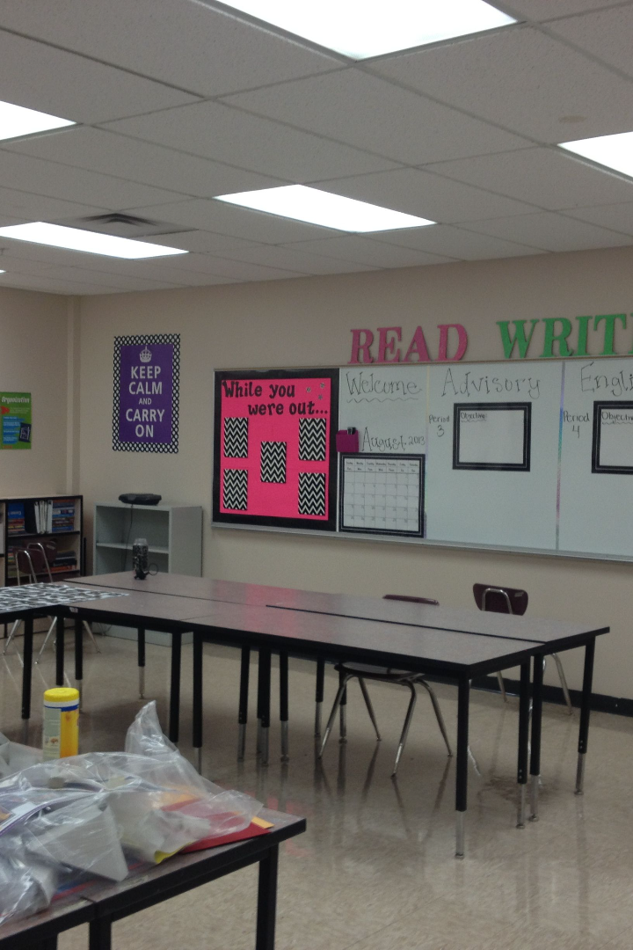
English Prepositions
Mastering English prepositions is essential for clear and effective communication. In this presentation, we will explore the definition, types, usage, and common mistakes of prepositions, as well as idiomatic expressions and tips for improvement.
AB
by Amel Bouakaz

Slide 2
Definition of Prepositions
A preposition is a word or group of words used to link nouns, pronouns and phrases to other words in a sentence. Some examples of prepositions are single words like in, at, on, of, to, by and with or phrases such as in front of, next to, instead of.
Prepositions in English are most frequently dictated by fixed expressions. While there are some general guidelines to follow, many prepositions are used idiomatically with certain verbs. In these cases, it is best to memorize the phrase instead of the individual preposition.
A Few Rules for Usage
Although there are hardly any rules as to when to use which preposition, most commonly prepositions define relationships between nouns and locate words, actions or ideas in a particular time or place. To remember the role of prepositions, notice that ''position'' appears in the word ''preposition''!

Slide 3
Examples of Common Prepositions
Time
Place
Direction
The meeting is at 3 PM.
The book is on the table.
She walked towards the door.

Slide 4
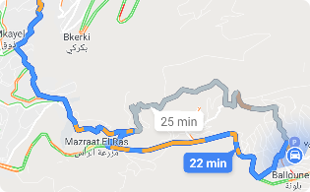
Types of Prepositions
Time
Place
Direction
Prepositions such as "before," "after," and "during" help us understand when an action occurs.
Words like "in," "on," and "at" specify the location of a person or object in relation to something else.
Prepositions like "to," "from," and "towards" indicate the path an action takes.
Other
Prepositions can also express relationships between people, possession, cause and effect, and more.

Slide 5
*Prepositions – Time
English | Usage | Example
in | • months/seasons • years • time of day • centuries and historical periods • after a certain period of time. | • in August/in the summer • in 1985 • in the evening • in the 19th century • Mystic Market closes in two hours.
at | • time of days • noon, night, and midnight • names of mealtime • age. | • at 2:30 • at night • at breakfast • I learned how to use a computer at 12.
on | • days of the week | • on Friday
since | • from a period of time up to the present (when it started). | • I have been a student since 2004.
for | • how long a period of time has been. | • I have been a student here for 2 years.
from..to… | • the beginning and end of a period of time. | • My appointment is from 13:30 to 14:00.
until | • a period of time up to a specific point in time | • I cannot go dancing until I finish reading this chapter
by | • in the sense of ''at the latest'' • due date. | • You must return your book by April 21st. • My essay is due by the end of the week.

Slide 6
* Prepositions – Place (Location and Direction)
English | Usage | Example
in | • when something is in a place, it is inside it (enclosed within limits) | • in class/in Victoria • in the book • in the car/in a taxi • You look serious in this photo.
at | • located at a specific place (a point) • for events • place where you are to do something • typical (watch a movie, study, work) | • at the library • at a concert/at a party • at the cinema/at school/at work
on | • being on a surface (not enclosed) • for a certain side (left, right) • for a floor in a building • for public transport • for television, radio | • I left the keys on the table. • Go down this hall to the end, turn right, and it's • The third door on your left. • My apartment is on the fourth floor. • I forgot my phone on the bus. • You can hear my brother on the radio.
to | • moving toward a specific place (the goal or end point of movement) | • Every morning, I take the bus to campus.

Slide 7
from | • for the origin or starting point | • I used carrots from my garden. • I received a suspicious email from my bank. • I will be on vacation from July 31 for a week.
towards | • movement in direction of something | • I suddenly saw a dog running towards me.
across | • movement from one side to another | • There is a coffee shop across the street. • I swam across the lake.
through | • movement from one side to another but'' in something'' | • I entered the room through an open window. • You have to go through the kitchen to get to the bathroom.
between | • a place ''in the middle'' of two or more separate people or things | • I was standing between my friend and his parents. • The gap between the rich and poor keeps growing.
among | • a place ''surrounded'' by more than two people or things together as a group (in the sense of ''included in'') | • France is among the countries of Western Europe. • Among the advantages of exercising regularly are lower risks of depression and a better quality of life.

Slide 8
* Prepositions – Connections
English | Usage | Example
of | • between two noun phrases to show that the first belongs to or is part of the second • to say how people are related | • The keyboard of my computer is pink. • Richard is the son of Audrey/He is a good friend of mine.
with | • Between two noun phrases when the second is a particular feature of the first • to say that people or things are together • for the specific thing used to perform an action | • I spilled coffee on the computer with a pink keyboard. • I think Sarah is studying with Tara/I went to a workshop with my friend. • My roommate killed a spider with a book.
by | • when we want to describe an action in a more general way | • My roommate saved my live by killing the spider

Slide 9
* Prepositions in Academic Writing
English | Usage | Example
about | • For topics (in the sense of ''with regard to/concerned with'') | • She was the author of many books about the history of ancient Egypt.
for | • with a purpose/giving a reason (associated with an action; shortened form of ''for the purpose of'') | • The concept of class is important for understanding how society works. • Theories about strategies for linking nouns and verbs
from | • the origin, cause or agent of something | • The meaning is often hard to guess from the individual words.
in | • inclusion, location or position within a time period or limits | • You can see this in works by contemporary authors.
on | • the basis for something | • Many engineers proceed on the assumption that the digital age is unique.
of | • belonging to, relating to, or connected with • describe a relation/causation • the origin, cause, motive or reason of something | • The results of the investigation are still relevant. • The root of the problem is the absence of any evidence supporting our thesis. • Henderson discovered that the king died of poisoning by analyzing blood samples.
by | • describe a direct cause or agent | • According to folklore, he was killed by strangulation by the Mad King when he protested the new tax.
with | • connected to something and near something • using something | • Respondents were asked to indicate levels of agreement with statements regarding immigration. • It is difficult to infer any definitive conclusion with the available data.
between | • marking a connection | • In this study, they investigated the relationship between education, diet and health.

Slide 10
Proper Usage of Prepositions in Sentences
1
Context is Key
2
Learn Phrases
3
Practice with Examples
Consider the overall meaning and context of a sentence to choose the appropriate preposition.
Some prepositions are commonly used with specific verbs or phrases. Memorizing them can improve your fluency.
Reinforce your understanding by practicing with sentences that use different prepositions in various contexts.

Slide 11
Common Mistakes Made with Prepositions
1
Confusing "In" and "Into"
He jumped in the pool, not *into* the pool.
Misusing "On" and "At"
2
The meeting is at 3 PM, not *on* 3 PM.
3
Forgetting "Of" After "Think"
I think of you, not *think* you.

Slide 12
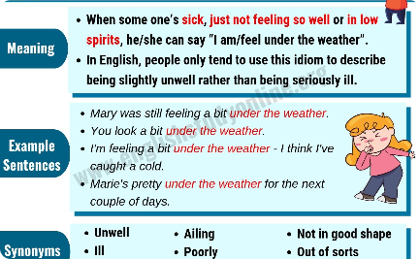
Idiomatic Expressions Using Prepositions
Head Over Heels
On the Fence
Under the Weather
When you're extremely in love, you can say you're "head over heels" for someone.
If you're undecided about something, you might be "on the fence" and need more information.
If you're feeling sick or unwell, you could say that you're "under the weather."

Slide 13
Tips for Improving Preposition Usage
1
Read and Listen
2
Practice with Native Speakers
3
Use Online Resources
Expose yourself to English materials such as books, articles, and podcasts to familiarize yourself with prepositions in context.
Take advantage of online exercises, quizzes, and tutorials that specifically target prepositions.
Engage in conversation with native English speakers and ask for feedback on your preposition usage.

