Slide 1
Lists and Arrays

Slide 2
Lists
STRINGS
Strings (a set of character - phrase -) in python are surrounded by either single quotation marks, or double quotation marks. Ex : in python 'hello' is the same as "hello".
Assign String to a Variable :
S = " hello “
print( s )
Multiline Strings
assign a multiline string to a variable by using three quotes:
a = """ welcome to pyton programming language, this is my first program,"""

Slide 3
Lists
STRINGS
Strings are Arrays
Using the position of the character to retrieve the character
Character at position number (the first character has the position 0):
a = 'python 3‘
print (a[0]) # ‘p'
print (a[2]) # ‘t'
print (a[6]) # ' ‘ blanc character
print (a[10]) # error !!! string index out of range
a
p | y | t | h | o | n |  | 3
0 | 1 | 2 | 3 | 4 | 5 | 6 | 7

Slide 4
Lists
STRINGS
Looping Through a String:
for j in "Python 3": print(j)
String Length
The len() function returns the length of a string:
a = "Hello, World!" print (len(a))
P
Y
T
H
O
N
3
13

Slide 5
Lists
STRINGS
Search : Using if statement
a = "Hello, World!, this is my first python program" if "this" in a: print("Yes, the word ‘this' is present.")
Here the condition is : ("this" in a ) which can be true or false
a = "Hello, World!, this is my first python program" print("this" in a )
True

Slide 6
Lists
A list is a data structure in Python that is sequence of elements. Each element or value that is inside of a list is called an item. Just as strings are defined as characters between quotes, lists are defined by having values between square brackets
Name_of_list = [ item1 , item 2, … , item n]
a list is used to store a collection of items(words, numbres , …. Lists are ordered, mutable (modifiable), and can contain elements of different data types, including numbers, strings, and even other lists.
L1 = [ " apple", " banana", "orange" ]

Slide 7
Lists
List of numbers
List of general data type
L1 = [ 1, 2, 3,4,5,6]
L1 = [ "hello", 0, 1, "python 3" , true]

Slide 8
Lists
colors = ['red', 'blue', 'green'] print(colors[0]) ## red print(colors[2]) ## green
print(colors[6]) ## ERROR !!!
Assignment with an = on lists does not make a copy. Instead, assignment makes the two variables point to the one list in memory.
b = colors ## Does not copy the list
b

Slide 9
Lists
Looping Through a list:
The *for* construct for var in list is an easy way to look at each element in a list (or other collection).
NB: Do not add or remove from the list during iteration.
squares = [1, 4, 9, 16] sum = 0 for num in squares: sum += num print(sum) ## 30

Slide 10
List Methods
Here are some other common list methods.
list.append(elem) -- adds a single element to the end of the list.
list.insert(index, elem) -- inserts the element at the given index, shifting elements to the right.
list.extend(list2) adds the elements in list2 to the end of the list. list.index(elem) -- searches for the given element from the start of the list and returns its index. Throws a ValueError if the element does not appear list.remove(elem) -- searches for the first instance of the given element and removes it (throws ValueError if not present)
list.sort() -- sorts the list in place. (The sorted() function shown later is preferred.)
list.reverse() -- reverses the list in place

Slide 11
Lists
my_list = [1, 2, 3, 4, 5]
# Indexing
print(my_list[0]) # Output: 1
# Slicing
print(my_list[1:3]) # Output: [2, 3]
# Appending
my_list.append(6) # Adds 6 at the end of the list
print(my_list) # Output: [1, 2, 3, 4, 5, 6]
# Removing
my_list.remove(3) # Removes the first occurrence of 3
print(my_list) # Output: [1, 2, 4, 5, 6]
# Iterating
for item in my_list:
print(item)

Slide 12
Lists - exercises
Write a Python program to sum all the items in a list.
Write a Python program to get the largest and smallest number from a list.
Write a Python program to print the numbers of even numbers from it
Write a Python program to calculate the difference between the two similar lists

Slide 13
Arrays الجداول
Arrays are lists but the main difference between them is::
Datatype : lists can contain elements of different data types (e.g., integers, strings, floats, etc.). Arrays, on the other hand, typically contain elements of the same data type.
Note: Python does not have built-in support for Arrays, but Python Lists can be used instead.
while lists are more flexible and easier to work with for general purposes, arrays offer better performance for numerical operations and are more suitable for mathematical computations.

Slide 14
Arrays الجداول
to store a collections of data there are Multiple data structures are possible (list, array, etc.)
in Python, arrays can be created using the array module from the Python Standard Library or the numpy library, and they can contain elements of the same data type.
Same datatype
1 | ok | hello | true | 0
0 | 1 | 21 | 33 | 4 | 5
List
Array

Slide 15
Arrays الجداول
Using module array of standard library
import array as arr
module Alias : to be used as reference
array_1 = arr . array ("i", [3, 6, 9, 12])
print(array_1)
the "i" signifies that all elements in array_1 are integers:

Slide 16
Arrays الجداول
2- Using library "numpy" : NumPy arrays support different data types. To create a NumPy array, you only need to specify the items
import numpy as np
array_2 = np.array(["numbers", 3, 6, 9, 12])
print (array_2)
print(type(array_2))
['numbers' '3' '6' '9' '12']
<class 'numpy.ndarray'>
array_2 contains one item of the string type (i.e., "numbers") and four integers.

Slide 17
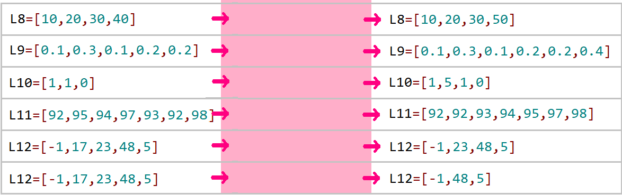
What command line should be entered to transition from the current list to the desired list?
Current list desired list

Slide 18
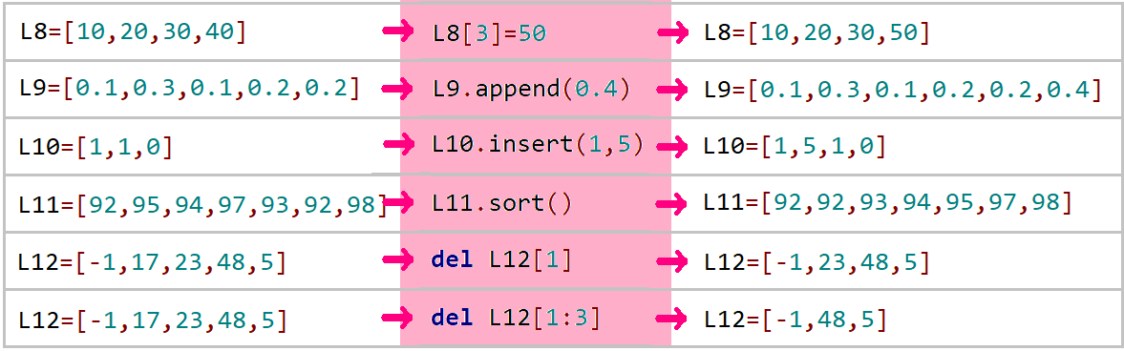

Slide 19
Generate a list of terms from a sequence.
Create a list of sequence example [0,2,4,6,8,10,12, …]
L = [ expression for n in range(k))]
Create a list of Un for n = 0 to k-1
Example
>>> L6 = [ 3*n +1 for n in range(11) ]
>>> L6
[1, 4, 7, 10, 13, 16, 19, 22, 25, 28, 31]

Slide 20
Provide the Python command that creates a list of term Un.​ Un= 50 + 10 x n for n = 0 to 30
Provide the Python command that creates the list of 100 elements that contains Zero value
L2 = [ 0 for k in range(100)]

Slide 21
Provide the Python command that creates the list of 50 first elements of odds numbers
Provide the Python command that creates the list of 50 first elements that are divided by 3

Slide 22
Arrays / Lists 2D (matrix)
Python provides powerful data structures called lists, which can store and manipulate collections of elements. Also provides many ways to create 2-dimensional lists/arrays.
Using 2D arrays/lists the right way involves understanding the structure, accessing elements, and efficiently manipulating data in a two-dimensional grid.
0 1 2 3
columns
Rows
0
1
2
3

Slide 23
Lists / Arrays 2D
Create Lists/Arrays 2D (Matrix)
Name_of_list =[ [ elem, elem , …] , [elem , elem, …] ]
Example
L1 = [[1,2,3,0] ,[5,6,7,1] ,[1,0,1,0] ,[0,0,0,0]]
0 1 2 3
0 | 1 | 2 | 3 | 0
1 | 5 | 6 | 7 | 1
2 | 1 | 0 | 1 | 0
3 | 0 | 0 | 0 | 0

Slide 24
Example
a = [[1, 2, 3], [4, 5, 6]]
print(a[0])
print(a[1])
b = a[0]
print(b)
print(a[0][2])
a[0][1] = 7
print(a)
print(b)
b[2] = 9
print(a[0])
print(b)
[1, 2, 3]
[4, 5, 6]
[1, 2, 3]
3
[[1, 7, 3], [4, 5, 6]]
[1, 7, 3]
[1, 7, 9]
[1, 7, 9]
0 1 2
0 | 1 | 2 | 3
1 | 4 | 5 | 6

Slide 25
Len(a) ------------ 2
Len(a[0]) ---------- 3
Try this code?
a = [[1, 2, 3, 4], [5, 6], [7, 8, 9]]
for i in range(len(a)):
for j in range(len(a[i])):
print(a[i][j], end=' ')
print()
1 | 2 | 3 | 4
5 | 6
7 | 8 | 9
a[1][2] return error list index out of range

Slide 26
Same code as previous
a = [[1, 2, 3, 4], [5, 6], [7, 8, 9]]
for row in a:
for elem in row:
print(elem, end=' ')
print()
1 | 2 | 3 | 4
5 | 6
7 | 8 | 9

Slide 27
Generate a 2-D list of terms from a sequence.
a1 = [[0,0,0]]*3 [[0, 0, 0], [0, 0, 0], [0, 0, 0]]
a2 = [[0]*3]*3 [[0, 0, 0], [0, 0, 0], [0, 0, 0]]
Rows Value
Column count
L = [ [expression] for n in range(k)]
Create a list 2D of Un with k-1 rows
L6 = [ [a for a in range(3) ] for n in range(4)]
[[0, 1, 2], [0, 1, 2], [0, 1, 2], [0, 1, 2]]

Slide 28
Exercises
Code for generate this ?
L1= [[0, 2, 4, 6, 8], [0, 2, 4, 6, 8], [0, 2, 4, 6, 8], [0, 2, 4, 6, 8], [0, 2, 4, 6, 8]]
calculate the sum of all the numbers
Make diagonal as 0
Calculate the max and min

Slide 29
Files in python
In Python, the open function is used to edit a file. This function takes the file path (relative or absolute) as its first parameter and the opening mode as its second parameter.
A relative path in computing is a path that considers the current location of reading.
An absolute path is a complete path that can be read regardless of the reading location.

Slide 30
Files in python
Example of open function
>>> MyFile = open("data.txt", "r")
>>> print fichier
<open file 'data.txt', mode 'r' at 0x7ff6cf3fe4b0>
it is noted that the second parameter is indicated by an 'r', this parameter indicates that the file is opened in read mode .

Slide 31
The opening modes are as follows:
'r' stands for opening in read mode (READ).
'w' stands for opening in write mode (WRITE), where the file's
content is overwritten with each opening. If the file doesn't
exist, Python creates it.
'a' stands for opening in append mode at the end of the file (APPEND).
If the file doesn't exist, Python creates it.
'b' stands for opening in binary mode.
't' stands for opening in text mode.
'x' creates a new file and opens it for writing.

Slide 32
Close a file
Use the function close() .
>>> MyFile.close()

Slide 33
Read the content of a file
for reading the file you can utilize the function read on file object
# coding: utf-8
file= open("data.txt", "r")
print file.read()
file.close()

Slide 34
Writing in a file
In order to write a text in the file use the function write :
f = open("data.txt", "a")
f.write(« hello world")
f.close()

