Slide 1
Intro to Javascript

Slide 2
Javascript Syntax

Slide 3
Variables
var name = expression; JS
var clientName = "Connie Client";
var age = 32;
var weight = 127.4; JS
variables are declared with the var keyword (case sensitive)
types are not specified, but JS does have types ("loosely typed")
Number, Boolean, String, Array, Object, Function, Null, Undefined
can find out a variable's type by calling typeof

Slide 4
Number type
var enrollment = 99;
var medianGrade = 2.8;
var credits = 5 + 4 + (2 * 3); JS
integers and real numbers are the same type (no int vs. double)
same operators: + - * / % ++ -- = += -= *= /= %=
similar precedence to Java
many operators auto-convert types: "2" * 3 is 6
But "2" + 3 is "23"

Slide 5
Comments (same as Java)
// single-line comment
/* multi-line comment */ JS
identical to Java's comment syntax
recall: 4 comment syntaxes
HTML: <!-- comment -->
CSS/JS/PHP: /* comment */
Java/JS/PHP: // comment
PHP: # comment

Slide 6
Math object
var rand1to10 = Math.floor(Math.random() * 10 + 1);
var three = Math.floor(Math.PI); JS
methods: abs, ceil, cos, floor, log, max, min, pow, random, round, sin, sqrt, tan
properties: E, PI

Slide 7
Special values: null and undefined
var ned = null;
var benson = 9;
// at this point in the code,
// ned is null
// benson's 9
// caroline is undefined JS
undefined : has not been declared, does not exist
null : exists, but was specifically assigned an empty or null value

Slide 8
Logical operators
> < >= <= && || ! == != === !==
most logical operators automatically convert types:
5 < "7" is true
42 == 42.0 is true
"5.0" == 5 is true
=== and !== are strict equality tests; checks both type and value
"5.0" === 5 is false

Slide 9
if/else statement (same as Java)
if (condition) {
statements;
} else if (condition) {
statements;
} else {
statements;
}
JS
identical structure to Java's if/else statement
JavaScript allows almost anything as a condition

Slide 10
Boolean type
var iLike190M = true;
var ieIsGood = "IE6" > 0; // false
if ("web devevelopment is great") { /* true */ }
if (0) { /* false */ } JS
any value can be used as a Boolean
"falsey" values: 0, 0.0, "", and “0.0"
"truthy" values: almost anything else
converting a value into a Boolean explicitly:
var boolValue = Boolean(otherValue);
var boolValue = !!(otherValue);

Slide 11
for loop (same as Java)
var sum = 0;
for (var i = 0; i < 100; i++) {
sum = sum + i;
} JS
var s1 = "hello";
var s2 = "";
for (var i = 0; i < s.length; i++) {
s2 += s1.charAt(i) + s1.charAt(i);
}
// s2 stores "hheelllloo" JS

Slide 12
while loops (same as Java)
while (condition) {
statements;
} JS
do {
statements;
} while (condition); JS
break and continue keywords also behave as in Java

Slide 13
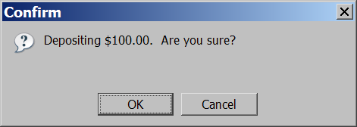
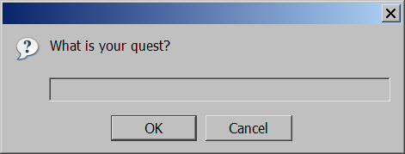
Popup boxes
alert("message"); // message
confirm("message"); // returns true or false
prompt("message"); // returns user input string JS

Slide 14
Popup boxes
confirm("message");
Example
if(confirm("are you right")==true){
response = "he is right";
}else
{
response ="he isn't right";
} JS

Slide 15
Popup boxes
prompt("message");
Example
s = prompt("what do you think about?"); JS

Slide 16
Arrays
var name = []; // empty array
var name = [value, value, ..., value]; // pre-filled
name[index] = value; // store element JS
var ducks = ["Huey", "Dewey", "Louie"];
var stooges = []; // stooges.length is 0
stooges[0] = "Larry"; // stooges.length is 1
stooges[1] = "Moe"; // stooges.length is 2
stooges[4] = "Curly"; // stooges.length is 5
stooges[4] = "Shemp"; // stooges.length is 5 JS
Notes:
two ways to initialize an array
length property (grows as needed when elements are added)

Slide 17
Arrays
Example
var t = [];
t[5] = 9;
What are the values in t[0], t[1], .. , t[4]?
Response
These values are undefined
Notes:
two ways to initialize an array
length property (grows as needed when elements are added)

Slide 18
Array methods
var a = ["Stef", "Jason"]; // Stef, Jason
a.push("Brian"); // Stef, Jason, Brian
a.pop(); // Kelly, Stef, Jason
a.unshift("Kelly"); // Kelly, Stef, Jason, Brian
a.shift(); // Stef, Jason
a.sort(); // Jason, Stef
array serves as many data structures: list, queue, stack, ...
methods: concat, join, pop, push, reverse, shift, slice, sort, splice, toString, unshift
push and pop add / remove from back
unshift and shift add / remove from front
shift and pop return the element that is removed

Slide 19
String type
var s = "Connie Client";
var fName = s.substring(0, s.indexOf(" ")); // "Connie"
var len = s.length; // 13
var s2 = 'Melvin Merchant'; JS
methods: charAt, charCodeAt, fromCharCode, indexOf, lastIndexOf, replace, split, substring, toLowerCase, toUpperCase
charAt returns a one-letter String (there is no char type)
length property (not a method as in Java)
Strings can be specified with "" or ''
concatenation with + :
1 + 1 is 2, but "1" + 1 is "11"

Slide 20
More about String
escape sequences behave as in Java: \' \" \& \n \t \\
converting between numbers and Strings:
var count = 10;
var s1 = "" + count; // "10"
var s2 = count + " bananas, ah ah ah!"; // "10 bananas, ah ah ah!"
var n1 = parseInt("42 is the answer"); // 42
var n2 = parseFloat("booyah"); // NaN JS
accessing the letters of a String:
var firstLetter = s[0]; // fails in IE
var firstLetter = s.charAt(0); // does work in IE
var lastLetter = s.charAt(s.length - 1); JS

Slide 21
Splitting strings: split and join
var s = "the quick brown fox";
var a = s.split(" "); // ["the", "quick", "brown", "fox"]
a.reverse(); // ["fox", "brown", "quick", "the"]
s = a.join("!"); // "fox!brown!quick!the" JS
split breaks apart a string into an array using a delimiter
can also be used with regular expressions (seen later)
join merges an array into a single string, placing a delimiter between them

Slide 22
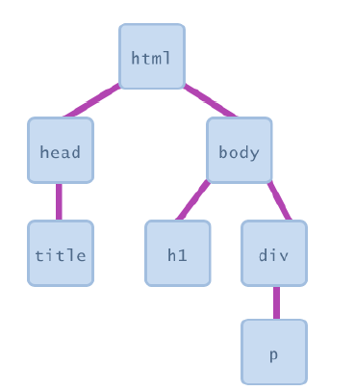
Document Object Model (DOM)
most JS code manipulates elements on an HTML page
we can examine elements' state
e.g. see whether a box is checked
we can change state
e.g. insert some new text into a div
we can change styles
e.g. make a paragraph red

Slide 23
Accessing elements: document.getElementById
document.getElementById returns the DOM object for an element with a given id
can change the text inside most elements by setting the innerHTML property
can change the text in form controls by setting the value property

Slide 24
Changing element style: element.style
Attribute | Property or style object
color | color
padding | padding
background-color | backgroundColor
border-top-width | borderTopWidth
Font size | fontSize
Font famiy | fontFamily

Slide 25
Onclick Event
onclick property is used within an HTML element to run a JavaScript function.
Example

Slide 26
Onclick Event
onclick property is used within an HTML element to run a JavaScript function.
Example

Slide 27
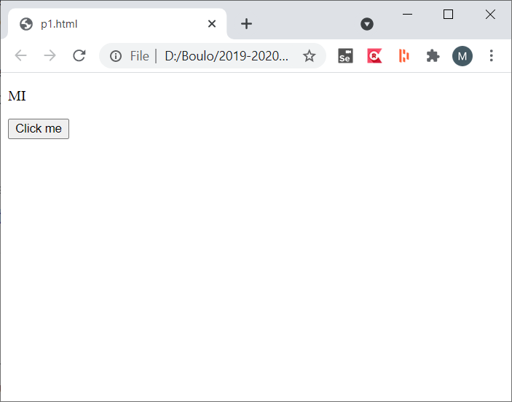
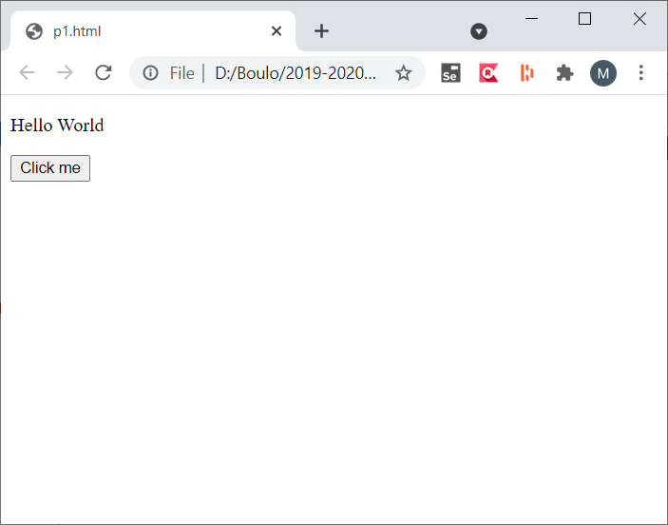
Onclick Event
onclick property is used within an HTML element to run a JavaScript function.
Example

Slide 28
Read values from form inputs
Text: document.getElementById('textInput').value;
Number: document.getElementById('numberInput').value;
Textarea: document.getElementById('textareaInput').value;
Select: document.getElementById('selectInput').value;
Checkbox: document.getElementById('checkboxInput').checked;

