Slide 1
Web application development
تطوير برامج الواب
Version 1.0

Slide 2
Content
How to be a web developer ?
Practical guide to be a professional web developer
Front-end developer
Back-end developer
Full-stack developer
HTML language

Slide 3
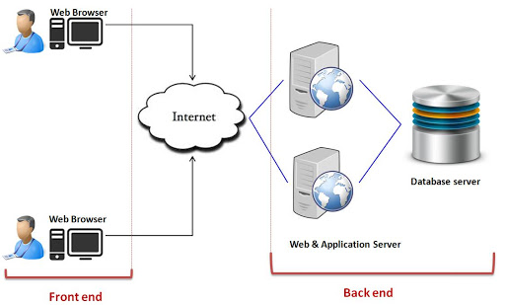
How to be a web developer ?
You simply need to learn new programming languages
But a web application has two parts
One runs on the server computer (back-end)
The second which runs on the client computer (front-end)

Slide 4
Practical guide to be a professional web developer
I’ve decided to learn to code. I like the web. I’m not sure where to start.
Try to be “Front-end web developer”.
Learn HTML
Learn Basic JavaScript
Learn CSS

Slide 5
Practical guide to be a professional web developer
Move to the be “Back-End developer”
PHP
Node.js
Django (Python)
Java solutions (JSF, Spring boot, …)
….

Slide 6
Practical guide to be a professional web developer
PHP back-end development
……

Slide 7
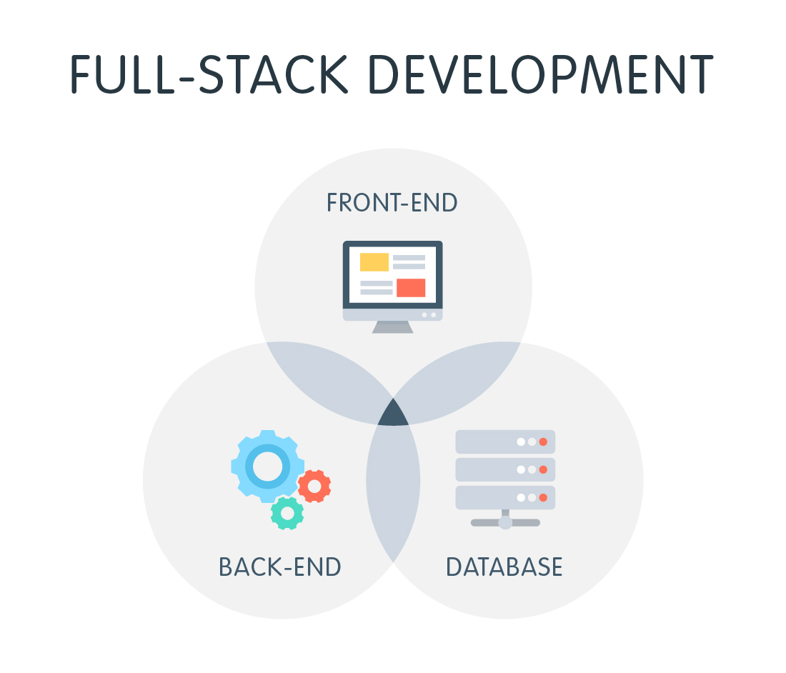
Practical guide to be a professional web developer
I need to choose between : Front-end, Back-end or Full-stack developer ?

Slide 8
HTML
Getting Started
I simply need a text editor like
Notepad of Ms Windows
TextEdit of Mac OSX
Notepad ++
Sublime 3
Atom

Slide 9
HTML
Getting Started
To run my code, I need one of those browsers
Chrome
Mozilla Firefox
Safari
Internet Explorer
…..

Slide 10
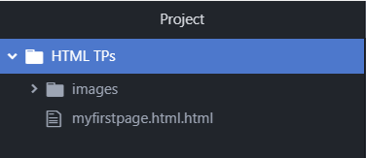
HTML
My first project
Create a folder X any where
Type in your editor “This is my first page”
Save this as “myfirstpage.html”
Open this file with your browser

Slide 11
HTML
My first page

Slide 12
HTML
My first page

Slide 13
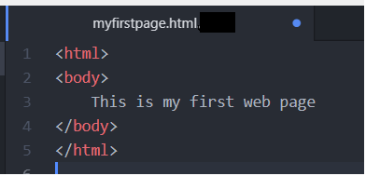
HTML
Tags, Attributes and Elements
Tags
Change your document so that it looks like this
Opening Tags <html>, <body>, ….
Closing Tags </html>, </body>, …

Slide 14
HTML
Tags, Attributes and Elements
Tags

Slide 15
HTML
Tags, Attributes and Elements
Attributes
Within opening tags, we can add attributes
Example

Slide 16
HTML
Tags, Attributes and Elements
Element
Tags tend not to do much more than mark the beginning and end of an element.
Example

Slide 17
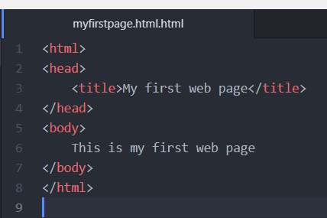
HTML
Page title
To add a title to your page, change your code so that it looks like this

Slide 18
HTML
Page title
To add a title to your page, change your code so that it looks like this

Slide 19
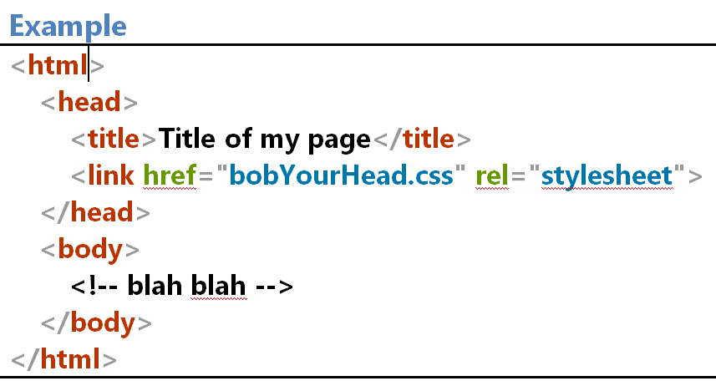
HTML
Head
It should be the first element inside an html element.
A title element is required within the head element.
meta, style, base, link, and script can also be used.

Slide 20
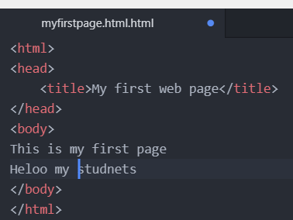
HTML
Paragraphs
Go back to your text editor and add another line to your page
But why the texts are in the same line ?

Slide 21
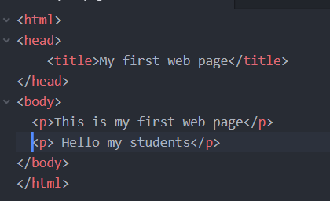
HTML
Paragraphs
Change your two lines of content so that they look like this

Slide 22
HTML
Paragraphs
Change your two lines of content so that they look like this

Slide 23
HTML
Paragraph emphasis
Within <p> element we can add other sub-elements
<em> …… </em> for italic text
<strong>…..</strong> for bold text
….
Example
Change your second paragraph so that it looks like this

Slide 24
HTML
Paragraph emphasis

Slide 25
HTML
Line break
The line-break tag can also be used to separate lines like this

Slide 26
HTML
Headings
The p tag is just the start of text formatting
They are h1, h2, h3, h4, h5 and h6

Slide 27
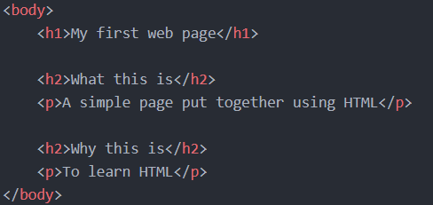
HTML
Heading
Example
h1 largest
h2 smaller
….. h6 smallest

Slide 28
HTML
Lists
Ordered list <ol> قوائم مرتبة
Unordered list <ul> قوائم غير مرتبة
Nested listsقوائم متداخلة
within <ol> and <ul> we can add list items <li>

Slide 29
HTML
Unordered Lists (Example 1)
Example
Change your code to the following

Slide 30
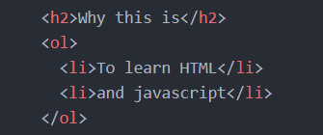
HTML
Ordered Lists (Example 2)
Example
Change your code to the following

Slide 31
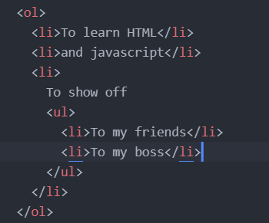
HTML
Nested Lists
We can add <ul> within <ol> and vice versa.
Example
Change your code to the following

Slide 32
HTML
Description lists <dl>
Similar to <ol> and <ul>
<dl> stands for description list, defines the descriptions list
<dl> contains <dt> elements
one <dt> contains one or more <dd> elements.
see the following example

Slide 33
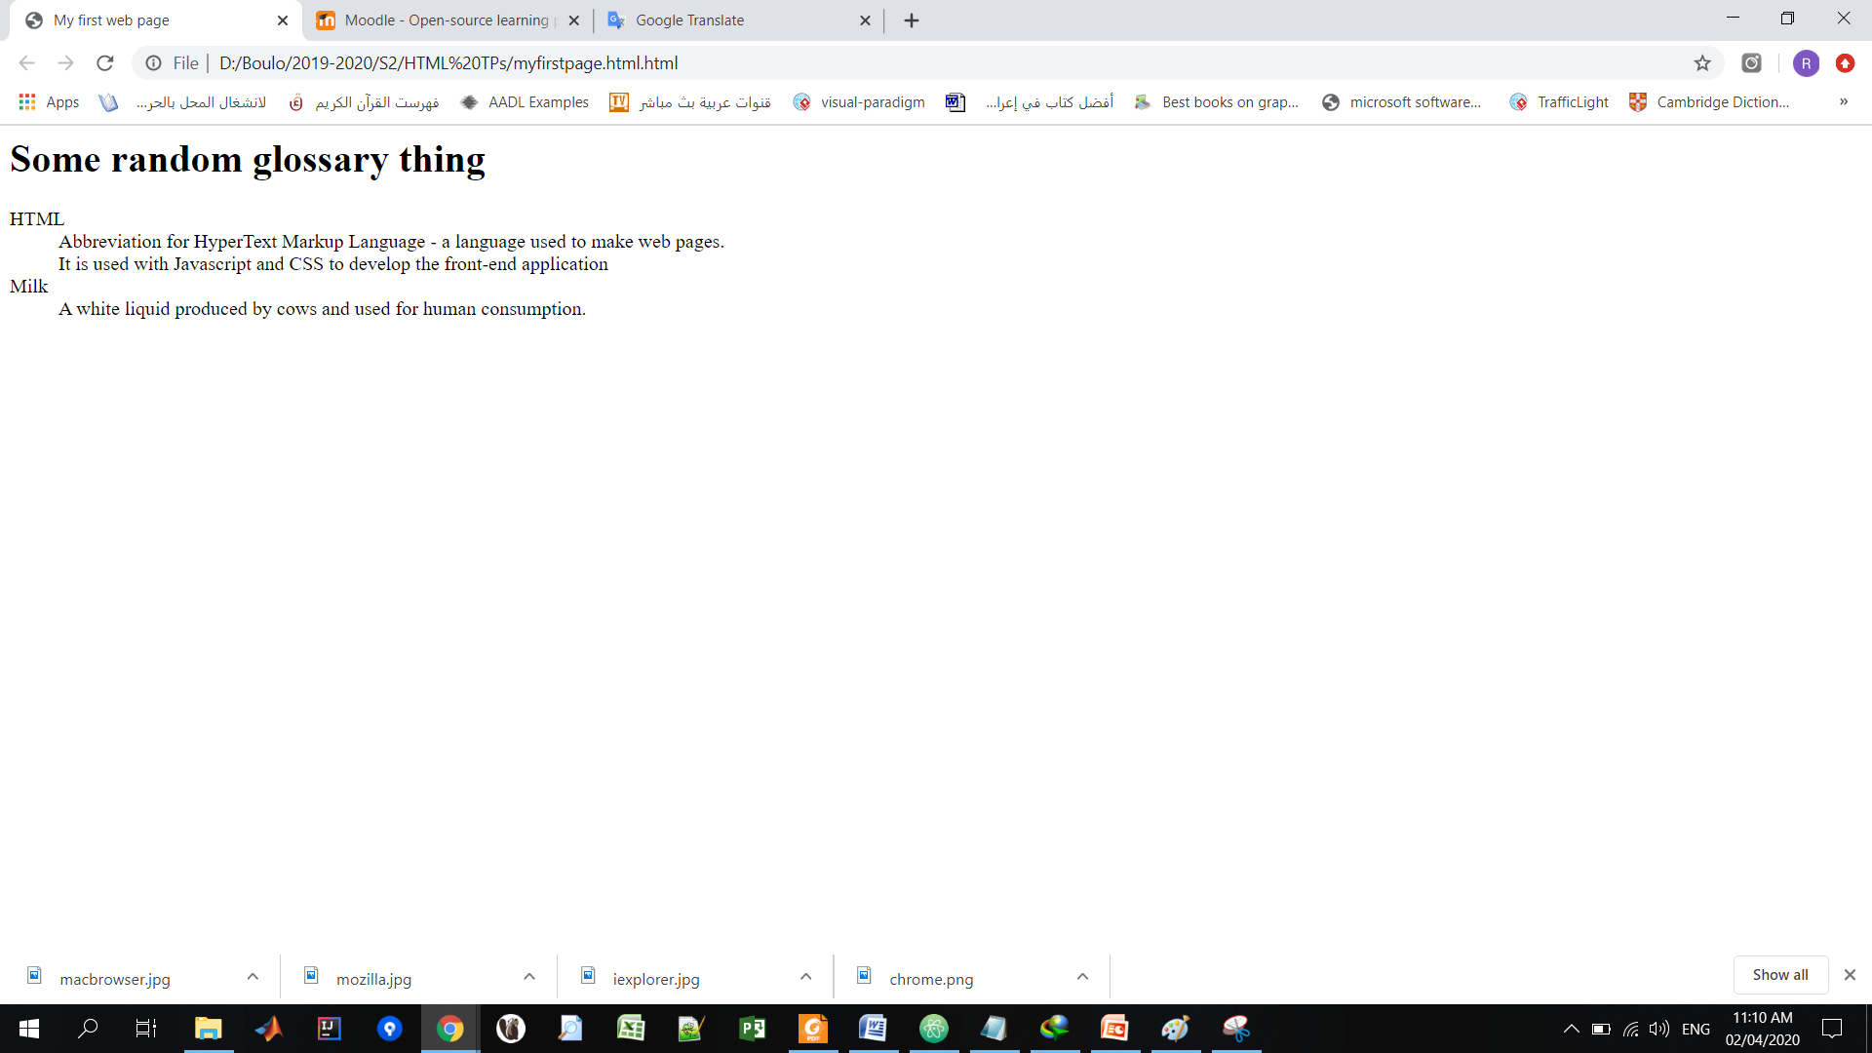
HTML
Description lists <dl>
Example
Change your code to the following

Slide 34
HTML
Definition terms
<dfn> is a definition term and is used to highlight the first use of a term.
Example

Slide 35
HTML
Links
The “HT” in HTML stands for “Hypertext ”.
It means a system of linked texts.
To create a link we use the tag <a>.
The link allows to go from one page p1 to another p2, or
To navigate in the same page.

Slide 36
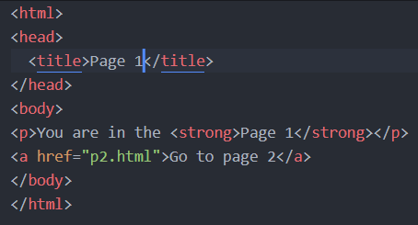
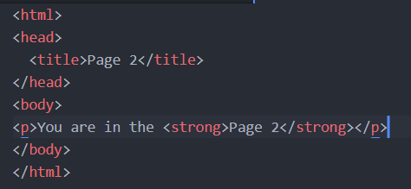
HTML
Links
Example
p1.html
p2.html
The href=“p2.html” attribute determines the target page

Slide 37
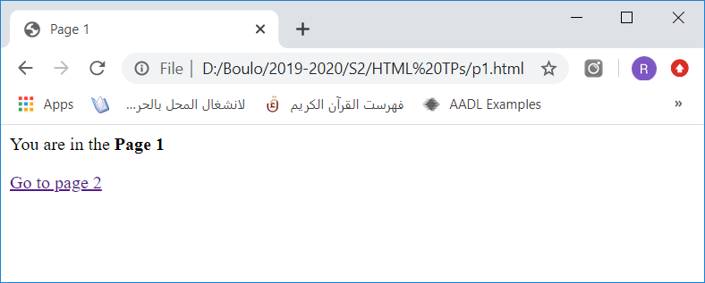
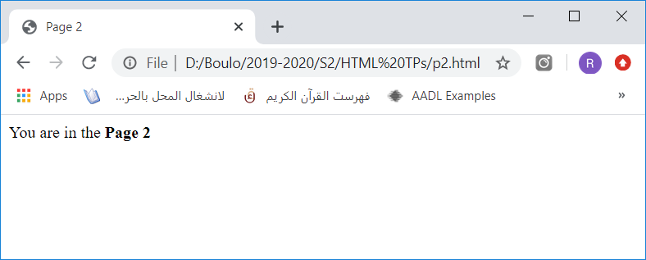
HTML
Links
Example

Slide 38
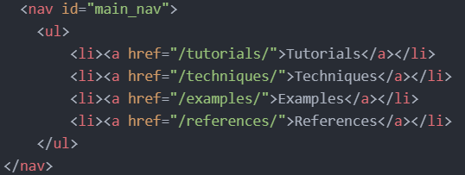
HTML
Navigation
<nav> is used to mark up a group of navigation links.

Slide 39
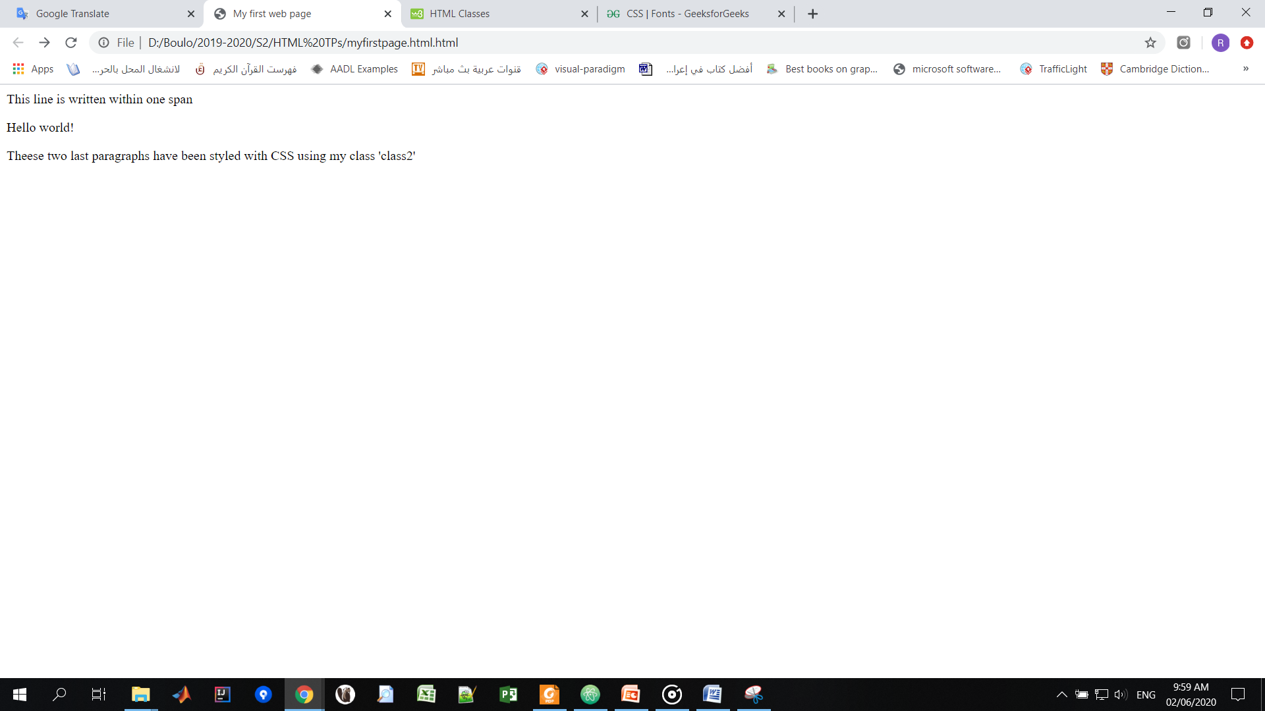
HTML
<span> and <div>
span and div tags are usually used in conjunction with CSS.
They are used to group a chunk of HTML parts.
Example
Add one <span> and one <div> to your page like following
But there’s no styles

Slide 40
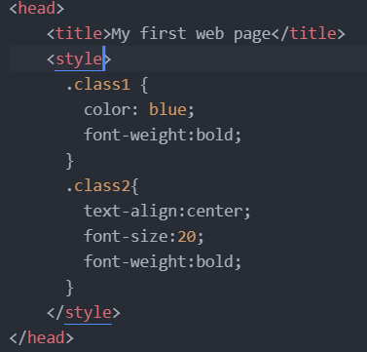
HTML
<span> and <div>
Example
How to style <span> and <div> contents using their class ids
CSS Style
Change the head of your page by adding this style element

Slide 41
HTML
Tables: rowspan and colspan
Table <table> is simply composed from three elements
Heading <th>
Rows <tr>
And Columns

Slide 42
HTML
Tables: rowspan and colspan
Example
<th>
<tr>
rowspan="2"
colspan="2"

Slide 43
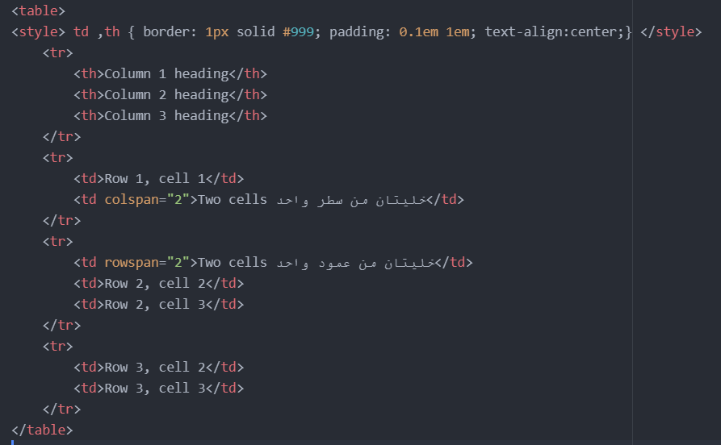
HTML
Tables: rowspan and colspan
Example

Slide 44
HTML
Images
The <img> tag is used to put an image in an HTML document
The most commonly used format for images are
JPEGs, GIFs, and PNGs.
Example

Slide 45
HTML
Forms
Forms are used to collect data inputted by the user
They are also used to send collected data across the web.
Example

Slide 46
HTML
Forms
Methods GET and POST
With GET method, data are shown in the address bar
with POST, data are not hidden
Example 1 (GET)

Slide 47
HTML
Forms
Example 1 (GET)
Before sending data

Slide 48
HTML
Forms
Example 1 (GET)
After sending data

Slide 49
HTML
Forms
Example 2 (POST)

Slide 50
HTML
Forms
Example 2 (POST)
Before sending data

Slide 51
HTML
Forms
Example 2 (POST)
After sending data

Slide 52
HTML
Forms (organization with table)
To organize form elements, we can use <table> within it
Example

Slide 53
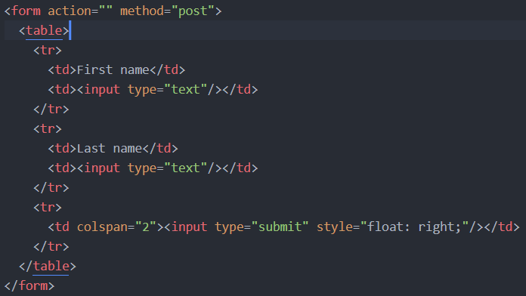
HTML
Forms
Example 1
Note
<table> is used here for organization

Slide 54
HTML
Forms
<form> contains different elements : <input>, <textarea>,…
<input type="text">
<input type="password">
<input type="checkbox">
<input type="radio">
<input type="submit">
<textarea rows="5" cols="20">
<select>
…

Slide 55
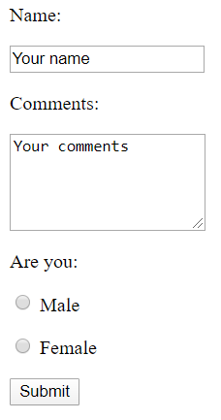
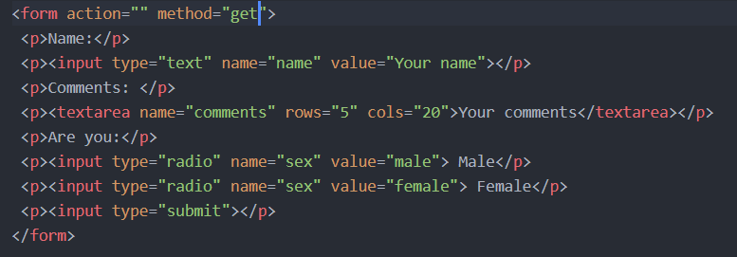
HTML
Forms
Example
variables
Initial values

Slide 56
CSS
Definition
CSS stands for Cascading Style Sheets.
It’s used to customize the look and feel of the HTML elements on your page.
CSS describes how HTML elements should be displayed.

Slide 57
CSS
CSS Solved a Big Problem
HTML was NEVER intended to contain tags for formatting a web page!
HTML was created to describe the content of a web page, like:
<h1>This is a heading</h1>
<p>This is a paragraph.</p>
When HTML 3.2 added <font> and color attribute it starts a nightmare for web developers
Because fonts and color information were added to every single page.
To solve this problem, the World Wide Web Consortium created CSS.

Slide 58
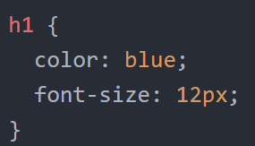
CSS
CSS Syntax
A CSS rule-set consists of a selector and a declaration block
Example

Slide 59
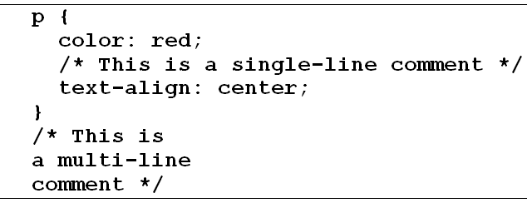
CSS
CSS comments
A CSS comment starts with /* and ends with */.
Example

Slide 60
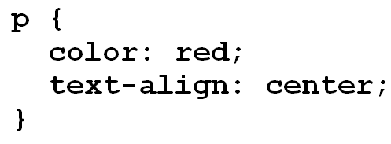
CSS
CSS Selectors
CSS element Selector
Example

Slide 61
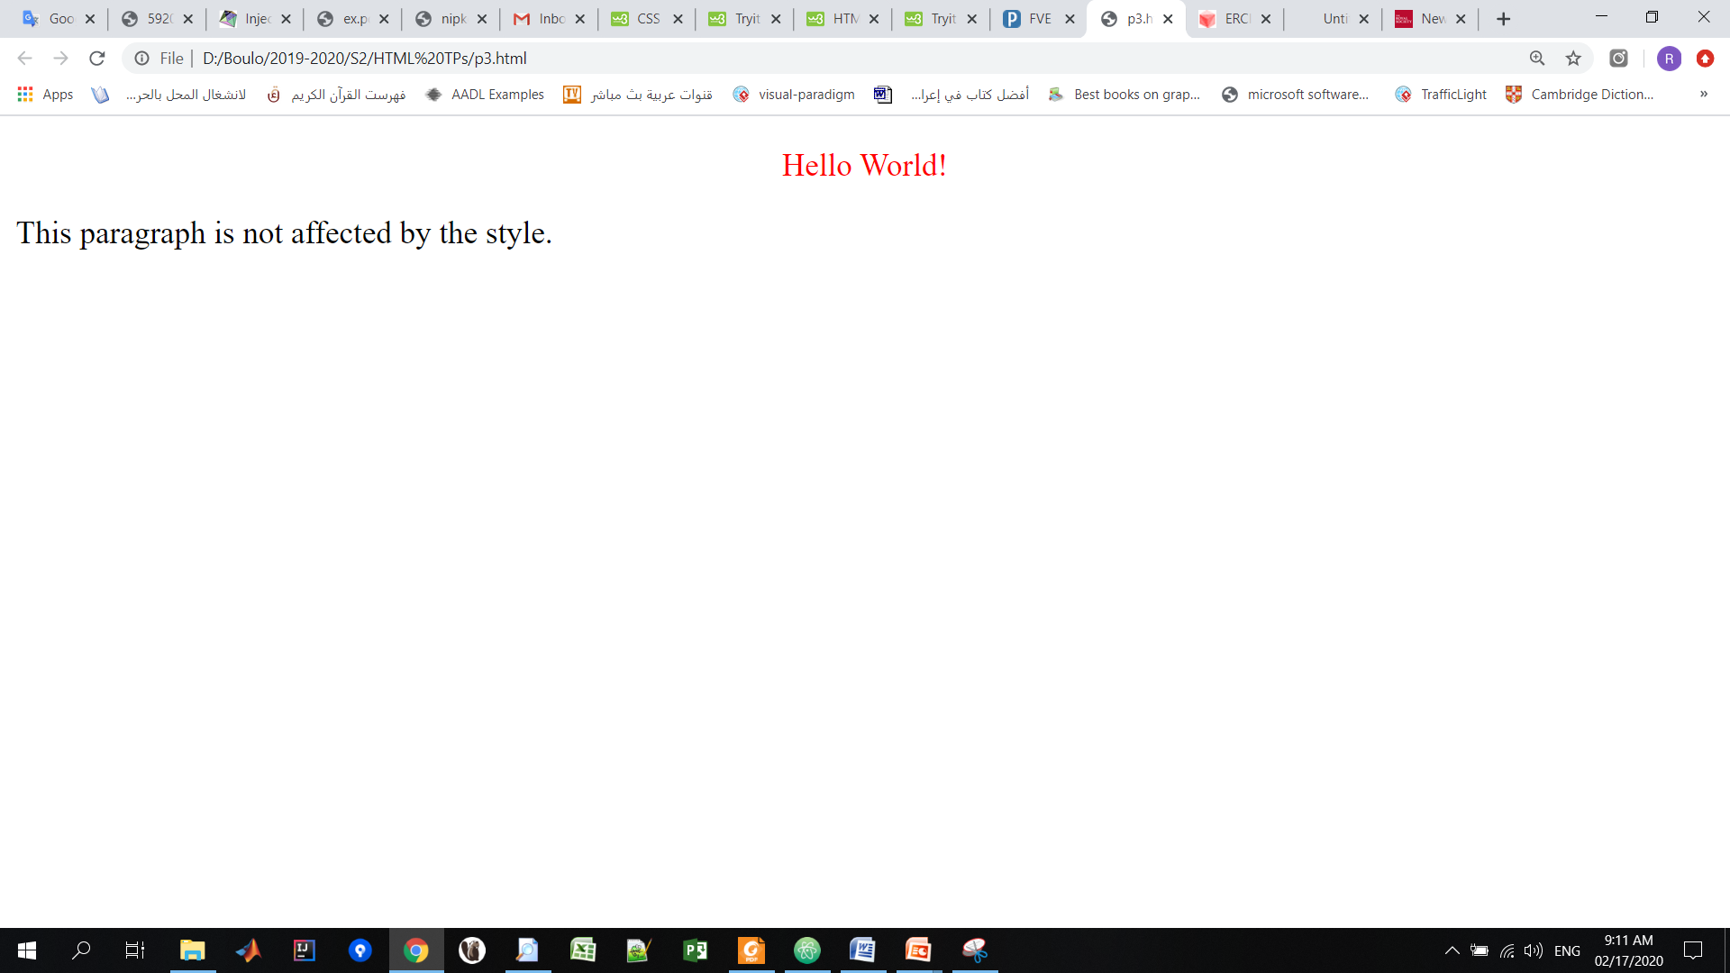
CSS
CSS Selectors
CSS id Selector (#)
Example

Slide 62
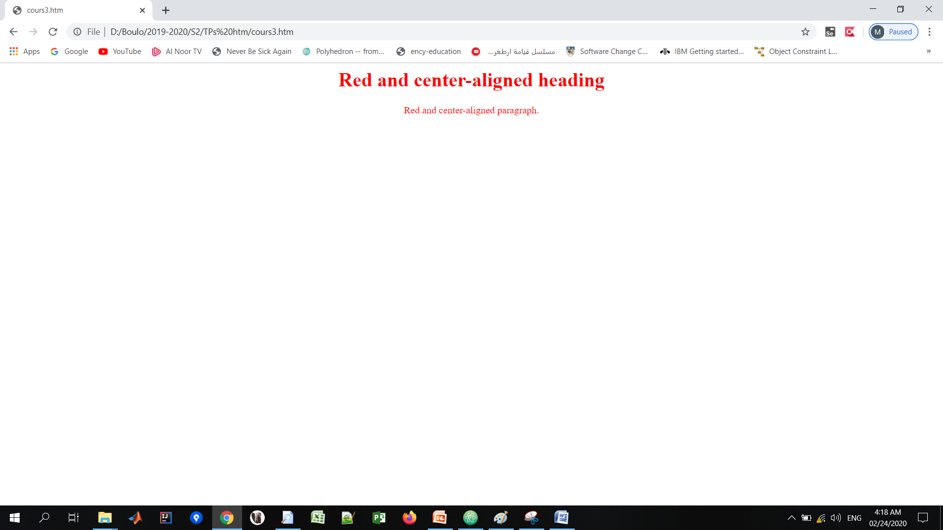
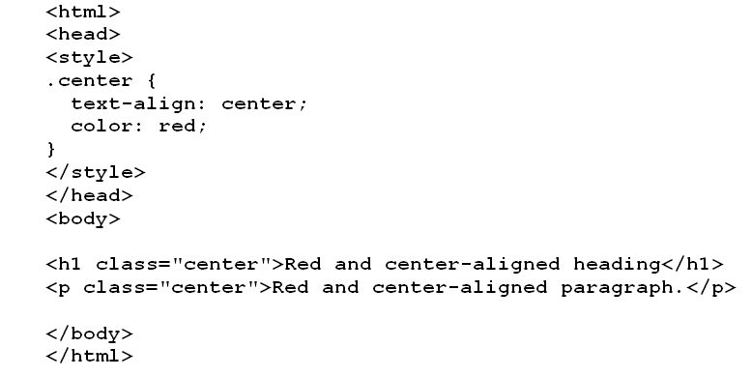
CSS
CSS Selectors
CSS class Selector (.)
Example

Slide 63
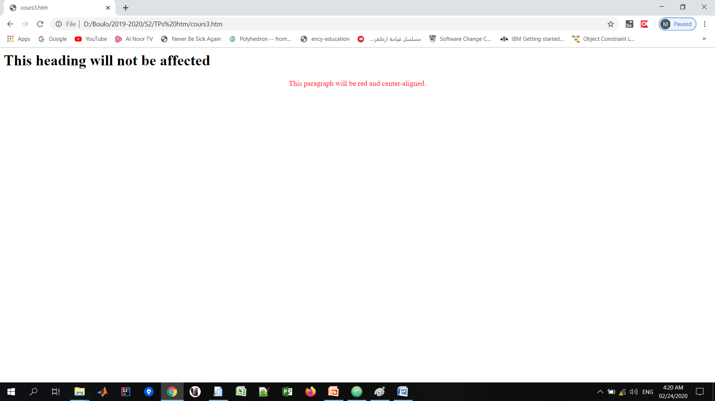
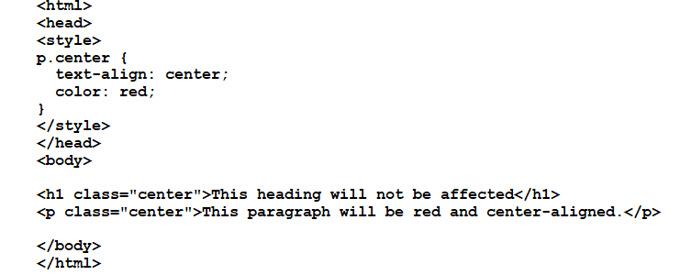
CSS
CSS Selectors
CSS class Selector
You can also specify that only specific HTML elements should be affected by a class.
Example

Slide 64
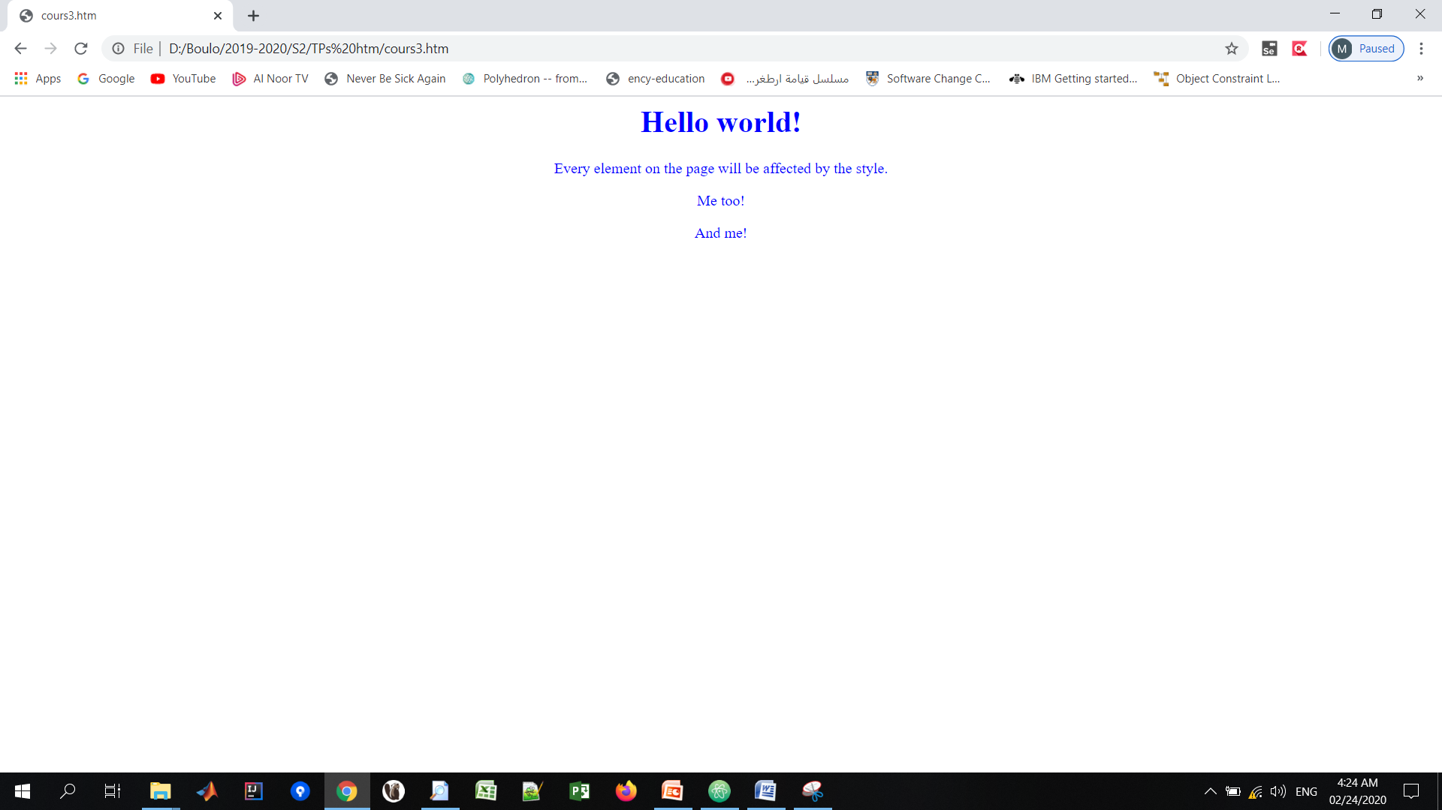
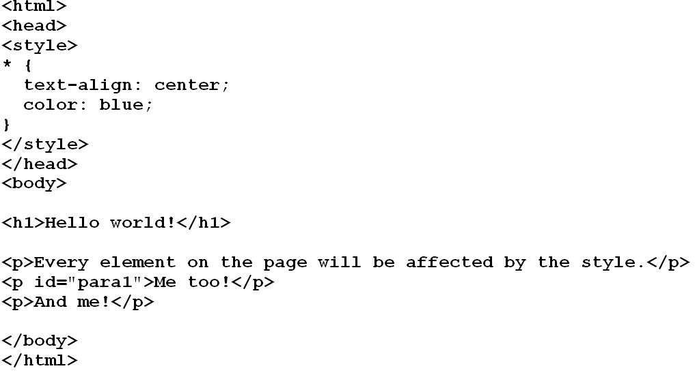
CSS
CSS Selectors
CSS Universal Selector (*)
The universal selector (*) selects all HTML elements on the page
Example

Slide 65
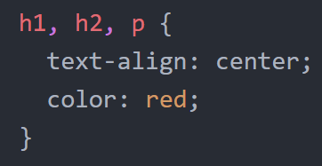
CSS
CSS Selectors
CSS Grouping Selector
The grouping selector selects all the HTML elements with the same style definitions.
It will be better to group the selectors, to minimize the code.
To group selectors, separate each selector with a comma.
Example

Slide 66
CSS
How to add CSS style
There are three ways
Inline CSS
Internal CSS
External CSS
Example (inline Style)

Slide 67
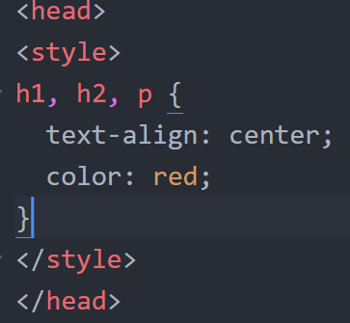
CSS
How to add CSS style
Internal
Added in the head of the page
Example (Internal Style)

Slide 68
CSS
How to add CSS style
External
External Styles are defined in a separated css file.
External styles are declared within the <link> element inside the <head> section.

Slide 69
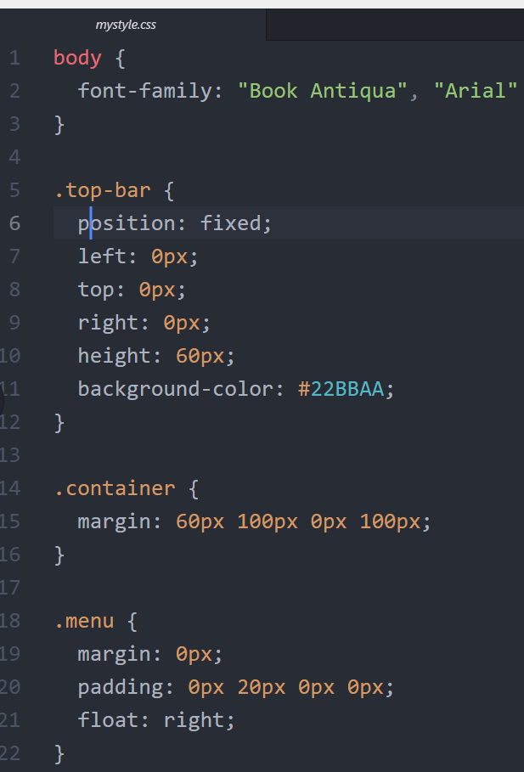
CSS
mystyle.css
How to add CSS style
External Style
Example

Slide 70
CSS
How to add CSS style
External Style
Example

Slide 71
CSS
How Cascading Order
What style will be used when there is more than one style specified ?
Number one has the highest priority.
Inline style (inside an HTML element)
Internal style
External style

Slide 72
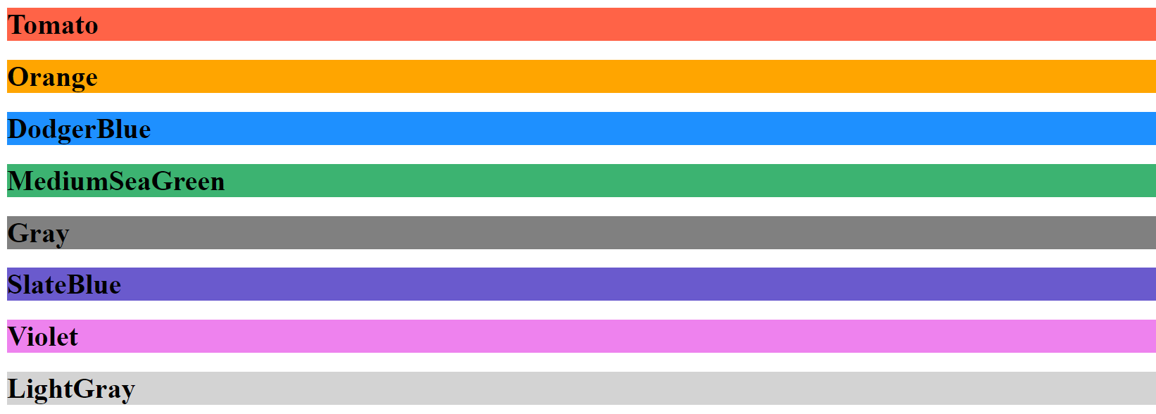
CSS
CSS Color
Colors are specified using predefined color names, or RGB, HEX, HSL, RGBA, HSLA values.
Color Names
CSS/HTML support 140 standard color names.
Example

Slide 73
CSS
CSS Color
2. RGB
RGB stands for Red, Green, Blue
Example

Slide 74
CSS
CSS Color
3. RGBA
RGBA stands for Red, Green, Blue, Alpha
Alpha adds transparency to the color
0.0 (fully transparent) and 1.0 (not transparent at all)
Example

Slide 75
CSS
CSS Color
3. HEX Value
In CSS, a color can be specified using a hexadecimal value in the form: #rrggbb
Example

Slide 76
CSS
CSS Color
3. HEX Value
In CSS, a color can be specified using a hexadecimal value in the form: #rrggbb
Hex color is another representation of RGB colors
Example
#ff0000 → RGB(255, 0 , 0) → red

Slide 77
CSS
Inline Vs block display (HTML)
All HTML elements (tags) are assigned a display property value of either inline or block.
Inline elements display in browsers horizontally.
[INLINE ELEMENT 1] [INLINE ELEMENT 2] [INLINE ELEMENT 3]
Block elements display in browsers vertically (stacked one on top of the other).
[BLOCK ELEMENT 1] [BLOCK ELEMENT 2] [BLOCK ELEMENT 3]

Slide 78
CSS
Inline Vs block display (HTML)
Examples of inline elements:
<a> <img> <strong> <em> <span>
Examples of block elements:
<p> <h1-h6> <div> <hr> <table> <ul> <ol>

Slide 79
CSS
Inline Vs block display (CSS)
Using CSS, you can change the inherent display property:
To force a block display, use the declaration display: block;
To force an inline display, use the declaration display: inline;
To force an inline display, use the declaration display: inline-block; (div)
To force a list, use the declaration display: list-item;
To hide elements matching the selector, use the declaration display: none;

Slide 80
CSS
Margins and Padding
A- If the margin property has 4 values:
margin: 40px 100px 120px 80px;
1. top = 40px 2. right = 100px 3. bottom = 120px 4. left = 80px
B- If the margin property has 3 values:
margin:40px 100px 120px;
1. top = 40px 2. right and left = 100px 3. bottom = 120px

Slide 81
CSS
Margins and Padding
C- If the margin property has 2 values:
margin: 40px 100px;
Top and bottom = 40px
Right and left = 100px
D- If the margin property has 1 value:
margin: 40px;
top, bottom, right and left = 40px

Slide 82
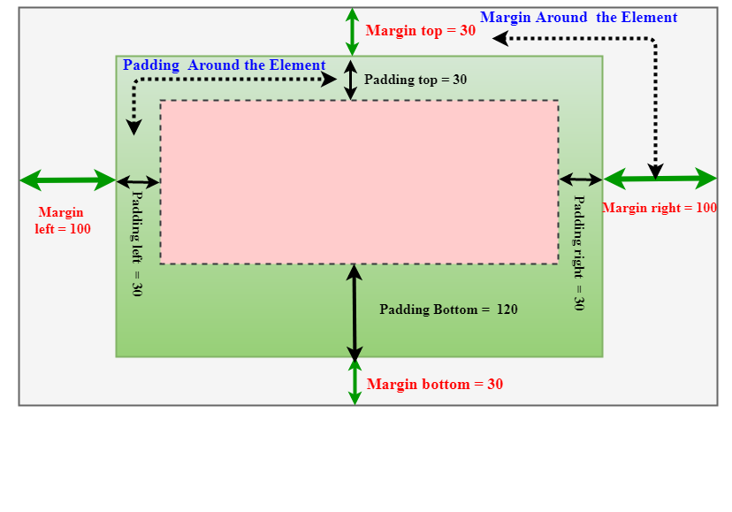
CSS
Margins and Padding

Slide 83
CSS
Display property
display: block;
Elements with ‘display: block’ occupy the full width of their containing element and start on a new line.
They stack on top of each other vertically.
display: inline;
Elements with ‘display: inline’ occupy only the space bounded by the content and do not start on a new line.
They flow along with adjacent inline elements.

Slide 84
CSS
Display property
display: inline-block;
Elements with ‘display: inline-block’ are similar to inline elements, but they can have padding, margins, and dimensions set, just like block elements.
They flow along with adjacent inline elements.
display: flex;
Elements with ‘display: flex’ create a flex container, allowing you to use flexbox properties to control the layout of their children.

Slide 85
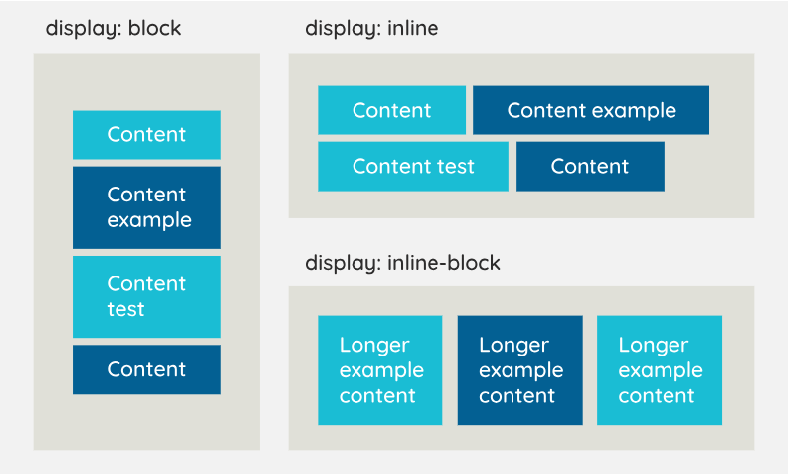
CSS
Display property

Slide 86
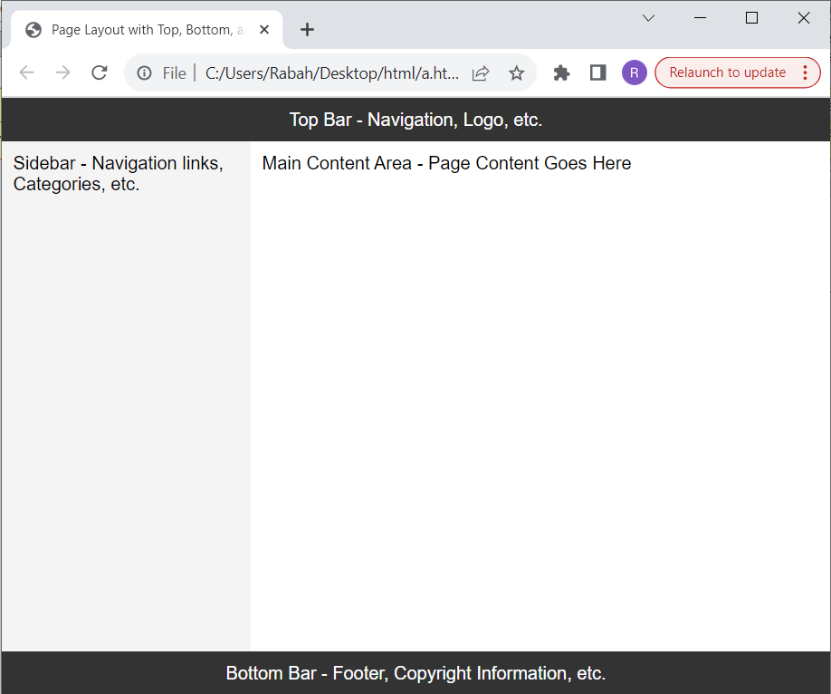
CSS
Example of ‘display: flex’

Slide 87
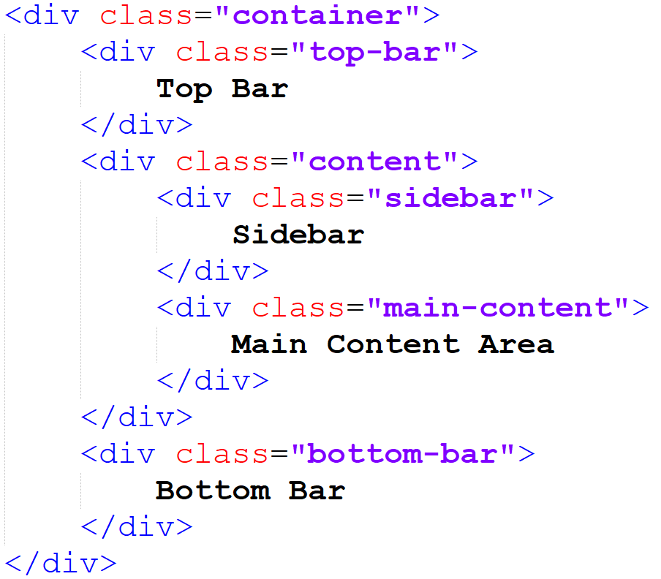
CSS
Example of ‘display: flex’

Slide 88
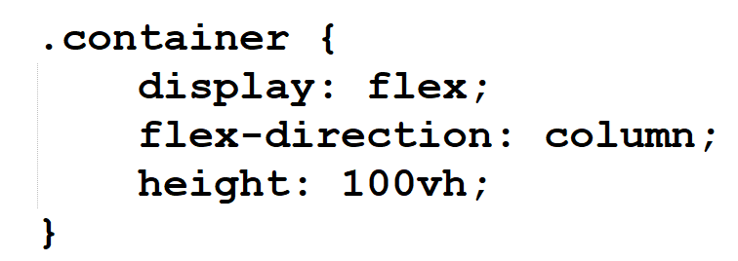
CSS
Example of ‘display: flex’

Slide 89
CSS
Example of ‘display: flex’

Slide 90
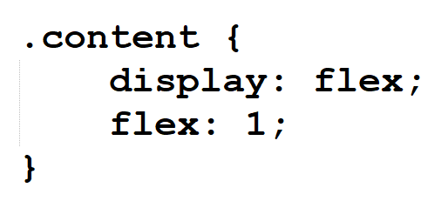
CSS
Example of ‘display: flex’

Slide 91
CSS
Example of ‘display: flex’

Slide 92
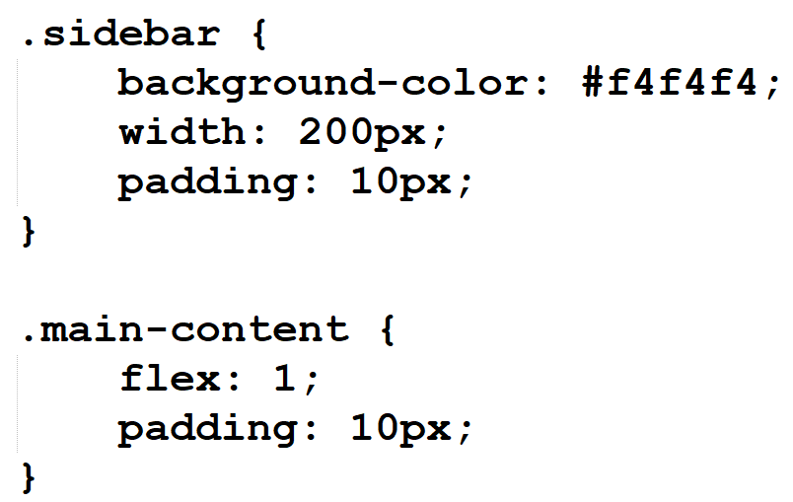
CSS
Example of ‘display: flex’

Slide 93
CSS
Example of ‘display: flex’

