Slide 1
Data type
Data structures are a way of organizing and storing data so that they can be accessed and worked with efficiently --------How to store
data types are essential because they determine how data is stored, processed, and presented to the users ---------------How many space

Slide 2
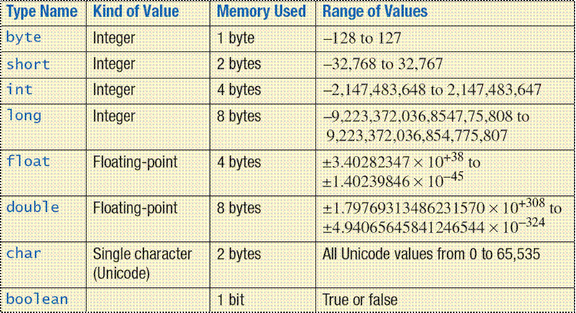
Data type in computer programming

Slide 3
Primitive (basic) data type Python
Primitive Data type
Integers
Float
Strings
Boolean

Slide 4
Integers
You can use an integer to represent numeric data and, more specifically, whole numbers from negative infinity to infinity, like 4, 5, or -1.
Integers are used when you want to represent numeric data, whole number specifically

Slide 5
Float
stands for 'floating point number'. You can use it for rational numbers, usually ending with a decimal figure, such as 1.11 or 3.14.

Slide 6
Strings
Strings are collections of alphabets, words, or other characters. you can create strings by enclosing a sequence of characters within a pair of single or double quotes. For example: ‘hello', “python code", etc.

Slide 7
Boolean
This built-in data type can take up the values: True and False, which often makes them interchangeable with the integers 1 and 0. Booleans are useful in conditional and comparison expressions, just like in the following examples:

Slide 8
Algorithms
A set of finite rules or instructions to be followed for problem-solving operations
Structure
algorithm name
Start
instr1
……
instr n
end

Slide 9
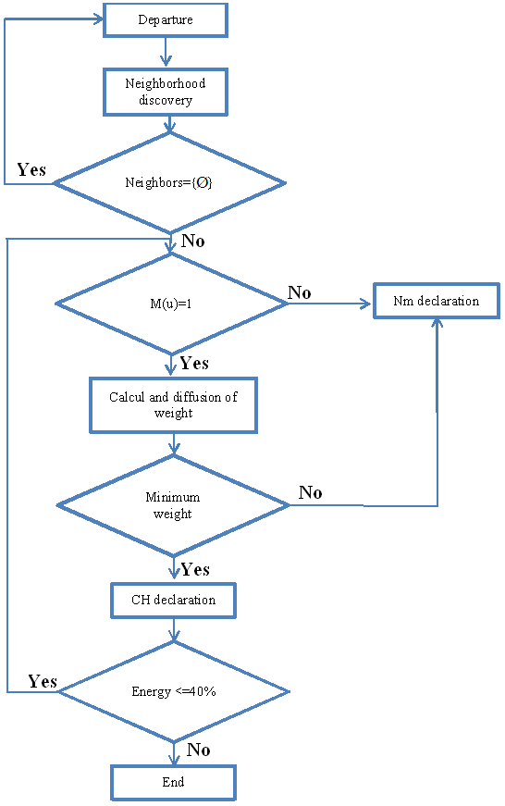
Algorithms forms
Organigram
Graphic form use geometric form

Slide 10
Algorithms forms
Pseudo-code
Text similar to the computer language
algorithm name
Start
instr1
……
instr n
end
algorithm Sol1
Start
Write(‘hello’)
end
Python Code:
print(“hello”)
Pascal Code:
Program Algo1;
Begin
Write(‘hello’):
End.

Slide 11
Print command Example

Slide 12
Variables
Location when we want to store a value
A memory case (cell)
Name used in order to store/ retrieve value
Python example
A = 0
Assignment (=) :
action putting a value in a variable (symbol =)
Memory
A
0

Slide 13
Declaring Variables
In pseudo-code
algorithm name
Variables : Names : Type
Start
instr1
……
instr n
end
In many programming language
Memory
a
b
algorithm Algo1
Variables : a:integer
b , c : real
Start
instr1
……
instr n
end
c

Slide 14
Declaring Variables
Example of other programming language
Pscal
Program Algo1
Var a : integer;
b : real;
c:String;
begin
……
end.
Java
Int a ;
Double b ;
String c;
Python
a =int (0) ;
b=float(3.2);
c=str(“hello”)

Slide 15
Variables names
Variables in python can contain alphanumerical characters and some special characters.
it is common to have variable names that start with lower case letters; but you can do whatever you want.
Some keywords are reserved and cannot be used as variable names due to them serving an in-built Python function; i.e. while, print, if. Your IDE will let you know if you try to use one of these.

Slide 16
Variables Type
Integer (int)
Float (float)
String (str)
Boolean (bool)
Complex (complex)
[…]
User defined (classes)

Slide 17
Python is dynamically typed; the type of the variable is derived from the value it is assigned.
You can always check the type of a variable using the type() function.

Slide 18
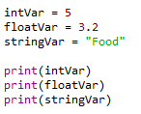
Assignment
Algorithm
X ← Y
X represents Case memory (variable)
Y represents expression(which can be value, variable, expression, …)
Python
b=2
A = 2
A = b * A
C = 2 * b + A

Slide 19
Basic input and output
Output
Python print() function prints the message (result of expression) to the screen or any other standard output device
Python : print (value(s), sep= text, end = text)
Example: >>> print(‘hello world’, ‘welcome ‘, sep=‘\n‘, end = ‘ . ’);
Hello world
Welcome .
Pseudo-code: Write(values)
Example : write(‘hello world’, ‘welcome’)

Slide 20
Basic input and output
input
Sometimes we might want to take input from the user (interaction)
Python provides a built-in function called input which takes the input from the user. When the input function is called it stops the program and waits for the user’s input. When the user presses enter, the program resumes.
python takes the input from the user as string type <class: str>

Slide 21
input
Pseudo Code
Read (variable_name)
Python
Name_variable = input (‘text’) # here type of Name_variable is str
Example
>>> name = input('What is your name?')
What is your name?|
NB: You need to explicitly convert it into a type that you want using typecasting.

Slide 22
Typecasting
1- Typecasting the input to Integer:
Example
Var1 = int (input(‘give a number’))
2- Typecasting the input to Float:
Example
Var1 = Float(input(‘give a number’))

Slide 23
Typecasting
Example 1
>>> Var1 = input(‘give 1st number ’)
give 1st number 17
>>> print(var1 + 20) ?Error
Example 2
>>> Var1 = input(‘give 1st number ’)
give 1st number 17
>>> Var2 = input(‘give 2nd number’)
give 1st number 20
>>> print(Var1 + Var2) ? 1720

Slide 24
Exercises
Create a script that takes two inputs, multiplies them, and then print the result.
A,B = input(“give two numbers”).spilit(); print(“a*b= “,A*B)
Ask for their year of birth, and compute their age example : your age is 25
A = input(“give your birth date”); print(“your age is “,2023-A)
Read five numbers in. after then print out their sum and mean

Slide 25
Conditionals and iterative statement
Programs are written for the solution to the real world problems.
A language should have the ability to control the flow of execution (called as structured programming language)

Slide 26
Type Conditionals and iterative statement
ITERATION
SEQUENCE
SELECTION

Slide 27
Sequence
Sequence is the default control structure; instructions are executed one after another.
Statement 1
Statement 2
Statement 3
……..
……..
……..
Example:
num1 = 1.5
num2 = 6.3
sum = num1 + num2
print('The sum is =‘, sum)

Slide 28
SELECTION
A selection statement causes the program control to be transferred to a specific flow based upon whether a certain condition is true or not.
Condition : - is a Boolean expression
- takes a value true or false
Equals: a == b
Not Equals: a != b
Less than: a < b
Less than or equal to: a <= b
Greater than: a > b
Greater than or equal to: a >= b
Complex condition : using ( ) , and logical operator (or , and)

Slide 29
Truth table
Example
( (a > b) and ( not ( b>=a ) )

Slide 30
If statement
Conditional constructs (also known as if statements) provide a way to execute a chosen block of code based on the run-time evaluation of one or more Boolean expressions (condition).
Pseudo-code:
if condition then
ints1
Inst2
…
end if
if a=0 then
write (‘a is null’)
Inst2
…
end if

Slide 31
Conditional statement in python
In Python, the most general form of a conditional is written as follows:
if first condition:
first body
elif second condition:
second body
elif third condition:
third body
else:
fourth body
: Colon Must
indentation

Slide 32
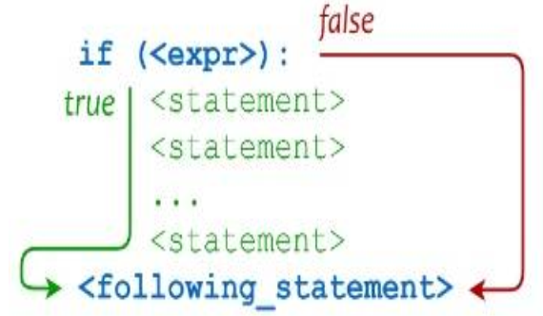
Python if statement

Slide 33
If Statement
Pseudo code If (condition) then inst1 Inst2 …. End if example: Read(a) If (a>0) then write(‘this number is positive’) end if write(‘ok’) | Python … example: a= int (input(‘ ‘)) If (a>0) : print(‘this number is positive’) print(‘ok’)

Slide 34
If else Statement
Pseudo code If (condition) then inst1 Inst2 …. Else inst1a Inst2a …. End if | Python Example: a= int (input(‘ give a number ?! ‘)) If (a>0) : print(‘this number is positive’) else: print(‘ this number is <= 0 ’)
Example
Read(a)
If (a>0 ) hen
write(‘this number is positive’)
else
write(‘this number is <=0’)
End if

Slide 35
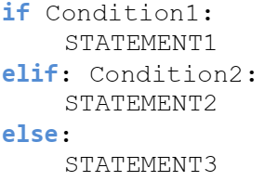
If elif else Statement
Pseudo code If (condition) then inst1 Inst2 …. Else if (condition2) then inst1a Inst2a …. Else if (condition3) …. … End if End if End if | Python Example: a= int (input(‘ give a number ?! ‘)) If a>0 : print(‘this number is positive’) elif a=0: print(‘this number is null’) else : print(‘this number is negative’)
Example
Write(‘give a number’)
Read(a)
If (a>0 ) then
write(‘this is positive’)
Else
if a=0 then
write(‘this is null’)
Else
write(‘this is negative’)
end if
End if

Slide 36
Exercises
Write a PYTHON program that reads a value of n and check the number is zero or non zero value.
Write a PYTHON program to find the biggest of two numbers.
Write a PYTHON program that reads the number and check it positive or negative.
Write a PYTHON program to check entered character is vowel or consonant.
Write a PYTHON program to check weather number is even or odd.

Slide 37
Match-case statement
Exist in many programming language (c, c++, java , pascal, ….)
Python didn’t have it until python 3.10
Like if … elif …elif … elif … … ….. statements
Used for multiple choices
In most cases : When we have if … elif …elif … elif … … ….. form ➔ we can use the match-case statement
Python syntax :

Slide 38
Match variable:
case value1 :
statement
statement
….
case value2 :
statement
statement
…
case … :
…..
case _ :
statement
statement
…
N=int(imput(‘enter a month number? ’))
Match N:
case 1:
print(‘January’)
case 2 :
print(‘February’)
case … :
…..
case _ :
print(‘your value is invalid !!! ’)

Slide 39
ITERATION OR LOOPING statements (Loops)
ITERATION

Slide 40
ITERATION OR LOOPING (Loops)
What is loop or iteration?
Loops can execute a block of code number of times until a certain condition is met.
The iteration statement allows instructions to be executed until a certain condition is met.
The iteration statements are also called as loops or Looping statements.

Slide 41
ITERATION OR LOOPING (Loops)
there are two kinds of loops in Python
while loop
for loop

Slide 42
while loop

Slide 43
The While Loop
A while loop allows general repetition based upon the repeated testing of a Boolean condition
The syntax for a while loop in Python is as follows:
while condition:
statements
Else :
statements
Where, loop body contain the single statement or set of statements.

Slide 44
The While Loop
Pseudo-code
While (condition) do
Statement
Statement
Statement
….
End while
Example
A← 0
While (a < 5) do
write(‘ok’)
a ← a +1
End while
while Loop

Slide 45
The While Loop
Example
>>>
Ok
Ok
Ok
Ok
Ok
>>>
5
b= 0
while (b< 5):
print(‘ok’)
b = b+1
Print(b)

Slide 46
Infinite loop (
Example
b= 0
while (b >= 0):
print(‘ok’)
b = b+1
>>>
Ok
Ok
Ok
Ok
Ok
Ok
Ok
ok
5
>>>
ok
b = 0
while (b < 0):
b = b+1
print(b)
Print(‘ok’)
∞

Slide 47
for loop

Slide 48
The for Loop
a for-loop or for loop is a control flow statement for specifying iteration
A for loop is used for iterating over a sequence (that is either a list, a tuple, a dictionary, a set, or a string).

Slide 49
The for Loop
Pseudo-code
for variable ← start to end by step do
statement_1
…
statement_n
End for
Variable is incremented automatically from start to end adding step in each iteration
for Loop
python
for looping variable in sequence:
code bloc

Slide 50
The for Loop
General syntax
for variable in range(n, m, p) :
statements
n: start value
m: end value
p: step value

Slide 51
Ok
Ok
Ok
Ok
Ok
Ok
Ok
Ok
Ok
9 times
for k in range(1, 10) :
print(“ok”)
K = 1,2,3,4,..,9
5 times
for k in range(1, 10, 2) :
print(“ok”)
Ok
Ok
Ok
Ok
Ok
Ok
Ok
Ok
Ok
Ok
Ok
Ok
Ok
Ok
ok
K = 1,3,5,7,9
for k in range(10) :
print(“ok”)
10 times
K = 0,1,…,9

Slide 52
h
e
l
l
o
w
o
r
l
d
Other sequence
for c in "hello world":
print(c)

Slide 53
Exercises
1. Write a PYTHON program to print the natural numbers up to n
2. Write a PYTHON program to print even numbers up to n
3. Write a PYTHON program to print odd numbers up to n
4. Write a PYTHON program to print sum of natural numbers up to n

