Slide 1
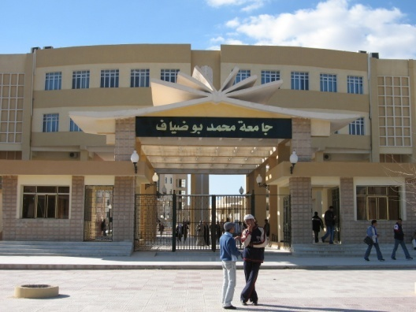
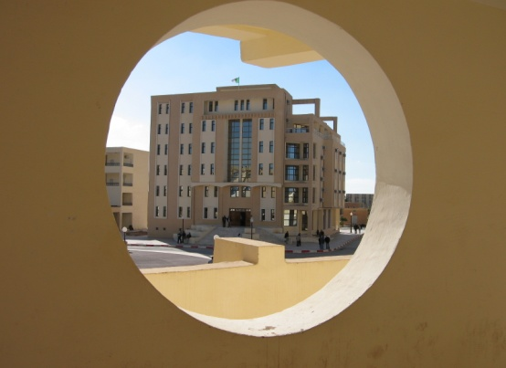
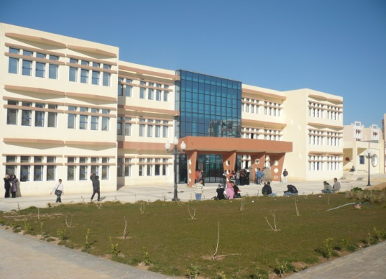
Course n04 Orthogonal projection
Urban Technology Management Institute
Department of Architecture
Academic year 2023 / 2024
prepared by
Professor Hynda Boutabba- Mili
1st year architecture

Slide 2
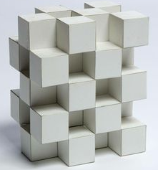
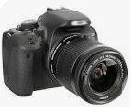
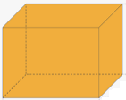
Representing a solid
To represent any object in nature, photography can be useful.
B = ?
A =?
But it cannot describe exactly.
Its shapes
its dimensions
and its hidden faces
We dissect the solid according to its different views
The different views are transcribed on paper
It is therefore a question of transcribing on a 2D support, a solid which is in 3D
This is the basis of PROJECTION

Slide 3
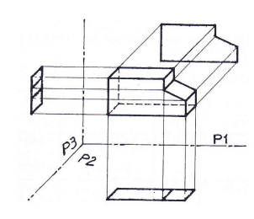
PROJECTION PRINCIPLE
2. The object is placed at the "center" of the trihedron so that the faces of the object are parallel to the faces of the trihedron
1. Choose an orthogonal projection trihedron
P3
P1
P2
3. The projections of the object are represented on the faces of the trihedron in directions orthogonal to each of the planes

Slide 4
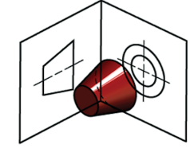
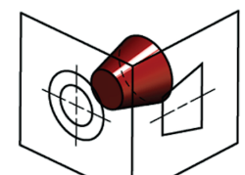
1
3
2
EUROPEAN vs AMERICAN PROJECTION
3
1
2
3
2
EUROPEAN PROJECTION
AMERICAN PROJECTION
The observed face is drawn in the projection plane located behind the volume
The observed face is drawn in the projection plane located in front of the volume

Slide 5
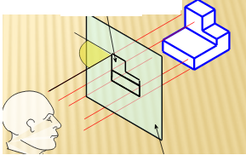
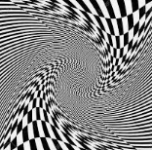
CHARACTERISTICS OF ORTHOGONAL PROJECTION
The LINES OF PROJECTION are perpendicular to the projection plane
The volume
Projection
Lines of projection
Projection Plan
Observer
The orthogonal projection allows the volume to be reproduced accurately, without:
Reduction
Nor Distorsion

Slide 6
PROJECTION PRINCIPLE
The projection on the P1 plane corresponds to the vision of the observer in front of the object. We’ll call this view " FRONT VIEW"
The projection on the P2 plane corresponds to the vision of the observer above the object. We’ll call this view "TOP VIEW"
The projection on the P3 plane corresponds to the vision of the observer to the right of the object. We will call this view "RIGHT VIEW"

Slide 7
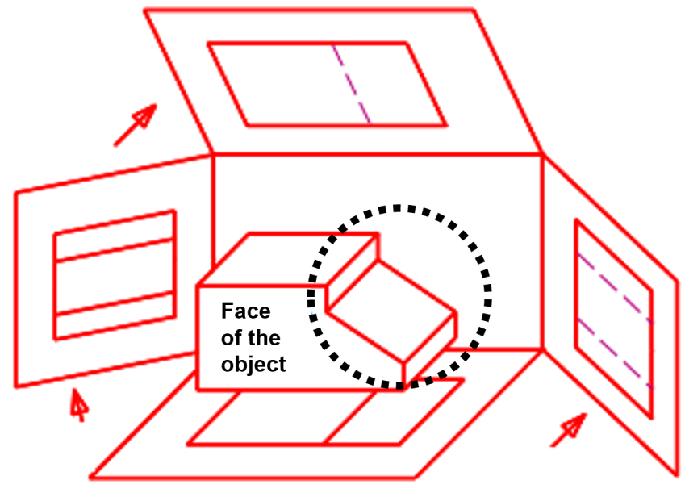
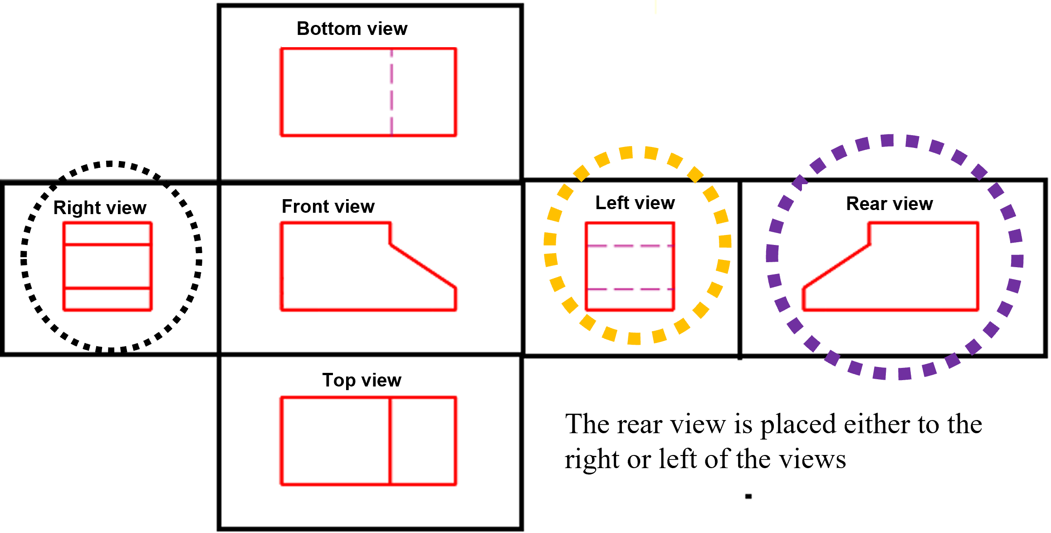
PROJECTION PRINCIPLE
We can imagine the same operation inside un cube: Projection cube. When we unfold the cube, we identify the views. It should be noted that:
1. The right view is placed to the left of the front view
2. The left view is placed to the right of the front view
3. The top view is placed below the front view
4. The bottom view is placed on top of the front view
5. The rear view is placed either to the right or left of the views

Slide 8
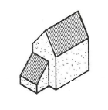
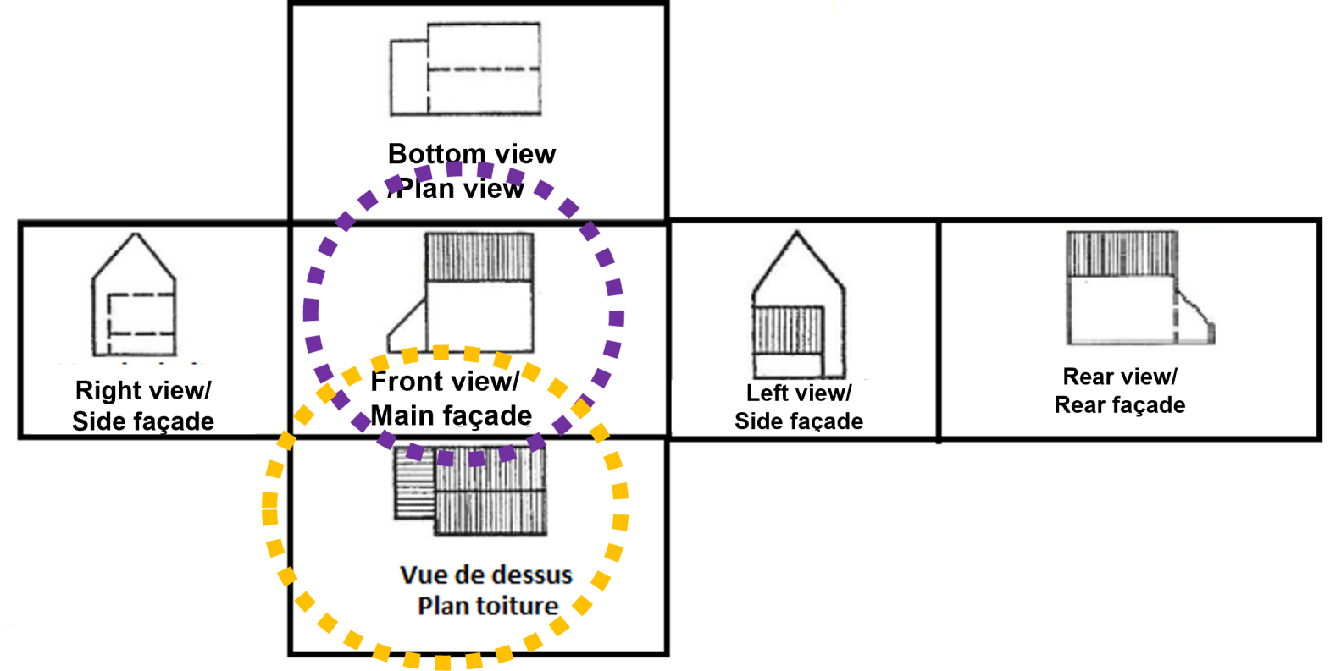
Views and architectural assimilations
Front view: Elevation or main façade: informs about lengths and heights
Bottom view: Plan view: informs about lengths and widths
Views from the right and left: Side facades: provide information on the main and additional heights and widths
Rear view: Rear façade
Top view: Roof plan

Slide 9
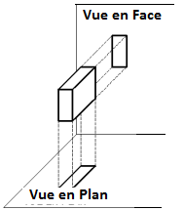
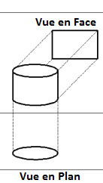
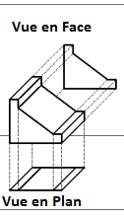
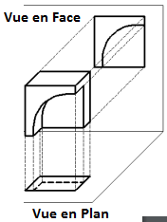
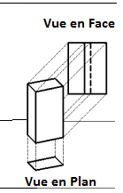
Some examples of ORTHOGONAL PROJECTION
Front view
Front view
Front view
Front view
Front view
Plan view
Plan view
Plan view
Plan view
Plan view
Precise standards must be applied in the drawing of a technical plan to facilitate its understanding.
Heavy solid line: For cut elements, or drawing the frame
Light solid line : For seen and uncut elements, dimensioning
Short dashed line: For elements hidden behind seen elements

Slide 10
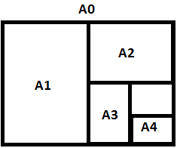
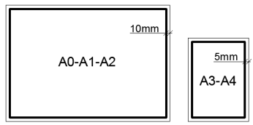
Paper Formats
The formats used are standard formats.
The basic format is 210mm by 297mm, it is the A4 format
The multiples of A4 (doubled each time) give standard formats:
A3 = 297mm par 420mm
A2 = 420 mm par 594mm
A1 = 594 mm par 840mm
A0 = 840mm par 1188mm
We use a frame all around the drawing

Slide 11
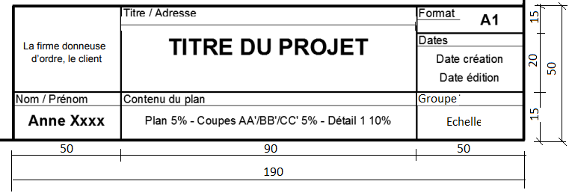
Title block
The title block is a kind of business card of the included drawing (the plan). It includes some information about the presented project.
It is located in the bottom right corner of the frame
Its width is from 190 to 200mm and its height can vary up to 277mm to 287mm maximum
Institut de GTU
Université de M’sila
A2
Projection orthogonale
2023:2024
Vue de face- Vue de gauche.

Slide 12
University of M’sila
Urban Technology Management Institute
Department of Architecture
Exo4: Orthogonal projection
Academic year 2023 / 2024
prepared by
professor Boutabba Hynda
1st year architecture course

Slide 13
Work Required
Once the volumetric composition chosen by the student is approved by the teacher,
* Draw the different views on A2 format, choosing the appropriate scale, respecting the type of line
The title block will have the dimensions given in the course
Each view will be rated and indicated with standardized writing
The duration of the exercise is 3 sessions

Slide 14
Thank you for your attention
و شـــكــــرا

