Slide 1
Ministry of Higher Education
Mohamed Boudiaf University- M’sila
Faculty of Letters and Languages
English Department
LECTURE 2
Defining Culture
Master One
Dr, Boulanouar S,

Slide 2
Outline
Various definitions of culture
Elements of culture
Types of Culture
Cultural Iceberg
Characteristics of culture

Slide 3
Defining Culture
“the evolving way of life of a group of persons, consisting of a shared set of practices associated with a shared set of products, based upon a shared set of perspectives on the world, and set within specific social contexts”
Moran & Lu (2001)
“Culture refers to that complex whole which includes knowledge, beliefs, art, morals, law, customs, and any other capabilities and habits acquired by man as a member of society”.
(Edward Tylor,2005)

Slide 4
CULTURE:
The values, traditions, worldview, and social and political relationships that are created, shared, and transformed by a group of people bound together by a common history, geographic location, language, social class, and/or religion. (adapted from Sonia Nieto)

Slide 5
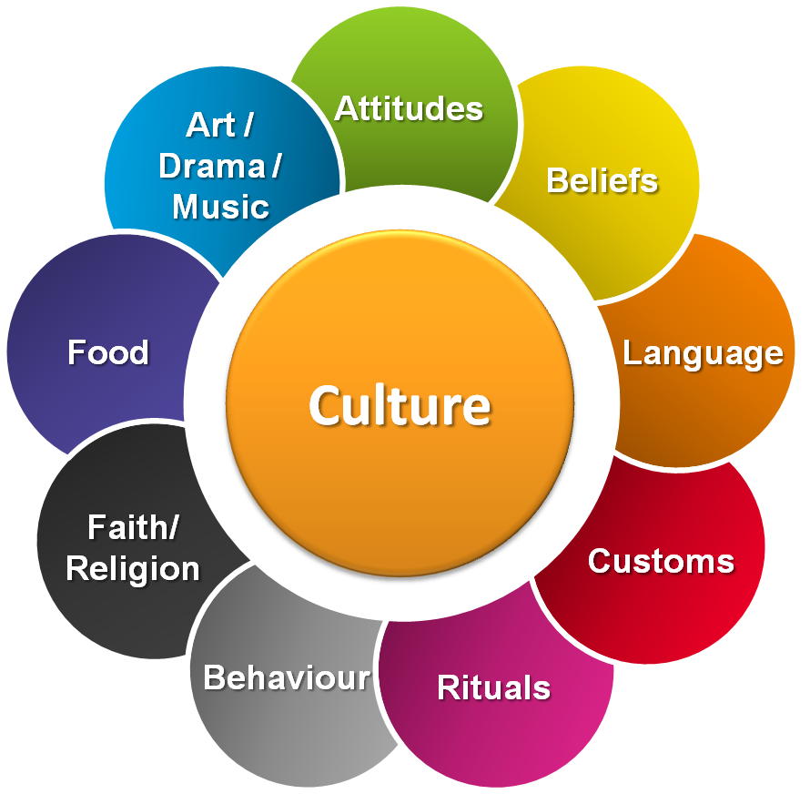

Slide 6
Elements of culture
Language
Social Organization
Customs and Traditions
Arts and Literature
Religion
Forms of Governance
Technology, Tools and Infrastructure

Slide 7
Language
Cornerstone of culture
All cultures have a spoken language (even if there are no developed forms of writing)
People who speak the same language often share a similar culture
Many societies include a large number of people who speak different languages
Each language can have several different dialects

Slide 8
Social Organization
Creates social structure by organizing its members into small units to meet basic needs
Family Patterns: family is the most important unit of social organization. Through the family children learn how they are expected to act and what to believe
Social classes: rank people in order of status, depending on what is important to the culture (money, job, education, ancestry, etc.)

Slide 9
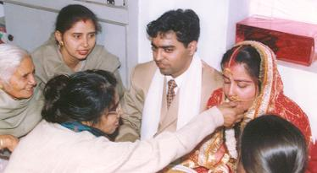
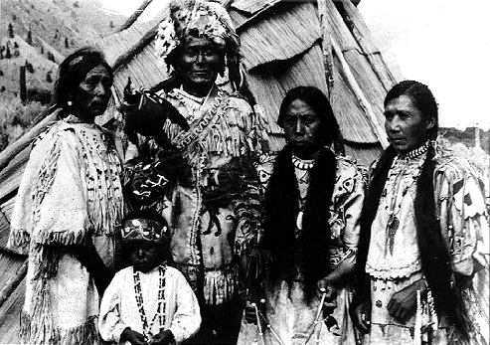
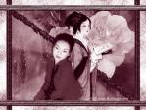
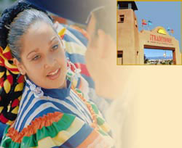
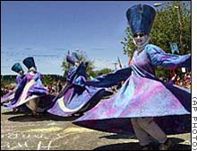
Customs and Traditions
Rules of Social Behavior
Enforces ideas of right and wrong
Often these ideas are part of the culture’s written laws

Slide 10
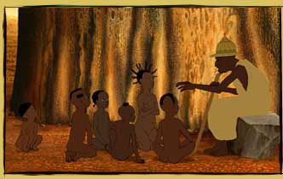
Arts and Literature
Products of the human imagination
Help us pass on the culture’s basic beliefs
Examples: art, music literature, folk tales

Slide 11
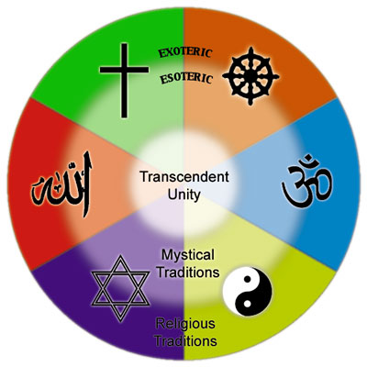
Religion
Answers basic questions about the meaning of life
Supports values that groups
of people feel are important
Religion can be a source of
conflict between cultures
Monotheism: Worship one God
Polytheism: Worship more than one God

Slide 12
Forms of Governance
People form governments to provide for their common needs, keep order within society, and protect their society from outside threats
Components of government:
1. Person/people who hold power in a society
2. Society’s rules, laws and political institutions

Slide 13
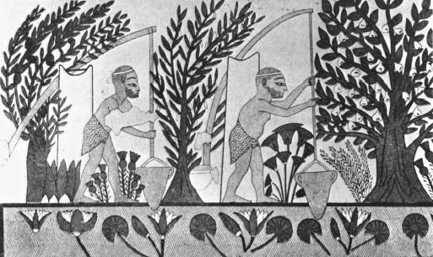
Technology, Tools and Infrastructure
Technology: Human innovation that generates the machinery, tools and materials required to meet the needs of the society
Tools: A mechanical device intended
to make a task easier
Infrastructure: The basic facilities and installations needed for the functioning of the community, such as homes, transportation and prisons.

Slide 14
Types of Culture
MATERIAL CULTURE
NON-MATERIAL CULTURE
It refers to the physical objects, resources, and spaces that people use to define their culture.
It is all the elements of culture that are not tangible such as languages, values, beliefs, ideologies, musical styles, and so on.

Slide 15
Classify the following into material and non-material culture.
BELIEF
EIFFEL TOWER
LANGUAGE
MOSQUE
BODY LANGUAGE
PAINTING
ACCENT
DRESSING CODE
MONEY
MANNERS

Slide 16
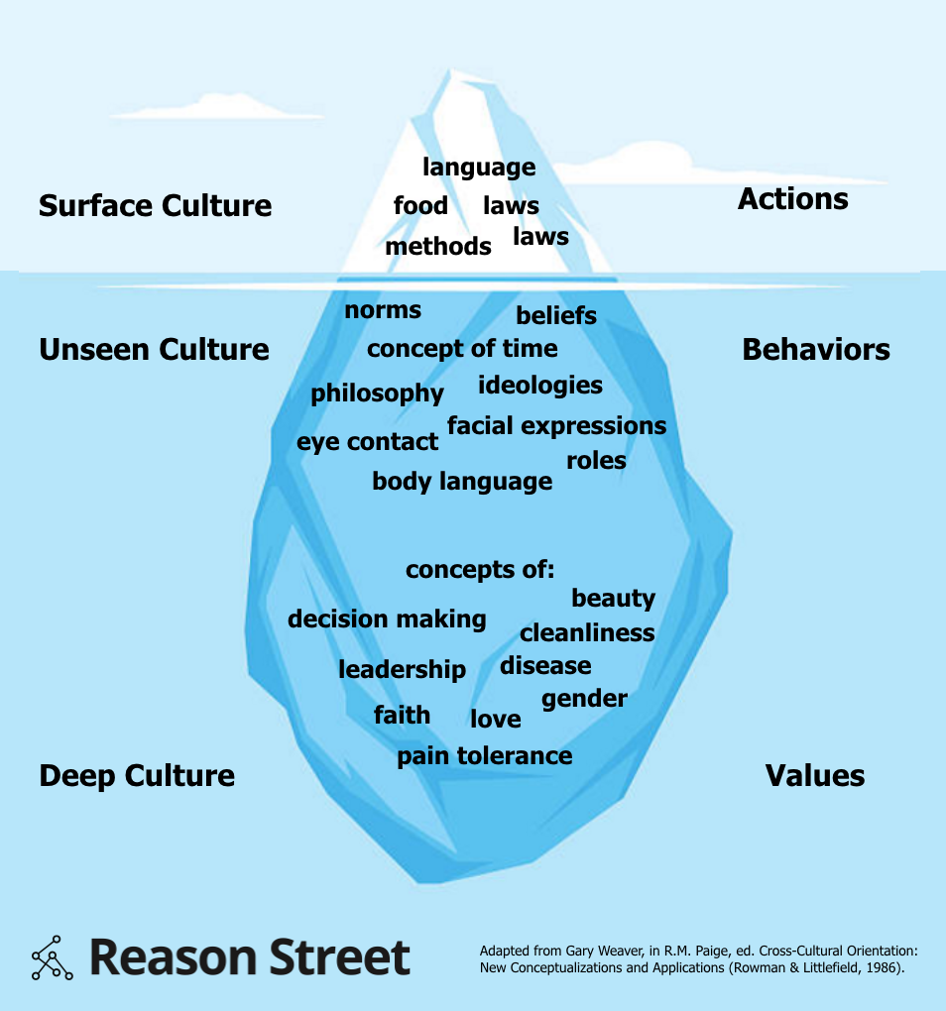
Culture Exists on 3 Levels

Slide 17
Characteristics of Culture
CULTURE IS LEARNED
Culture is not biologically passed from older generations to the newer ones. It is learned through experience. The members of a culture share certain ideals which shape their lives. The future generations learn to follow the same ideals.
The process of learning culture is known as enculturation.

Slide 18
Characteristics of Culture
CULTURE IS SHARED
Every culture is shared by a group of people, usually inhabiting the same part of the world. The region they live in, the geographical conditions around them, their country’s past, the belief system and values of its people.

Slide 19
Characteristics of Culture
CULTURE IS DYNAMIC
Cultures undergo a gradual change. With passing time, some beliefs change, certain traditions or rituals are eliminated, language and mannerisms of people change, and thus their culture.
But why do CULTURES change? One way they change is through diffusion. Diffusion is the spreading of an idea, thing, or behavior between cultures.

Slide 20
Characteristics of Culture
CULTURE IS TRANFERRED
Cultural values are transferred across generations in the form of symbols and stories that make them easier to understand. The beliefs that a culture holds, take the form of customs and rituals that people are supposed to follow.
The languages which are a part of culture, are integrated into the education system. Sometimes, values and religious beliefs are also made a part of it

Slide 21
Characteristics of Culture
CULTURE IS SYMBOLIC
Symbols are signs, emblems, and/or other things that are arbitrary but represent something in a meaningful way.
Language is probably the most significant cultural symbol, it is the transportation by which humans transmit culture from one generation to another.
How many symbols can you think of?

Slide 22
HOMEWORK
What are the theoretical perspectives (interpretations) of culture?
Why does a culture change or die?

Slide 23
Reading list
Hall’s High-Low context cultural taxonomy (1976)
Hofstede’s six dimensions (1980 )
Schwartz’s seven dimensions of culture. Also called Schwartz´s (2006) theory of cultural values,

