Slide 1
ELECTROPHORESIS

Slide 2
Content
Introduction
Principle and theory of electrophoresis
Different types of electrophoresis techniques
Moving Boundary Electrophoresis
Zone electrophoresis - Paper, Cellulose acetate and Gel electrophoresis
Applications of electrophoresis

Slide 3
Introduction
The transport of particles through a solvent by application of an electric field is called as electrophoresis.
Most of the polymers (containing macromolecules) are electrically charged and will therefore move in an electric field.
Electrophoresis is useful in identification and structure
determination of such big molecules.

Slide 4
Definition
Electro means Electricity
Phoresis means Separation
Separation of serum proteins by the effect of an electric current.
Electrophoresis is a physical method of analysis which involves separation of the compounds that are capable of acquiring electric change in conducting electrodes.
Electrophoresis may be defined as the migration of the charged particle through a solution under the influence of an external electrical field.
Ions that are suspended between two electrodes tends to travel towards the electrodes that bears opposite charges

Slide 5
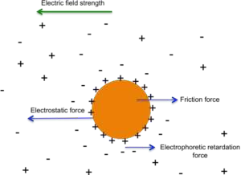

Slide 6
Macromolecules can be characterized by their rate of movement in an electric field.
This property is used to determine protein molecular weights, to distinguish molecules by virtue of their net charge or their shape and to separate different molecular species quantitatively.
Rate of movement of macromolecules in an electric field is useful parameter to know any change in amino acid regarding its charge.

Slide 7
Electrophoresis is similar to chromatography.
Electric field is used as a dragging force.
Technique is simple, very effective and clean.
Large number of samples can be separated, identified and quantitatively measured.

Slide 8
Theory of electrophoresis
As movement of ions or their mobility depends upon the frictional coefficient, which in turn depends on the function of some of the physical properties of the molecules such as weight, molecular shape, size etc.
The law of electrostatics states :
^{F} electric ^{= qE}
where F _{electric} is electrical force on an ion, q is the charge on the ion and E is the electric field strength.

Slide 9
The resulting electrophoretic migration of the ion though the solution is opposed by a frictional force
^{F} friction ^{= Vf}
where V is velocity (rate of migration) of the ion and f is its ‘frictional coefficient’.
The frictional coefficient is a measure of the drag that the solution exerts on the moving ion and is dependent on the size, shape and state of the ion as well as on the viscosity of the solution.

Slide 10
Working of electrophoresis
The working principle of electrophoresis is that it causes the separation of the molecules, ions or colloidal particles that suspends in the matrix under the force of an electric field.
The electric field allows the migration of the positively charged molecule towards the anode and the migration of negatively charged molecule towards the cathode.
Therefore, electrophoresis is the electrokinetic phenomenon where the motion of molecules occurs under an electric field.

Slide 11
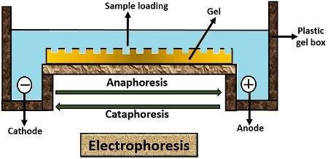

Slide 12
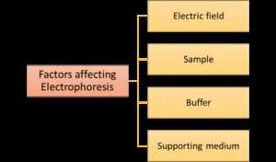
Factors affecting electrophoresis

Slide 13
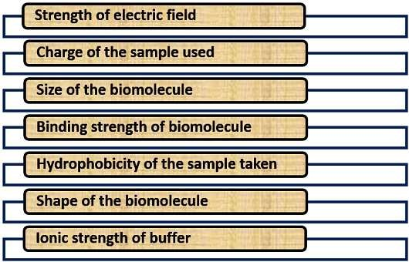
Factors affecting electrophoresis

Slide 14
https://www.youtube.com/watch?v=hXJxTqGb_XU

Slide 15
Types of electrophoresis
Moving boundary electrophoresis
Zone electrophoresis

Slide 16
Moving boundary electrophoresis
First used by Sweedish biochemist Arne Tisellus, to separate proteins in 1937.
In this method, the electrophoresis is carried in solution, without
a supporting media.
The sample is dissolved the buffer and molecules move to their
respective counter charge electrodes.
Moving boundary electrophoresis is carried out in a U shape tube with platinum electrodes attached to the end of both arms

Slide 17
At the respective ends, tube has refractometer to measure the change in refractive index of the buffer during electrophoresis due to presence of molecule.
Sample is loaded in the middle of the U tube and then the apparatus is connected to the external power supply.
Charged molecule moves to the opposite electrode as they passes through the refractometer, a change can be measured.
As the desirable molecule passes, sample can be taken out from the apparatus along with the buffer.

Slide 18
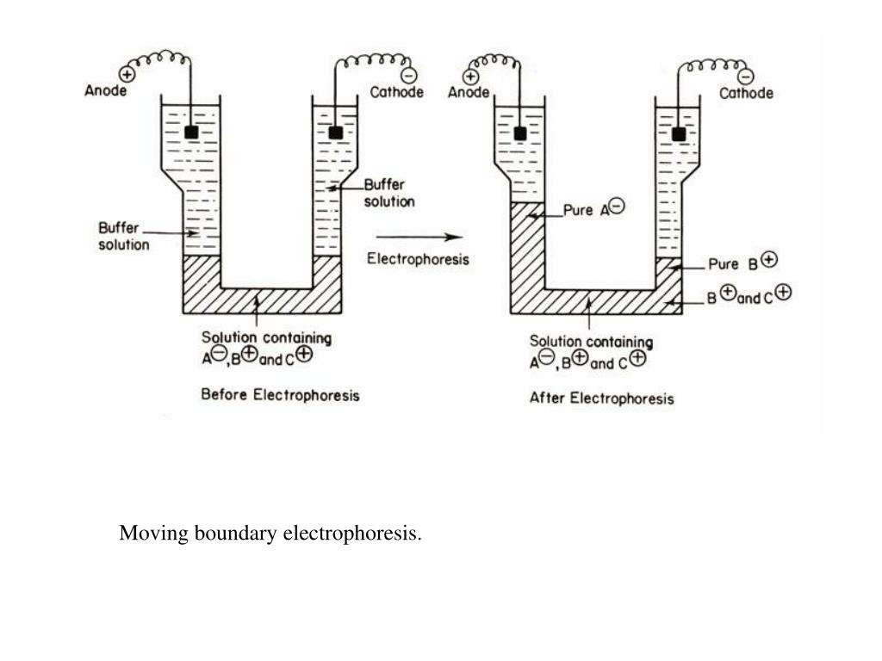
Instrumentation

Slide 19
Disadvantages of Moving Boundary electrophoresis-
The resolution of the technique is very low due to the mixing of the
sample as well as over-lapping of the sample components.
The electrophoresis technique is not good to separate and analyze the complex biological sample instead it can be used to study the behavior of the molecule in an electric field.

Slide 20
Zone electrophoresis
In this method, an inert polymeric supporting media is used between the electrodes to separate and analyze the sample.
The supporting media used in zone electrophoresis are absorbent
paper, gel of starch, agar and polyacrylamide.
The major advantage of presence of supporting media is that it minimizes mixing of the sample and immobilization of the molecule after electrophoresis.
It makes the analysis and purification of the molecule from the gel
much easier than the moving boundary electrophoresis.
The gel electrophoresis is the best example of zone electrophoresis.

Slide 21
Methods of electrophoresis
1. Paper electrophoresis
2. Cellulose acetate strip electrophoresis
3. Gel electrophoresis

Slide 22
Paper electrophoresis
Paper electrophoresis (PE) is useful for the separation of small-charged molecules, such as amino acids and small proteins using a strip of paper (chromatography paper).
In this technique, the motion of colloidal particle of solution occurs leading to subsequent separation along the paper strip.
PE is easier in comparison to gel electrophoresis.
It does not require matrix preparation and it does not contain charges
that interfere with the separation of compounds.

Slide 23
A strip of filter paper is moistened with buffer and the ends of the strip are immersed into buffer reservoirs containing the electrodes.
The samples are spotted in the center of the paper and high voltage is
applied.
Application of high voltage causes less diffusion of small molecules giving better resolution and it take less time to complete the process.
Spots migrate according to their charges.
After electrophoresis, separated components can be detected by variety of staining techniques, depending upon their chemical composition.

Slide 25
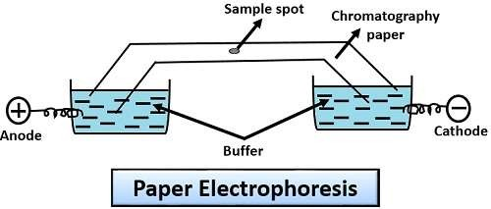

Slide 26
Applications of Paper Electrophoresis
a simple, inexpensive, and accurate laboratory procedure for various research and clinical studies.
easily available and easy to handle, allowing new methodologies to be tried
and developed with convenience.
Clinical applications of PE include study of sickle cell disease, hemoglobin C abnormalities, and separation of blood clotting factors and serum plasma proteins from blood sample.
used in separation and identification of alkaloids.
used for testing suitability of municipal water supplies, toxicity of water, and other environmental components.
Drug-testing industry uses paper electrophoresis to determine presence of
illegal or recreational drugs in job applicants and crime suspects.
since 1950s used by the investigators and in forensics to analyze inks used
in currency to check the counterfeiters.
Lack of sensitivity and reproducibility are limitations of PE.

Slide 27
Cellulose acetate strip electrophoresis
Many biological samples adsorb on cellulose, that is paper.
The adsorption is because of hydroxyl groups present in cellulose.
Adsorption reduces the movement and therefore causes tailing of spots/bands
This spreading of spots reduces resolution.
To solve this problem cellulose acetate membrane is used where most of the hydroxyls have been converted acetate groups.
Cellulose acetate is preferred because of its simplicity and high resolution at low applied voltage.

Slide 28
Cellulose acetate strip electrophoresis
It contains 2-3 acetyl groups per glucose unit and its adsorption capacity is less than that of paper.
It gives sharper bands.
Provides a good background or staining glycoprotein
Application:
Widely used in analysis of clinical and biological protein sample (albumin and globulins).
Alternative to paper electrophoresis.

Slide 29
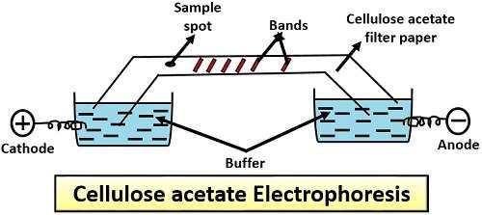

Slide 30
Gel electrophoresis
It makes the use of gel as a support matrix.
Most popular and commonly used method.
Used for both analytical and preparative processes.
It is the most common method to carry out the process of electrophoresis.

Slide 31
Principle:
In this porous gel matrix is used which consist of the cross-linked polymer network.
Through this network, molecules of different size, charge and shape pass through.
This relies upon the fact that negatively charged molecule will attract towards the positive end and vice versa.
After the migration, bands will appear on the gel matrix at different levels those which lag behind will be the heavy molecules and those which moves faster are lighter molecules through the pores of the gel matrix.

Slide 32
Types of Gel electrophoresis
Horizontal (Agarose gel electrophoresis)
Vertical (SDS-PAGE)

Slide 33
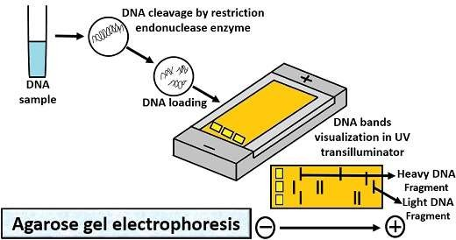
Horizontal gel electrophoresis

Slide 34
Horizontal gel electrophoresis
To carry out this kind of electrophoresis, following steps involve:
First, take agarose into the water to make the slurry or to dissolve the agarose.
Cool the agarose solution, and then transfer it to the casting tray containing comb.
Add electrophoresis buffer (Tris-acetate EDTA buffer) to cover the gel up to 1mm.
Then, take the DNA sample.
Add the desired amount of 6X gel loading buffer.
After that, take out the comb and slowly load the sample mixture containing tracking dye (Bromophenol blue) into the wells through the micropipette.
Close the lid of the gel tank, and turn on the power supply so that DNA can migrate towards the positive electrode.
Run the gel, until the bromophenol blue migrates on an appropriate distance through a gel.
At last, remove the gel tray and place is in a UV transilluminator, to see the orange-red
coloured DNA bands.
Application: Agarose gel electrophoresis is used for the isolation of nucleic acid
especially DNA.

Slide 35
Vertical gel electrophoresis
SDS-PAGE
It stands for Sodium Dodecyl Sulfate- Polyacrylamide Gel Electrophoresis and includes the
following steps:
First, add the resolving gel between the two glass plates of the casting frame.
Then, place a comb on the glass plates leaving 1cm space.
Add isopropanol on the top of the gel.
After solidification of resolving gel, remove the isopropanol using filter paper.
Load the stacking gel on the top of the glass plates.
Then, place a comb and solidify the stacking gel for desired time.
After solidification of stacking gel, remove the comb that forms a well.
Place a ladder into the extreme right and place the protein sample with a tracking dye
(Bromophenol blue) into the other wells, by using a micropipette.
Then turn on the voltage supply, so that tracking dye can cross the gel by forming different bands.
After the completion of electrophoresis, take out the gel and rinse it with deionized water 4-5 times to remove SDS and buffer.
Then, dip the gel in the Coomassie blue stain which is a staining buffer, stains the invisible protein bands after a few hours.

Slide 36
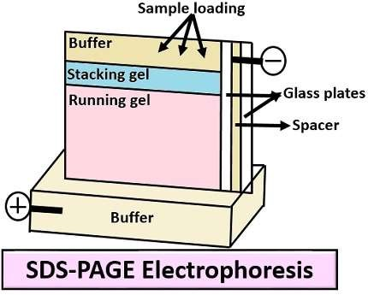
Vertical gel electrophoresis

Slide 37
Capillary Electrophoresis (CE)
This type of electrophoresis makes the use of a capillary tube or narrow bore tube. There are following steps involve:
First, ends of capillary immerse into inlet and outlet vials.
Fill the Inlet and outlet vials with an electrolytic solution.
Connect the electrode to the high power supply up to 5-30 kV.
And the sample then injects through the hollow capillary tube by the
electrokinetic energy.
Under the influence of the electric field, different zones of analyte or
sample form which migrates towards the outlet side.
These bands are then detected directly by a capillary wall.
Application: Capillary electrophoresis is used for the analysis of food, pharmaceutical product, environmental pollutants.

Slide 38
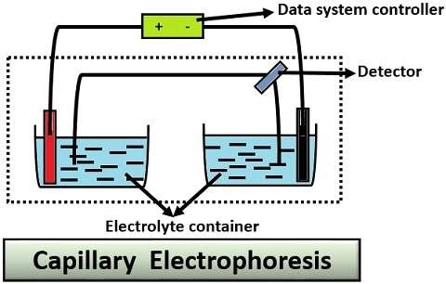

Slide 39
Applications of Electrophoresis
It is a tool of macromolecular separation
Many biological complex samples can be separated by using various methods of electrophoresis
In some cases, identification of molecules is also possible
Gel method is more commonly used for routine laboratory experiments as well as
research oriented separations and identification
Electrophoresis is handy tool for biologist and biochemist like the use f
chromatographic techniques by organic chemist.
Many handy instruments are available for conducting such separation experiments.

