Slide 1
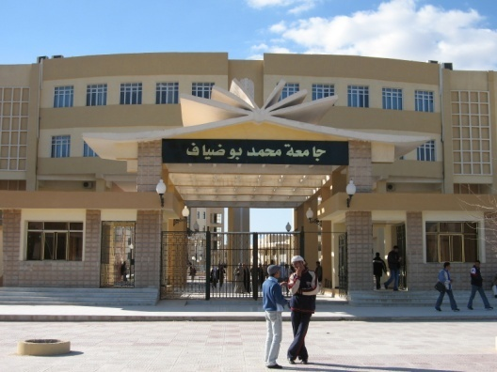
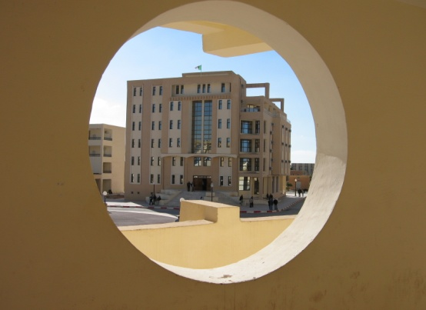
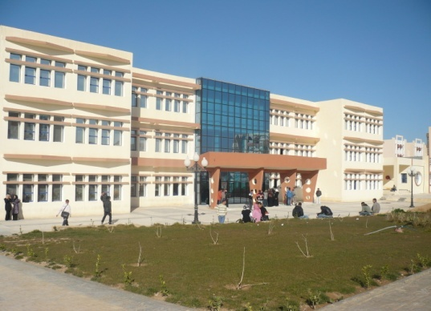
Race n05 . Cavalier and axonometric perspectives
Urban Technology Management Institute
Department of Architecture
Academic year 2023 / 2024
prepared by
professor Boutabba Hynda-Mili
1st year architecture course

Slide 2
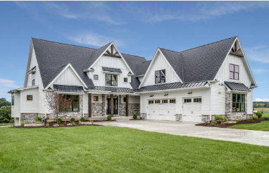
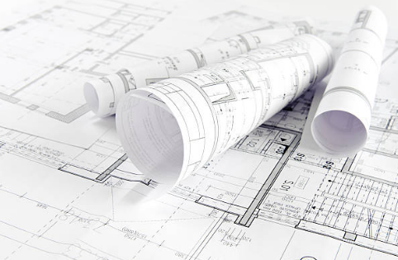
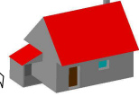
Conveying an idea
The architect is the bearer of an idea.
He is the master of the idea, of the architectural project
To be able to pass it on to others (customer, administration, manufacturer, etc.) etc) he needs to draw this idea with:
Clarity and rigour
Understood by all the staff
Y
In addition to the two dimensions X, Y, we can introduce depth
Via The different plans (views)that give Dimensions with Accuracy according to (X,X) and (Y,Y)
Z
Z
The Perspective
X

Slide 3
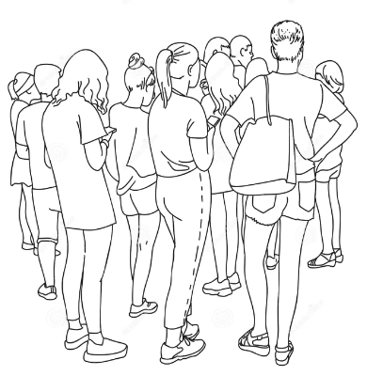
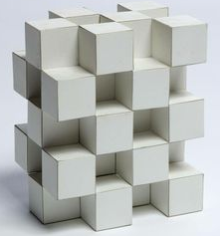
What is a perspective?
Perspective is the set of rules that allow you to represent the view of objects or characters
In three-dimensions (H, L and P), on a flat surface,
Height
Width
Depth
taking into account the effects of distance and their position in space relative to the observer.
Perspective is the art and technique of representing an object in 3Dimension on a flat surface. (Example a sheet of paper, a wall, a screen...)

Slide 4
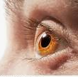
Types of Perspectives
Perspective therefore makes it possible to represent the ILLUSION of depth on a flat surface
It feels like what we're looking at is real
And it is in the light of this realism that we observe
several TYPES of PERSPECTIVES
The CAVALIER or CUBIC PERSPECTIVE
AXONOMETRIC PERSPECTIVE
The EUCLUDIAN PERSPECTIVE known as FRONTAL or “with a vanishing point"
The oblique PERSPECTIVE known as the "conical or "two-vanishing point"
Bird’s eye view
Worm’s eye view

Slide 5
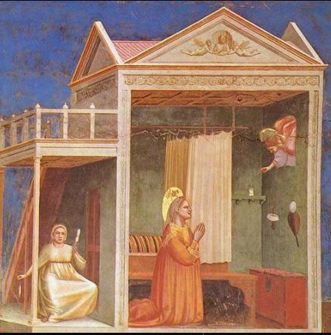
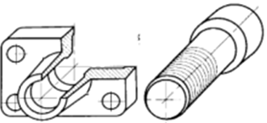
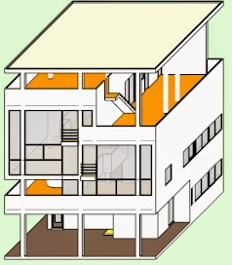
Cavalier Perspective
This is the oldest representation. It is used in:
ARCHITECTURE
Industrial Design
IN ORIENTAL ART &
Occidental before the Renaissance

Slide 6
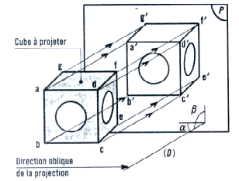
Cavalier Perspective
The cube to project
It is the oblique projection on a plane (P) of an object whose main face is placed parallel to the projection plane.
Oblique direction
Of projection

Slide 7
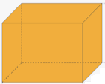
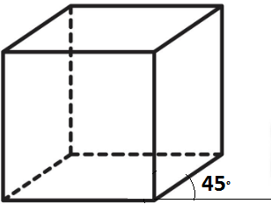
Comment est dessinée La perspective cavalière?
Importance is given to the front view, which is drawn without reduction or distortion, therefore;
In TRUE SIZE
2. The vanishing lines (which represent the depth of the volume) remain parallel
3. The vanishing lines are drawn inclined with an angle of 45° and a reduction coefficient K = 0.7, but for ease of drawing K will be equal to 0.5

Slide 8
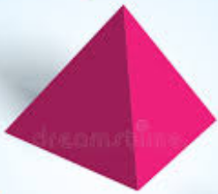
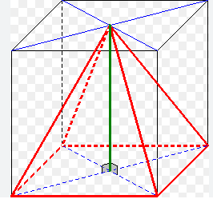
How are the volumes drawn in cavalier perspective?
How to Draw the square Base Pyramid?
I'm going to imagine it's inserted into a glass box
X
X
1. I draw the parallelepiped in cavalier perspective
X/2
45°
2. I draw the base of the pyramid
3. Then I determine the vertex which is the point of intersection of the two diagonals of the top face of the parallelepiped
4. I link the 4 points of the base with the apex

Slide 9
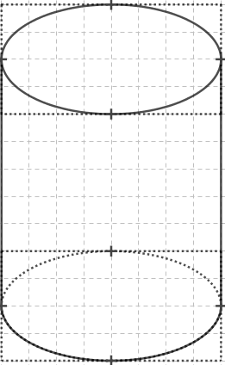
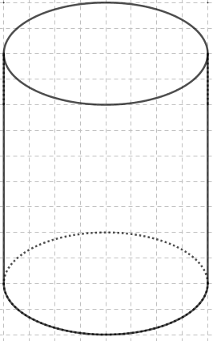
How are the volumes drawn in cavalier perspective?
How to draw the cylinder?
I'm going to imagine it's inserted into a glass box
1. I draw the parallelepiped in cavalier perspective
2. I draw the circular bases of the cylinder which will become ellipses
3. I connect the two ellipses with lines
4. The visible parts are in heavy lines and the hidden parts are in dotted lines

Slide 10
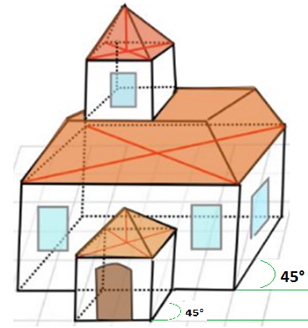
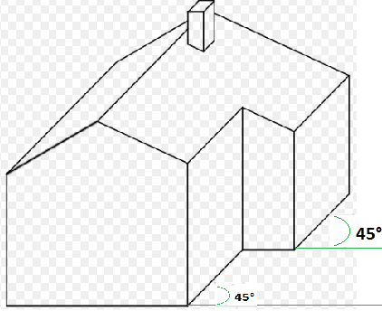
Examples of Cavalier Perspectives
Side view inclined at 45° . Width reduced to 0.5
Full-size front view

Slide 11
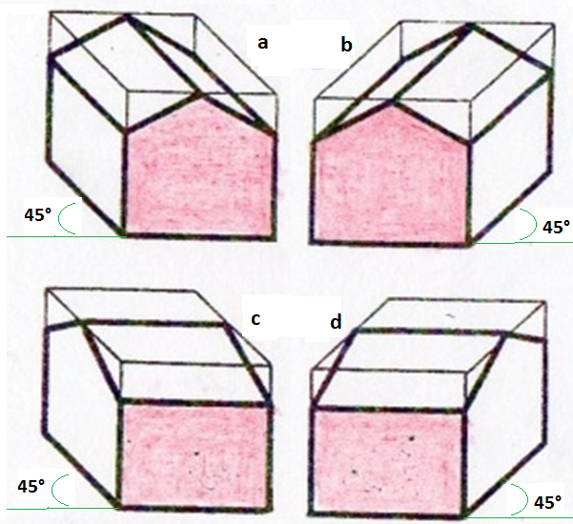
Examples of Cavalier Perspectives
Example of a perspective of the same house by changing the front view

Slide 12
Axonometric Perspective

Slide 13
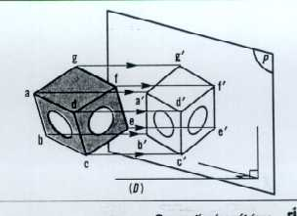
Axonometric Perspective
It is the oblique projection on a plane (P) of an object whose principal faces are arranged obliquely to the projection plane.

Slide 14
Depending on the projection angle and reduction factor chosen, several types of axonometric perspectives are observed
A/ THE ISOMETRIC PERSPECTIVE
B/ The DIMETRIC PERSPECTIVE
C/ THE TRIMETRIC PERSPECTIVE
All the parallels of the observed object remain parallel on the representation. The axonometric perspective is more elaborate than the cavalier, but it is still "incorrect" for the human eye.

Slide 15
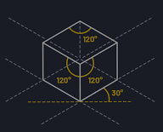
A/ THE ISOMETRIC PERSPECTIVE
Of all the 3 axonometric perspectives (isometric, dimetric, trimetric) it is the easiest to implement.
It represents the three visible faces of the volume with more fairness than the cavalier perspective
The edges of the volume follow axes angled 120° from each other, hence the angle 30°
All actual lengths of the workpiece are multiplied by a coefficient
K = 0, 82
However, to make it easier to implement, K will be equal to 1

Slide 16
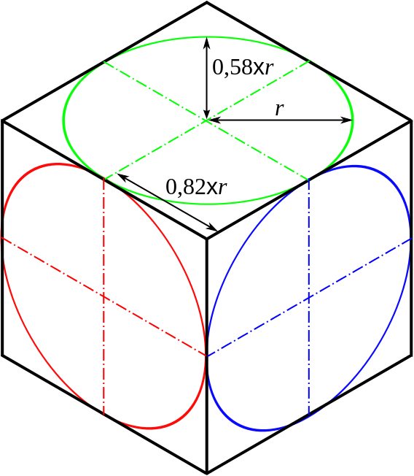
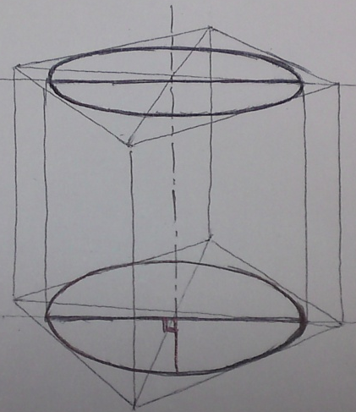
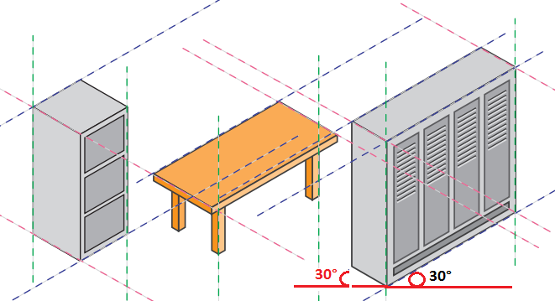
A/ THE ISOMETRIC PERSPECTIVE
In isometric perspective, the tangents remain the same (midpoint of the sides), but the circle becomes an ellipse
To draw a cylinder, you have to include it in an imaginary parallelepiped (a glass box drawn according to the principles of isometric perspective), then draw the upper and lower circular faces which will become ellipses, and use dotted lines for the hidden lines and solid lines for visible lines)
Example of Isometric Perspective

Slide 17
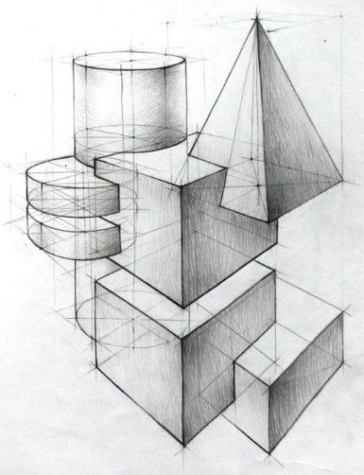
Example of ISOMETRIC PERSPECTIVE
Top view

Slide 18
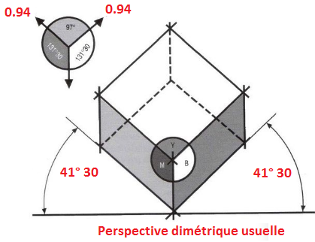
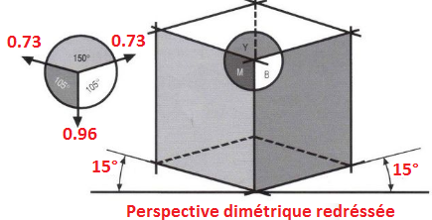
B/ The DIMETRIC PERSPECTIVE
The usual dimetric perspective is used to represent the most important face of a volume. The angle is 41°30. The reduction factor is
K= 0.94.
usual dimetric perspective
The straightened dimetric perspective makes it possible to highlight an elongated profile. The angle is 15° and the reduction factors are:
K= 0.73 (for X and Y axes)
K= 0.96 (for the Z-axis).
straightened dimetric perspective

Slide 19
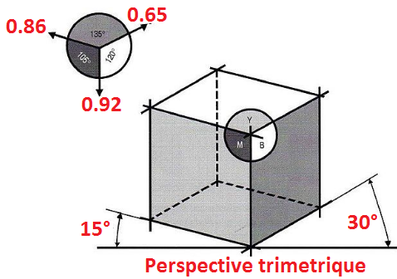
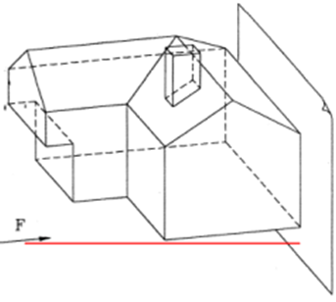
C/ THE TRIMETRIC PERSPECTIVE
The trimetric axonometric perspective allows vertical edges to be separated as much as possible.
The angles are 15° and 30°
The reduction factors are:
K= 0.65 (for the X-axis) K= 0.86 (for the Y axis) K= 0.92 (for the Z axis)
Trimetric perspective

Slide 20
University of M’sila
Urban Technology Management Institute
Department of Architecture
Exo6: Cavalier and Axonometric perspectives
Academic year 2023 / 2024
prepared by
professor Boutabba Hynda-Mili
1st year architecture course

Slide 21
Assignment
Once the volumetric composition chosen by the student is approved by the teacher. Draw on A2 format:
1- Cavalier perspective with a 45° angle and a reduction coefficient of (K=0.5)
2-Isometric perspective with 30° angle, and a reduction coefficient of (K=1)
Make sure to choose the proper Scale
The title block will have the dimensions given in the course
The duration of the exercise is 3 sessions
Military perspective
Architect perspective
Cavalier perspective
Isometric perspective
Dimetric perspective

Slide 22
Thank you for your attention
و شـــكــــرا

