Slide 1
Artificial Neural Networks
Diabetes Prediction Using Artificial Neural Network

Slide 2
Abstract
Topic: The study focuses on using Artificial Neural Networks (ANN) to predict diabetes.
Objective: Minimize the error function during the training of the model to improve prediction accuracy.
Training Results:
The average error function was 0.01.
The prediction accuracy for diabetes was 87.3%.

Slide 3
Introduction
Nature of Diabetes:
Chronic disease caused by insufficient insulin production or inefficient use of insulin by the body.
Results in high blood sugar levels, leading to potential severe organ damage.
Urgency for Early Diagnosis:
Highlights the need for early diagnosis to manage and mitigate the severe complications of diabetes.
Global Impact:
As of 2015, approximately 8.5% of adults aged 17 and over were affected by diabetes.
Diabetes was responsible for 1.5 million deaths in 2013, with high blood glucose levels causing another 2.3 million deaths.
Role of Artificial Intelligence:
Emphasizes the use of Artificial Neural Networks (ANN) to improve prediction and management of diabetes.
ANNs consider various health indicators such as blood glucose levels, blood pressure, body mass index, and family history to enhance diagnostic accuracy.
Trends and Prevalence:
The number of people with diabetes has doubled worldwide in the past decade.
Currently, over 200 million people are living with diabetes.
The global prevalence of diabetes is increasing by about 7% annually.
Importance of Advanced Detection:
Focuses on advanced detection methods to prevent or delay serious diabetes complications, both vascular and non-vascular.

Slide 4
Current Diagnostic Methods
Blood Tests
Symptom Recognition
Challenges
The current diagnostic methods have limitations and may not always provide accurate predictions for diabetes

Slide 5
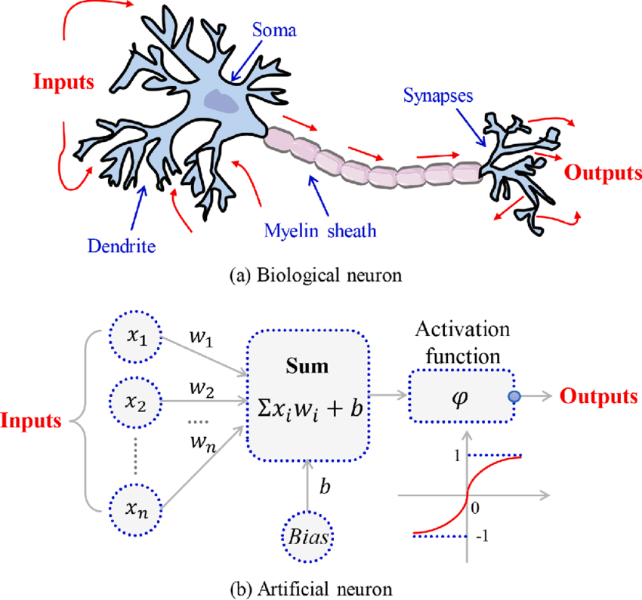
What is it Artificial Neurons Networks
Artificial Neural Networks (ANNs) are computational models inspired by the biological neural networks that constitute animal brains. These networks are one of the main technologies in artificial intelligence, used to simulate human capabilities in learning and decision-making.

Slide 6
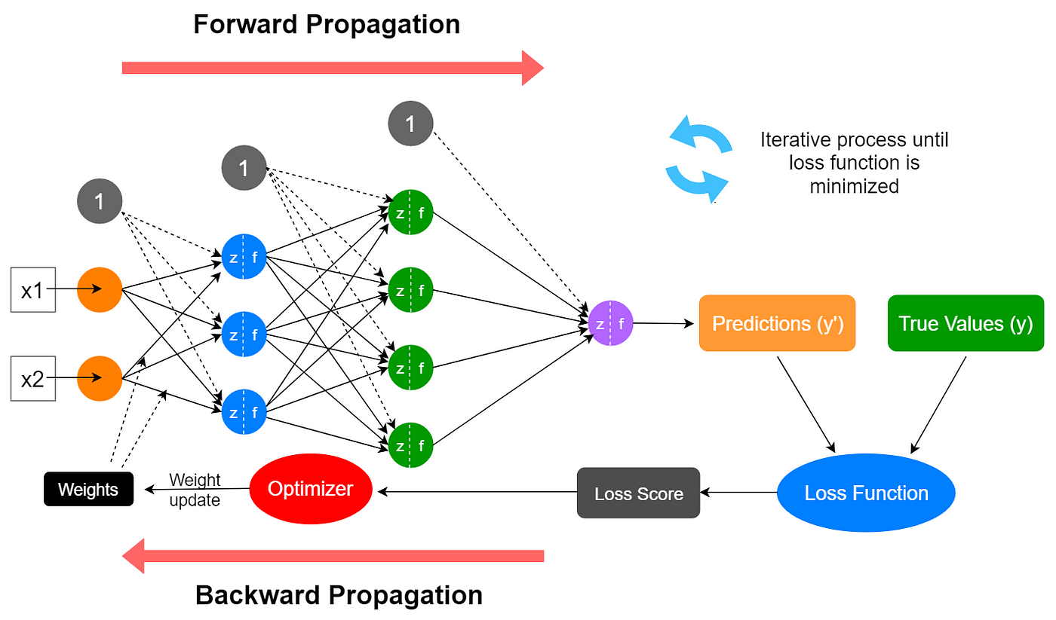
Overview of a Neural Network’s Learning Process

Slide 7
1. Assign random numbers to the weights.
2. For every element in the training set, calculate output using the summation functions embedded in the nodes.
3. Compare computed output with observed values.
4. Adjust the weights and repeat -2- and -3- if the result isn’t less than a threshold value.
5. Repeat the above steps for other elements in the training set.

Slide 8
attributes in the Data set
NO | Attribute name
1 | Pregnancies: Number of pregnancies
2 | PG Concentration: Plasma glucose at 2 hours in an oral glucose tolerance test
3 | Diastolic BP: Diastolic Blood Pressure (mm Hg)
4 | Tri Fold Thick: Triceps Skin Fold Thickness (mm)
5 | Serum Ins: 2-Hour Serum Insulin (mu U/ml)
6 | BMI: Body Mass Index: (weight in kg/ (height in m)^2)
7 | DP Function: Diabetes Pedigree Function
8 | Age: Age (years)
9 | Diabetes: Whether or not the person diabetes

Slide 9
Example in the Data set

Slide 10
Neural network evaluation
The neural network used consists of one input layer with 8 inputs, three hidden layers, and one output layer.
The model was implemented in the Just Neural Network (JNN) environment using diabetes diagnosis data that includes 1004 samples.
The network demonstrated a diabetes prediction accuracy of 87.3% after 158,000 training cycles, with an average error of 0.010.

Slide 11
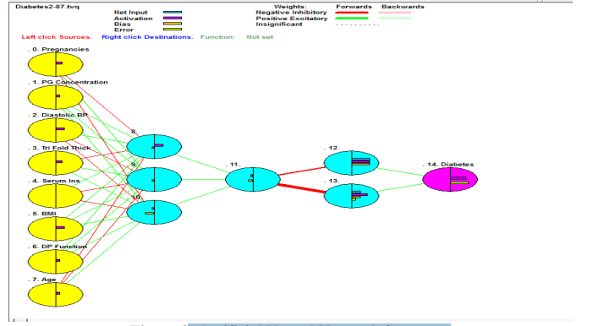
Artificial Neural Network Structure

Slide 12
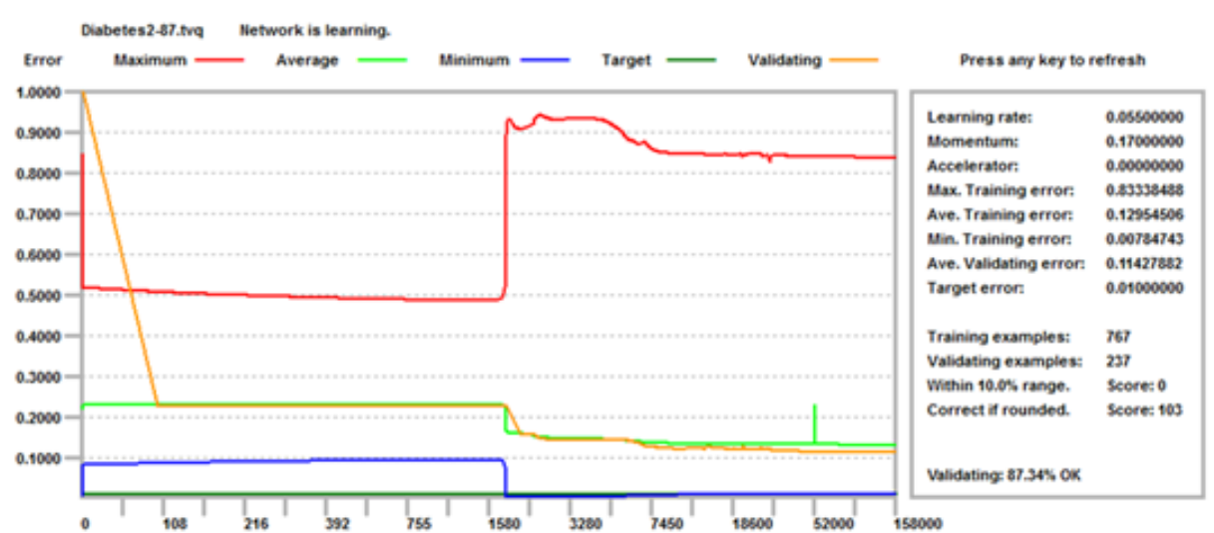
Learning progress

Slide 13
Attributes importance (the most influential factor on diabetes)

Slide 14
IMPLEMENT

Slide 15
IMPORTATION OF library

Slide 16
READING DATA & DISPLAY HEAD

Slide 17
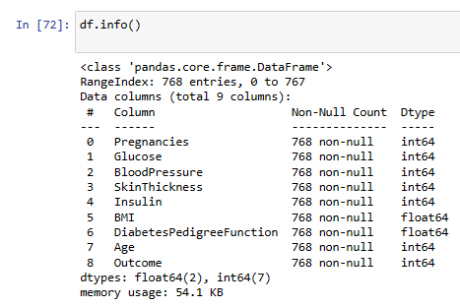
GET DF INFO CHECK MISSING VAL

Slide 18
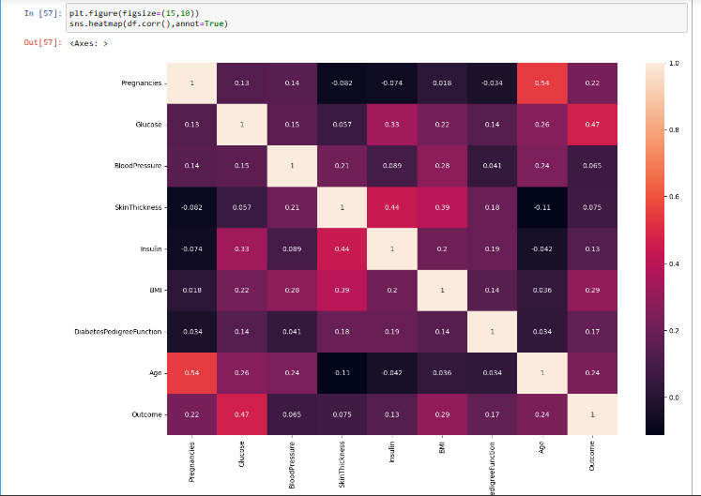
DISPLAY CORRELATION FEATURES

Slide 19
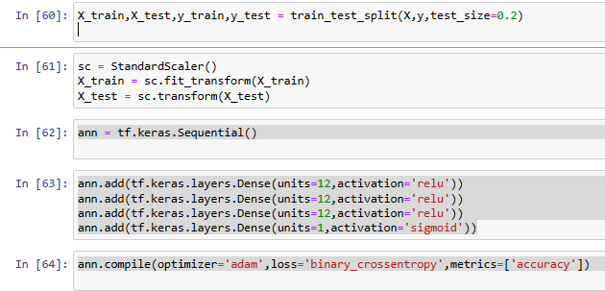
TRAIN & TEST SPLIT

Slide 20
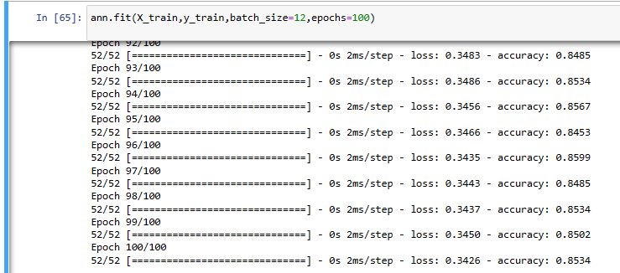
accuracy

Slide 21
Conclusion
The model in the JNN environment proved effective in predicting diabetes, achieving a prediction accuracy of 87.3% and an average error of 0.010.
The results demonstrate the ability of artificial neural networks to recognize complex patterns associated with diabetes.
Improving neural network techniques can enhance the development of medical decision-support tools, contributing to more accurate and effective healthcare.

